Slide 1
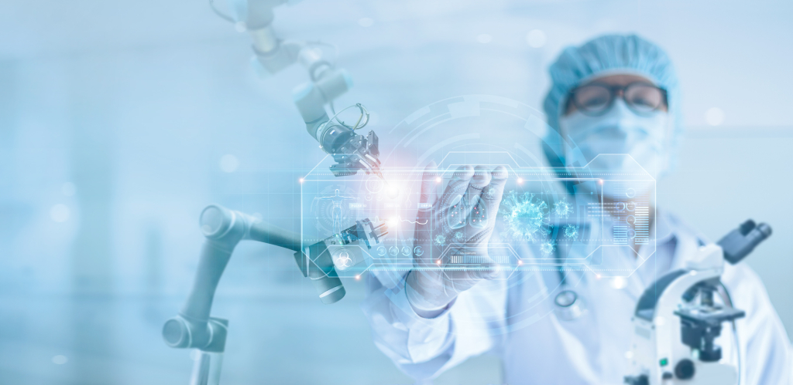
Pandemics
TECH FOR
To be able to explain how technology is used during pandemics and to prevent further spread of diseases. To broaden my knowledge of careers available in this field
Notes:
Hi Everyone, my name is ???? and this Tech We Can lesson is Tech for Pandemics.
So …. our aim today is to show you lots of different and interesting ways technology is being used to help us fight and prevent diseases spreading and treat people when they are poorly with a virus. We will also look at how technology supports people with things such as isolation and social distancing. We want to highlight the people behind this tech and the types of jobs they have. Hopefully you might consider one of these jobs for your future.

Slide 2
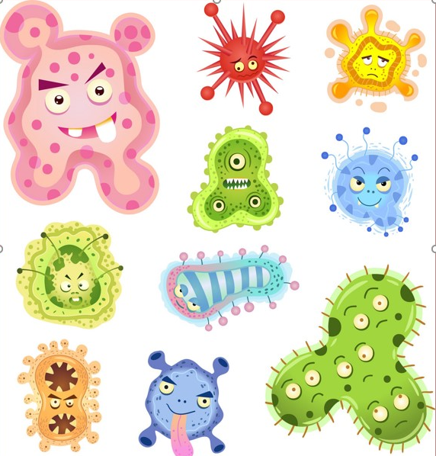

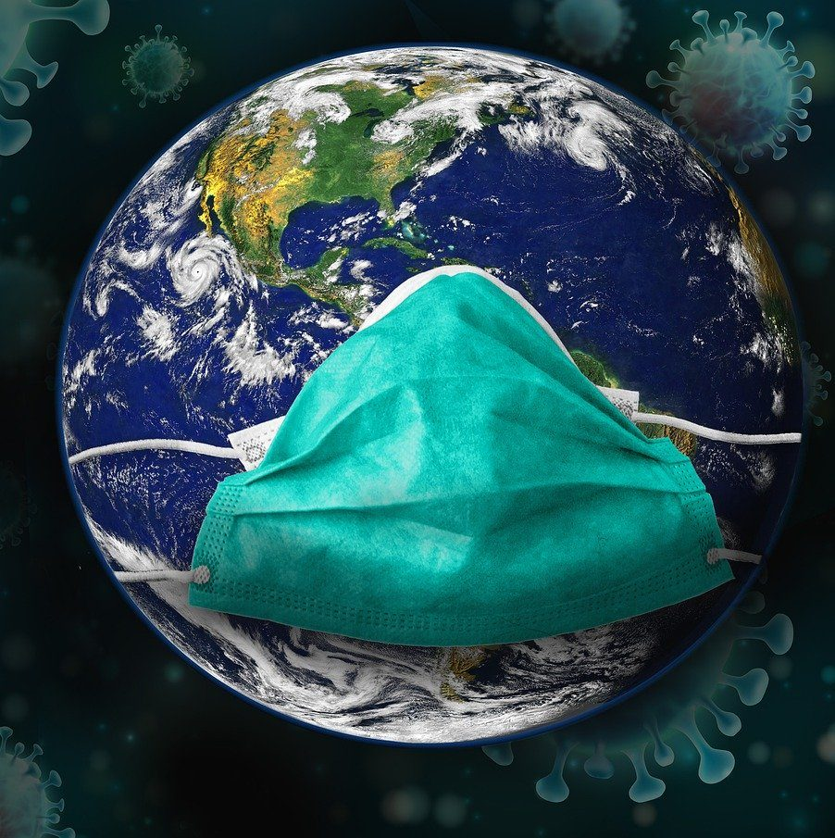
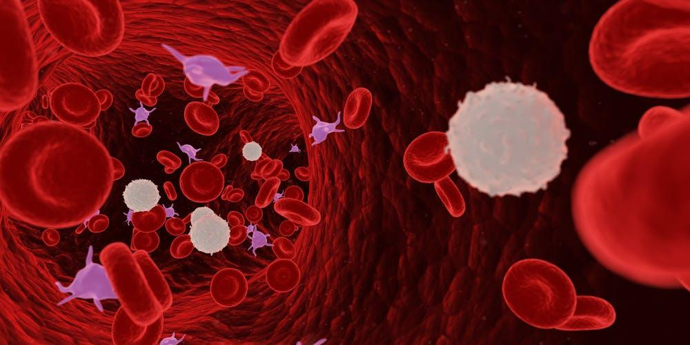
What is a virus? What is a pandemic?
#TechWeCan | Tech for Pandemics
Notes:
Before we start looking into Tech for Pandemics – I just want to briefly talk about the meanings of the words virus and pandemic.
Viruses are tiny particles that can cause disease in people, animals and plants. Viruses can cause things such as the flu, chicken pox or measles.
Our bodies are made up of lots of tiny cells. When a virus enters a cell in a living thing, like our bodies, it can reproduce itself, spread and infect other cells.
Our bodies do naturally fight off viruses. One way we fight off a virus is through a fever. You may have been poorly before and felt very hot – this may have been your body detecting a virus and raising your temperature to try and stop that virus from spreading. Some viruses don’t like the heat so it’s a very clever way of our bodies protecting themselves.
We also have an immune system to help protect us. When our bodies detect a virus they produce special white blood cells and something called antibodies to attack the virus. And what's even cleverer is the fact that once our these cells have fought off a virus, they stay in our bodies ready to detect that virus again and prevent future infections from the same virus. This is why you are unlikely to catch the same virus twice – because your body has already learnt how to fight it.
A pandemic is a global disease outbreak. It is when a disease or virus spreads quickly and easily between people and can cause serious illness. Pandemics have happened many times in the past including the plagues, The Black Death, Spanish Flu and the most recent Coronavirus.
There may be future pandemics but today we are going to discuss how technology is and can help prevent this happening and reduce the effects on our health and daily lives.

Slide 3
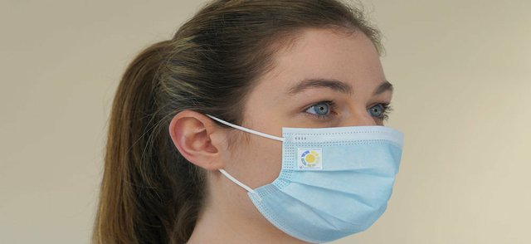
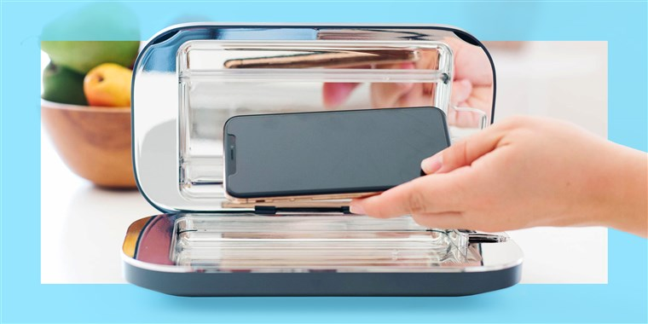

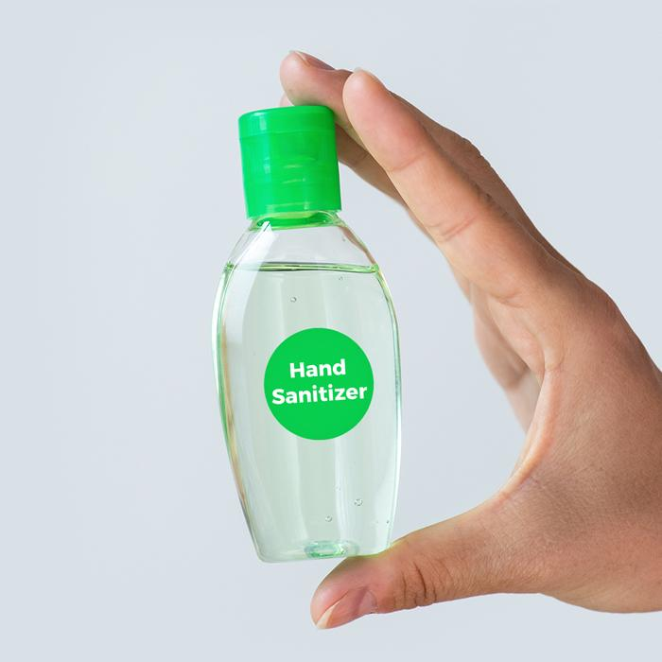
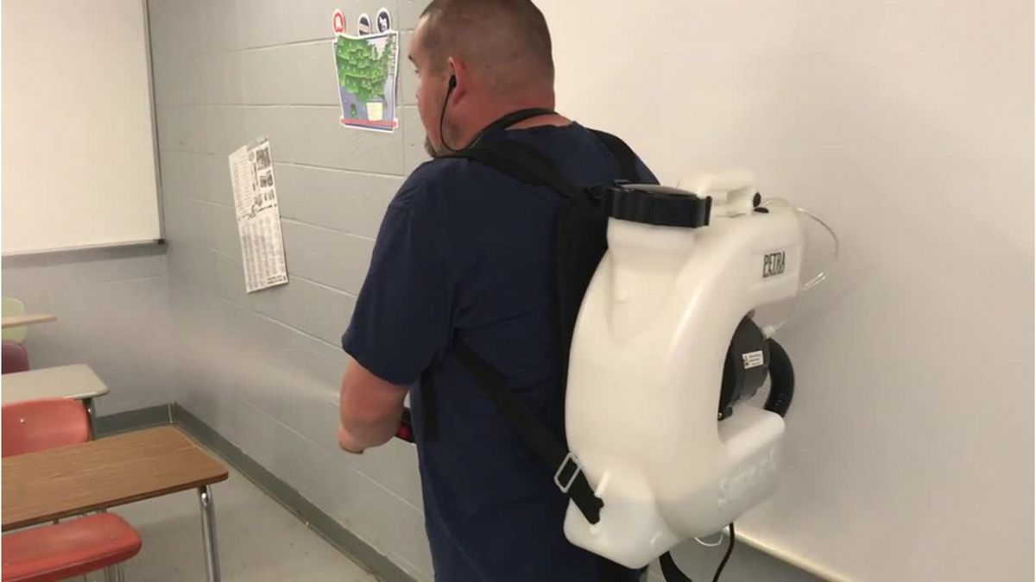
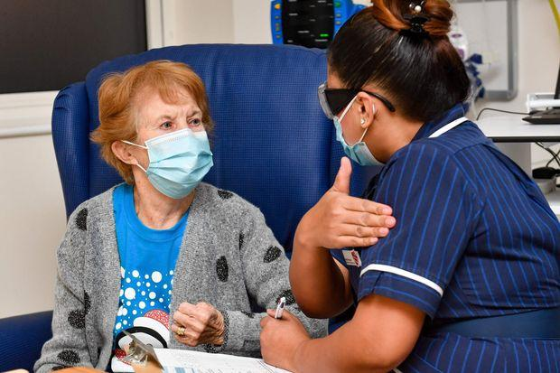
Technology used to help control the spread of viruses
#TechWeCan | Tech for Pandemics
Notes:
We are going to start today by looking into ways technology is used to help control the spread of viruses.
Wearing face masks and face coverings effectively reduce our chances of catching and spreading a virus. An interesting fact about the corona virus pandemic is that more than 50 countries around the world asked people to cover their faces when leaving their homes in 2020.
During the Coronavirus pandemic, many tech companies thought of new and innovative ways they could create face masks to help stop the spread of the virus. For example, the blue mask in the top right has a specially little patch on the side which tells the user when they need to replace their face mask – it is create by a company called Insignia Technologies. The special little smart label changes colour to show when a disposable face mask has been worn for too long and needs to be changed. This is especially useful for doctors and nurses who can work very long shifts in the same masks and protection.
AI has also been used in lots of different ways to help control the spread of coronavirus. The logo in the middle is from a company called BlueDot. They specialise in using human and artificial intelligence to detect the spread of viruses and diseases. AI or artificial intelligence is when we teach computers or machines to think, make decisions and identify things. BlueDot were one of the first companies in the world to identify that coronavirus was a risk and could start to spread outside of China. It’s really quite clever how it works, it constantly scans through media and news all over the world in many different languages, to see what they are reporting and talking about and then detect trends and spot places where viruses might be spreading. If it thinks it’s spotted something, it then alerts a human to have a look into it in more detail.
The picture in the bottom right is of the first lady ever to receive a coronavirus vaccine in the UK (outside of the people involved in the trials). Doctors use vaccines to prevent many diseases caused by viruses. Vaccines are made from of dead or weakened viruses and they help our bodies learn how to fight the virus so if we ever come in contact with the real virus, we are unlikely to become poorly as our bodies will already know what to do and how to fight it.

Slide 4



Meet today’s role models
Dr Cleo Kontoravdi
Reader in Biosystems Engineering
Cleo looks at how we can make drugs for people with cancer and vaccines cheaper and faster. Since the Covid 19 pandemic started, Cleo and her colleagues have been working non-stop to find ways we can make Covid vaccines faster and get them to everyone in the world so that we can protect them from the virus.
Dr Maria Papathanasiou
Lecturer in Life Science and Process Systems Engineering
Maria teaches ways of combining mathematics with other sciences such as biology and chemistry to better understand the human body. She also uses the power of mathematics to research how diseases appear and spread and also how drugs are made. Maria also use mathematics as a tool to find the fastest, safest and cheapest routes through which we can transport vaccines and drugs to as many people as possible.
#TechWeCan | Tech for Pandemics
Notes:
We are now going to meet our role models for today. Katie spoke to Cleo and Maria. They both work for the Imperial College in London. Both Cleo and Maria have been very busy using their skills and expertise to help during the Coronavirus pandemic. Katie asked them all about their jobs – let’s have a listen to what they had to say ..
CLEO PLAY VIDEO from 10:35 – 15:25 (image hyperlinked)
MARIA PLAY VIDEO from 15:25 – 20:30 (image hyperlinked)
I found it really interesting when Cleo said ……
And also when Maria said …….

Slide 5
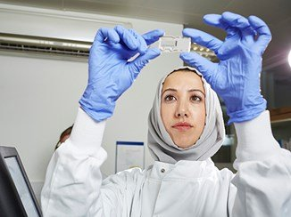
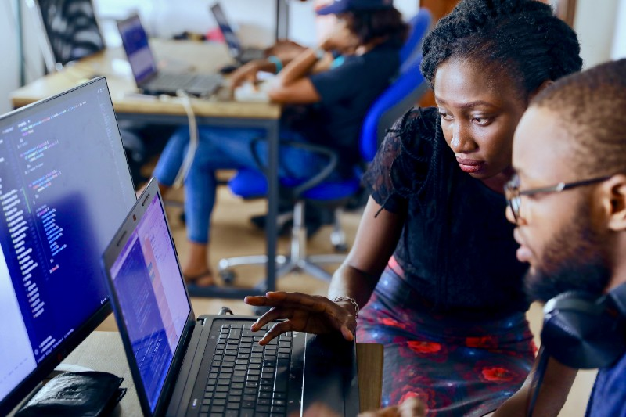
Careers in tech to help control the spread of viruses
Research Scientist
Machine Learning Engineer
???????????????
As a research scientist, you could work in laboratories researching, developing and creating the vaccines of the future. You could help protect people from future viruses and help cure and manage diseases. If you like science and helping others, then this could be the future job for you.
As a machine learning engineer, you could use your mathematical and computing skills to help programme computers to access data and be able to learn and improve for themselves.
#TechWeCan | Tech for Pandemics
Notes:
So if you would like a future job helping to control the spread of viruses then one of these careers could be just right for you.
You could be a research scientist. As a research scientist, you could work in laboratories researching, developing and creating the vaccines of the future. You could help protect people from future viruses and help cure and manage diseases. If you like science and helping others, then this could be the future job for you.
You could also be a machine learning engineer. As a machine learning engineer, you could use your mathematical and computing skills to help programme computers to access data and be able to learn and improve for themselves – without a human telling them what to do.

Slide 6
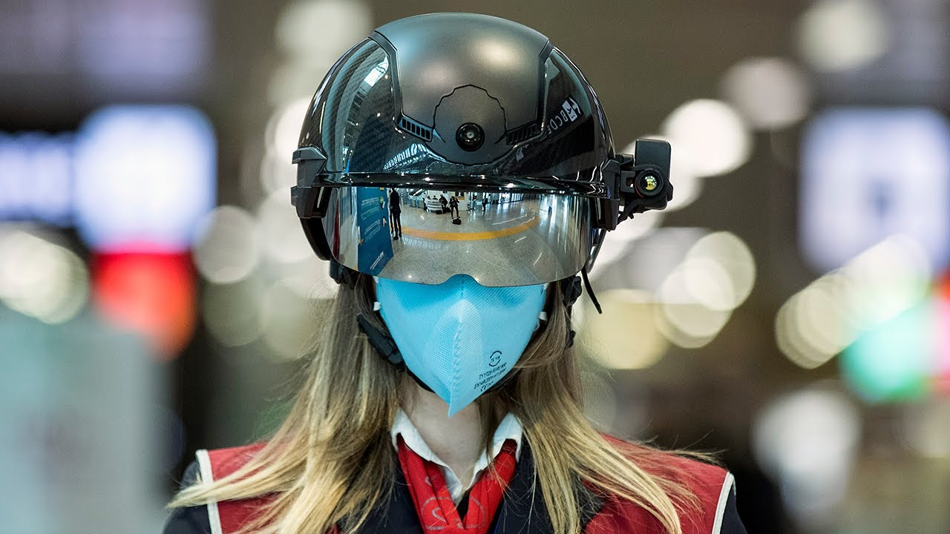
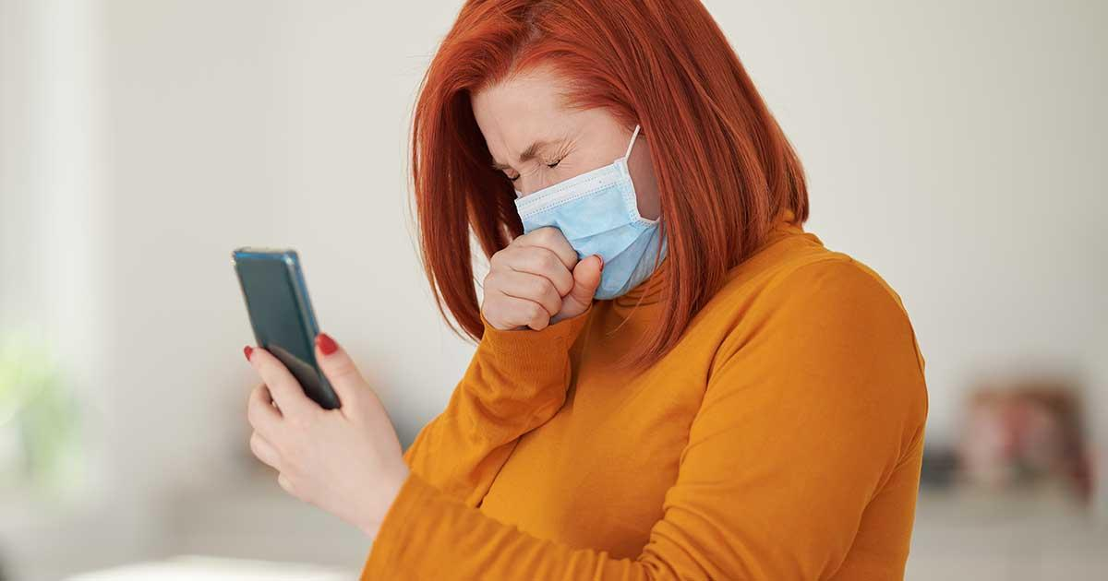
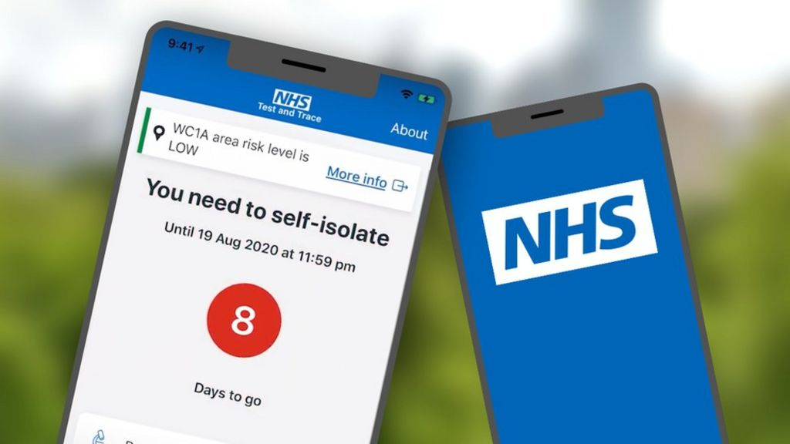
Technology used to detect and monitor the spread of a virus
#TechWeCan | Tech for Pandemics
Notes:
As I mentioned earlier, one of the main symptoms of coronavirus and most viruses is a high temperature. You will may have a digital thermometer at home that your parents and carers put to your head to check if you have a temperature. The picture in the top left is a lady in a special smart helmet at an airport in Rome. She can use the helmet to look around and scan the temperatures of all of the passengers around her. She can therefor identify anyone with a temperature who could potentially spread the virus to the other passengers.
The picture in the top right is of a person coughing near her phone. Researchers in the US have been working on developing an app which could use artificial intelligence to listen to your cough and predict if you have corona virus or not. When you go to the doctors, they already listed to your cough to see if you have certain viruses or illnesses. What these researchers have done is record thousands of clips of people coughing with and without Coronavirus. They have then programmed the computers to recognise if you sound like you have coronavirus cough or not. They currently have a 98.5% success rate of accurately detecting people who have then had a positive coronavirus test. Hopefully this will continue to be tested and made into an approved app soon. Future viruses could have different symptoms so perhaps there could be a way of using AI to detect these too. Maybe AI could recognised certain rashes, or types of spots or any other symptoms.
You may have also heard of the track and trace app which the NHS released in 2020 to help reduce the spread of coronavirus. Many people thought that the app tracked your location but this is not how it worked. Instead the app records your distance from other phones which also have the app installed. You could also choose to ‘check in’ at a venue. People can then add in symptoms and test results to their app and your app then alerted you if you were at risk of having caught corona virus and needed to self isolate. Lots of different features in one app all helping to help control the spread.

Slide 7

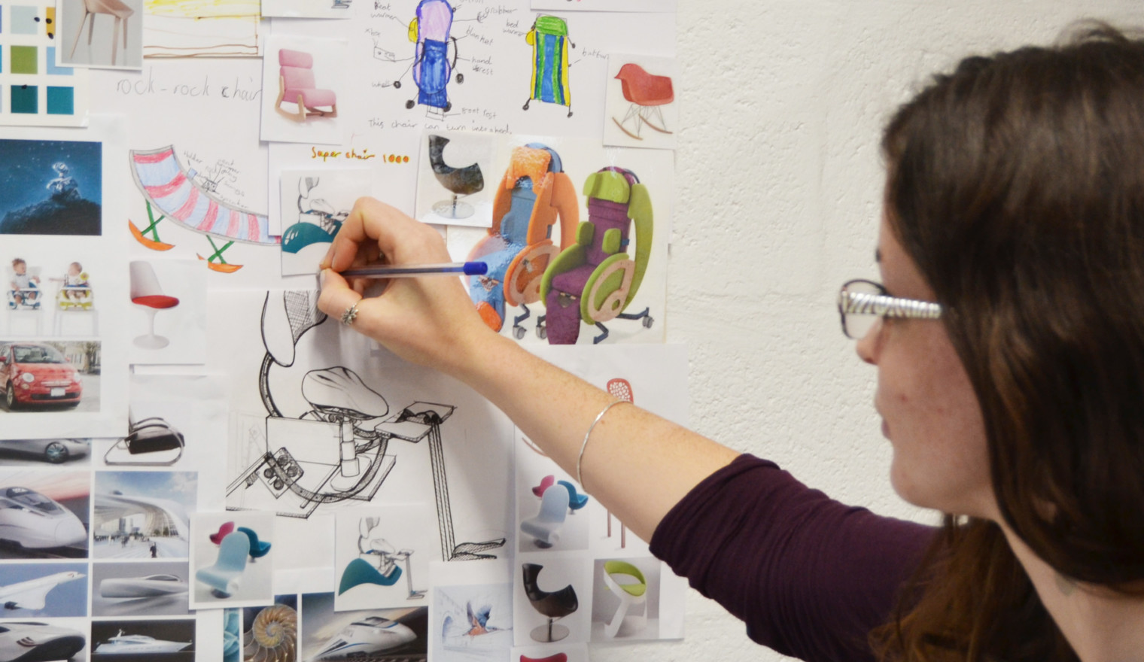
Careers in tech to detect and monitor the spread of a virus
App Designer
Product Designer
As an app designer, you could design the medical apps of the future. Perhaps you could design a way of detecting and monitoring a virus so it doesn’t spread to become a pandemic.
As a product designer, you could design and create new products or improve existing ones. This could be the techy gadgets of the future which help detect and monitor viruses.
#TechWeCan | Tech for Pandemics
Notes:
If you like the sound of a future job helping to detect and prevent the spread of virus then these could be 2 future jobs for you.
You could be an app designer. As an app designer, you could design the medical apps of the future. Perhaps you could design a way of detecting and monitoring a virus so it doesn’t spread to become a pandemic.
If you would like a future career designing and developing technology and gadgets to detect and monitor viruses, you could be a product designer. Product designers design and create new products or improve existing ones. You may have already looked at one of the pieces of tech we have covered today and thought, ‘That’s cool but it would be great if it could also do this’. If you think like that, then perhaps you are a product designer of the future.

Slide 8
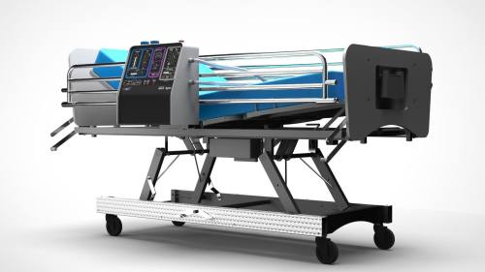
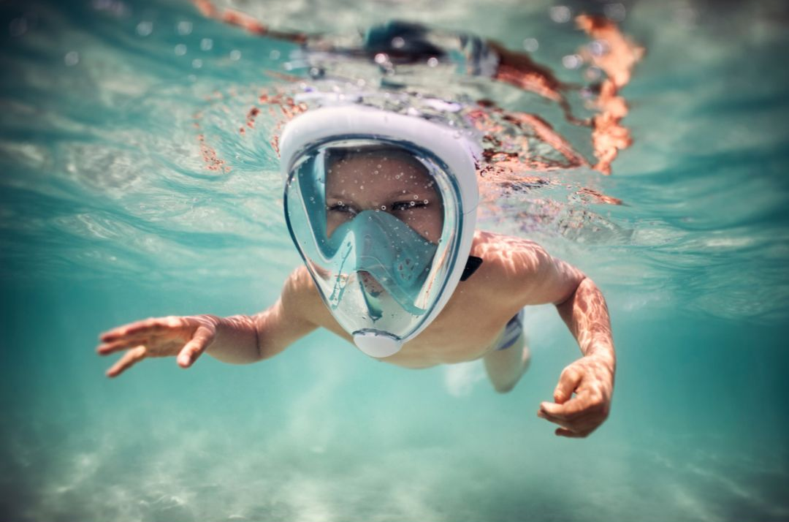
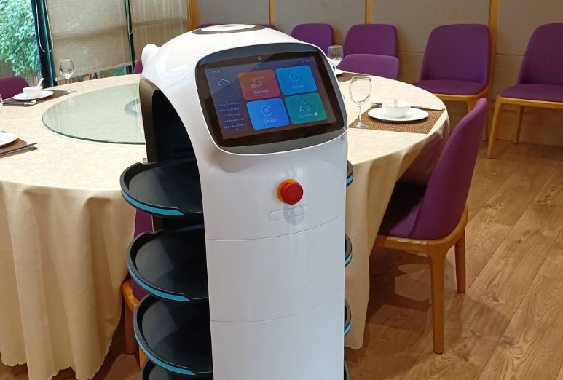
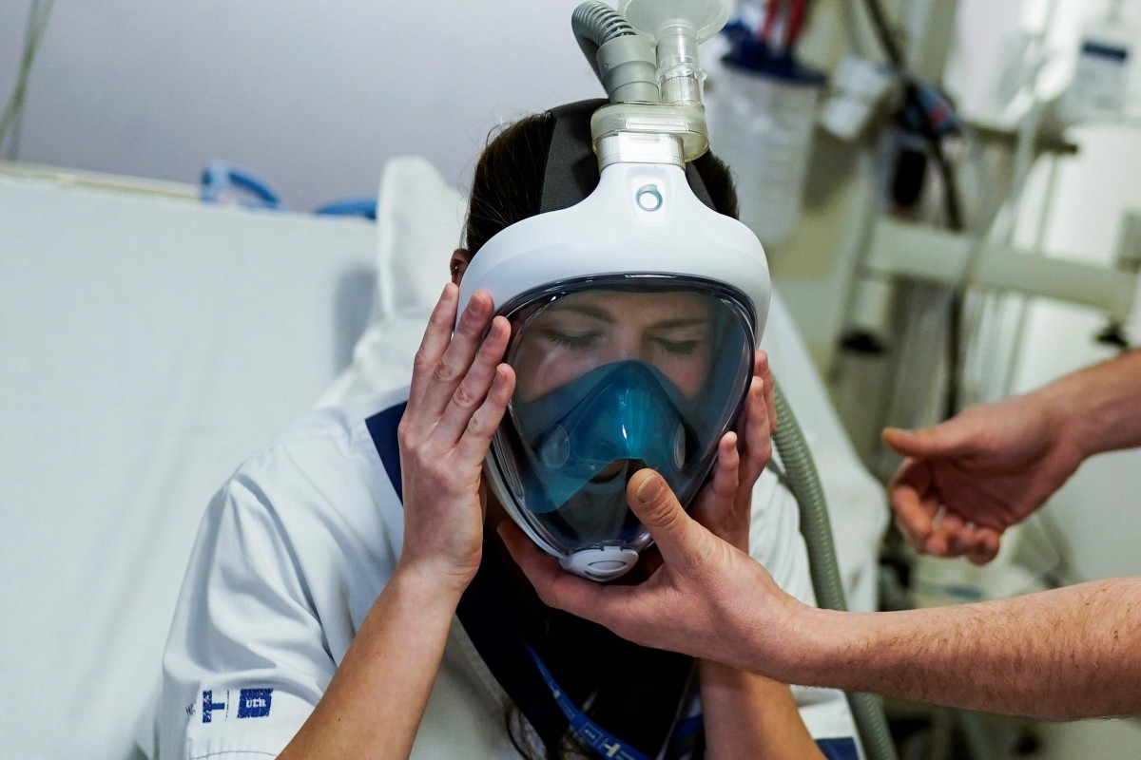
Technology used to treat people who become poorly with a virus
#TechWeCan | Tech for Pandemics
Notes:
During the coronavirus pandemic, many seriously ill people needed to be put on ventilators. These are machines which help a person to take air in and out of their lungs when they can’t or are struggling to breath themselves. In many countries around the world, they did not have enough ventilators or medical equipment to help treat the increasing number of poorly people who were arriving in hospitals with Covid19. Lots of companies, inventors, designers and manufacturers then stepped in to try and support by thinking of ways they could help make medical equipment. For example companies like Tesla who usually make cars and Dyson who usually make hovers, adapted their factories to create ventilators to help treat people who were really poorly with coronavirus. Although some of these ventilators were not used, it’s such a great thing to see that these companies easily adapted their technology and manufacturing to try and help – also their research and the things they discovered whilst making them could really help designers and developers of health care equipment in the future.
The picture in the top right is actually a snorkelling masks which you can buy at lots of sporting shops to go swimming with and look at all the fish. Engineers at an Italian 3D printing company called Isinnova actually had a inventive idea to 3D print special valves to go into these masks to turn them into oxygen masks to help people breath – you can see a nurse testing one in the bottom right picture.
The robot in the bottom left picture is a robot that is used in restaurants to order and deliver food. Cleverly, this technology has been used and adapted to make robot nurses. I’m going to tell you about Tommy, a robot nurse which is used in a hospital in Italy. Tommy’s face is a touch screen so patients can use Tommy to send or record messages to the doctors. The great thing is, Tommy protects nurses and doctors from constantly going in and out of a room to help a patient with Covid 19. Tommy isn’t used on seriously ill patients, he is used to help monitor patients in a stable condition whilst doctors and nurses help those who are more seriously ill. Tommy monitors all of the medical machines connected to the patients which are doing things like taking their pulse and temperature. If the patient shows any sign of needed immediate help then the nurses and doctors are sent an alert.

Slide 9
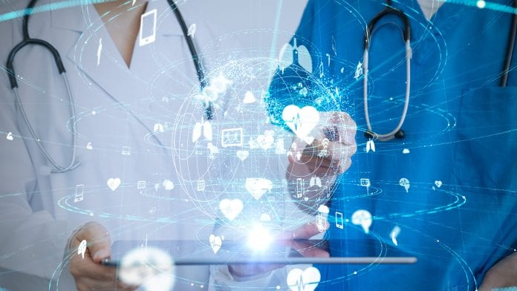
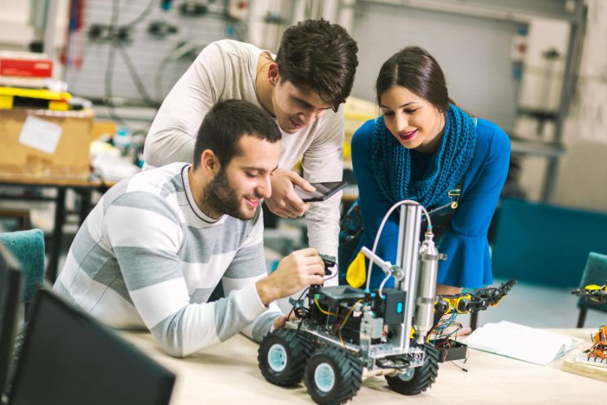
Careers in tech to help treat people who become poorly with a virus
Mechanical or Electronic Engineer
Robotics Engineer
As a mechanical or electronic engineer, you could work in many different areas. One of these areas could include designing the medical machines and products of the future to help save lives. If you like solving problems, making and building things and helping others, then this could be the future job for you.
As a robotics engineer, you could design, build, programme and test the robots of the future. These could be robots to help improve healthcare and support doctors and nurses to work more safely with infectious diseases and viruses.
#TechWeCan | Tech for Pandemics
Notes:
If you like the sound of a future job helping to treat people when they are poorly with a virus then these could be 2 future jobs for you.
You could be a mechanical or electronic engineer. As a mechanical or electronic engineer, you could work in many different areas. One of these areas could include designing the medical machines and products of the future to help save lives. If you like solving problems, making and building things and helping others, then this could be the future job for you.
You could also be a robotics engineer. As a robotics engineer, you could design, build, programme and test the robots of the future. These could be robots to help improve healthcare and support doctors and nurses to work more safely with infectious diseases and viruses.

Slide 10
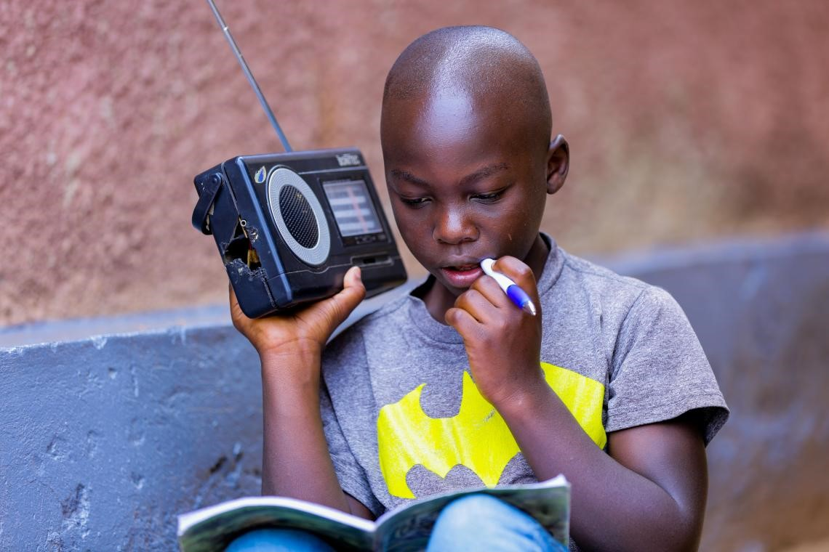
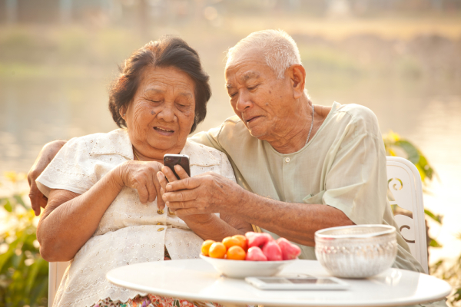
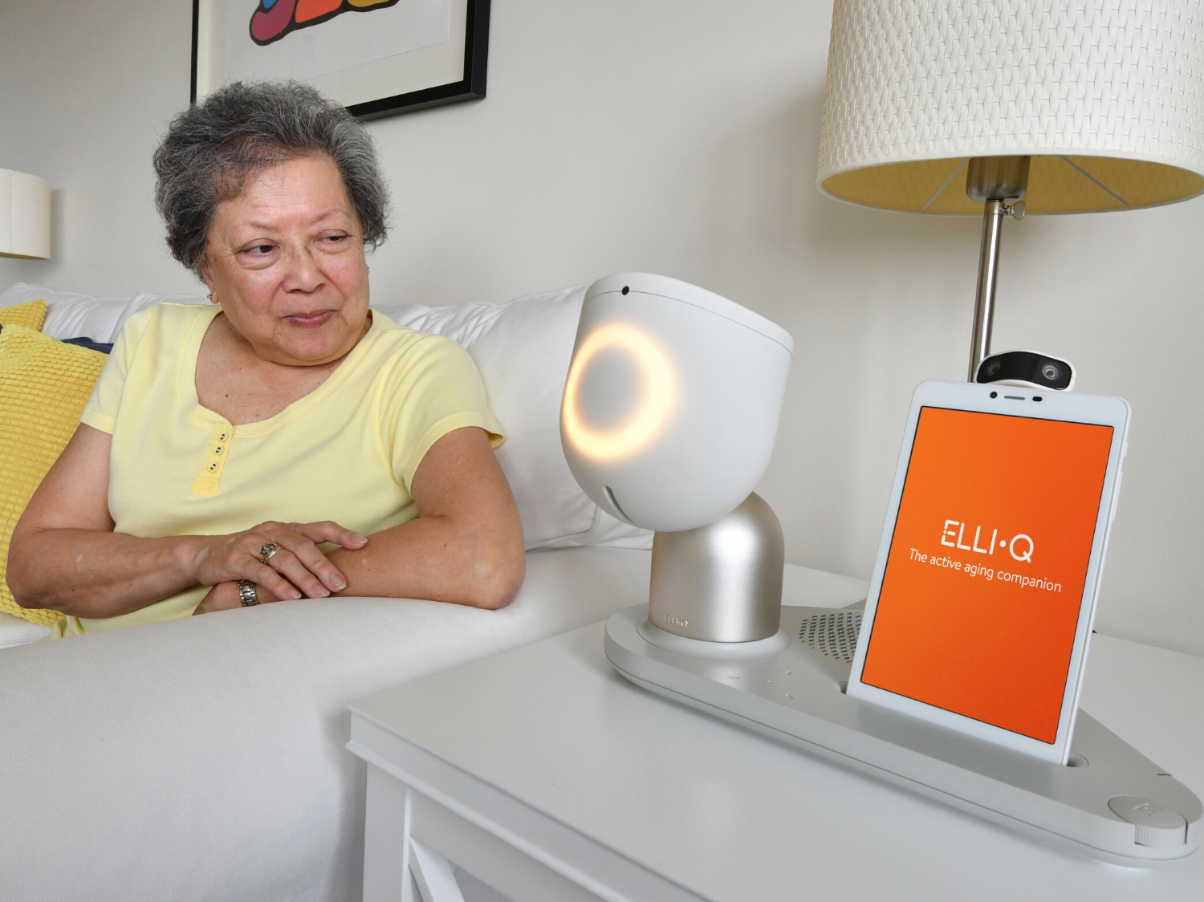
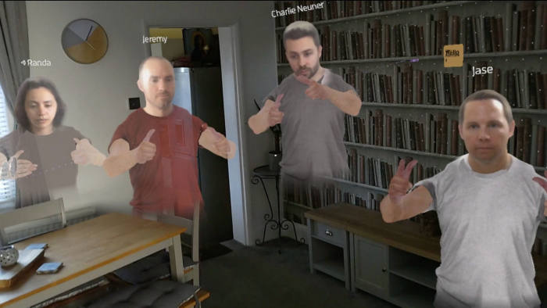
Technology used to help people to continue learning, working and communicating safely during a pandemic
#TechWeCan | Tech for Pandemics
Notes:
One way to help control the spread of viruses is through a lockdown. If we stop people moving around and meeting each other then we also stop the virus being able to move around and spread.
Lockdowns do create a number of challenges. One of these challenges is the fact that schools need to close but children need to continue learning. During the Coronavirus Pandemic, technology was key to ensuring teachers and children could still communicate. In 2020 more than 90% of the countries in the world had some sort of online or remote learning. This meant that 1.5 billion children used technology talk to their teachers and attend lesson or submit their work (so you were definitely not alone if this also included you). Unfortunately though, the access to technology around the world and even in the UK is still not readily available to everyone. Also during 2020, at least a third of the world's children didn’t have access to technology and were unable to complete their remote learning. The young boy in the top left picture is using a radio to listen to his teacher and complete his school work – his teacher realised that many of the students wouldn’t have computers or internet but many could find access to a radio.
Another challenge to lockdowns is managing our mental health. It can be a very lonely time and it's hard for us all to be separated from family and friends. Thankfully many of us have used online platforms such as Zoom and Facetime to communicate with our friends and family. There are also lots of other tech companies working on solutions to help combat loneliness not just during lockdowns but in everyday life also. In this next short clip we are going to hear about a companion robot called Elli Q. Let’s have a listen to find out how Elli Q works.
AI for the Aging – Introducing Elli-Q by fuseproject - YouTube (play clip from YouTube)
Doesn’t Elli Q sound brilliant, actually trying to combat loneliness using technology by doing thing like playing games with people. I find this tech really exciting and it makes me wonder what future robots like this will look like. Will they look like real people for example. Will people like this or will this be too scary? Who knows what the future of this technology holds? Interesting though!
And finally lockdown has also been a challenge for many businesses – no longer being able to meet in person and collaborate with you teams has provided challenges for many companies. In the image on the bottom right, employees from a company called PwC are using their Virtual Reality Headsets to view their colleagues as avatars in the same room as them. Making it feel like they are all together when actually they are miles apart in their own homes. Again I think this tech is very exciting to watch in the future. I wonder if we will be having holographic meetings and people will just pop up on our desk – Star Wars style.

Slide 11
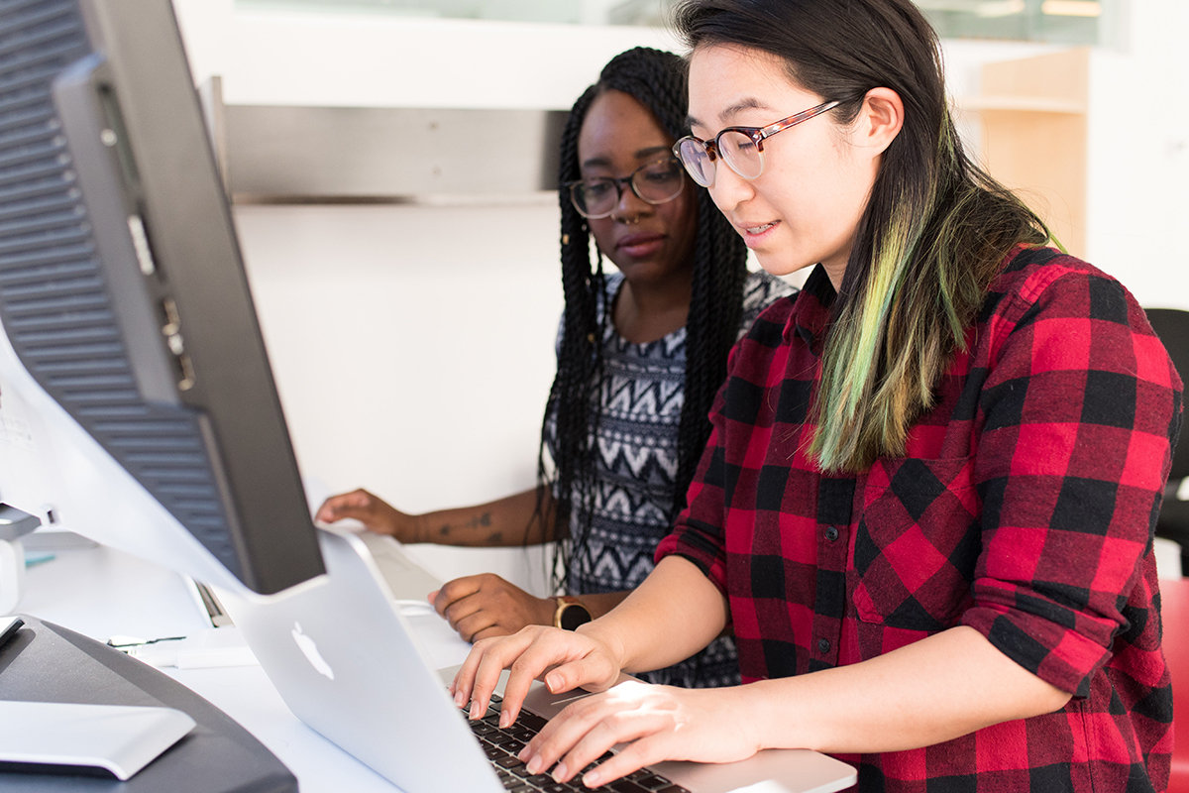
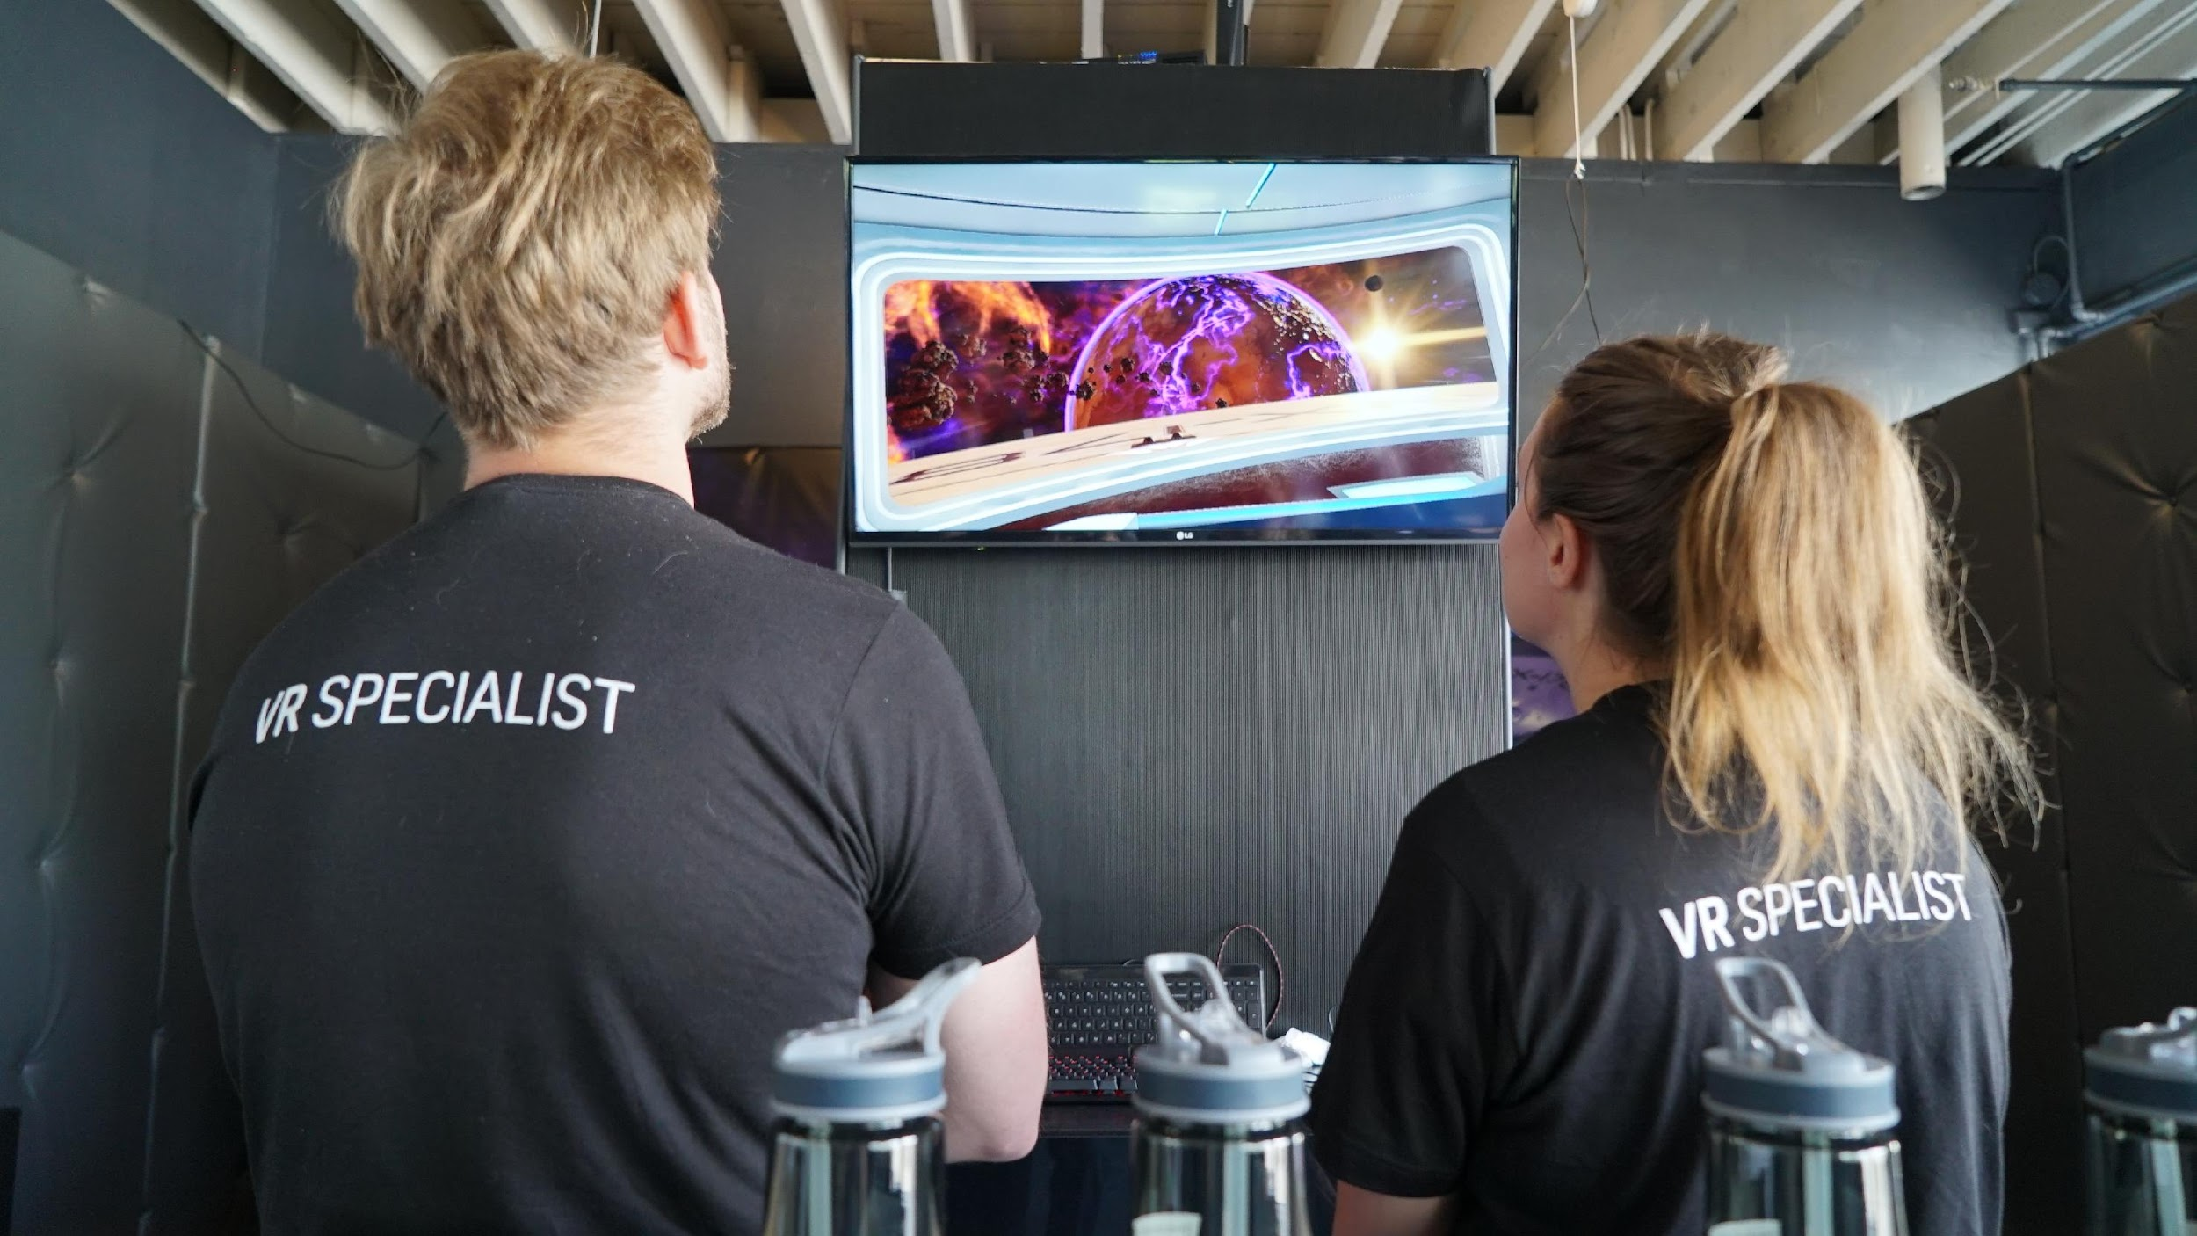
Careers in to help people to continue learning, working and communicating safely during a pandemic
Software Developer
VR/AR Specialist
As a software developer, you could work in many different areas. You could help develop the learning software of the future to help make online and remote learning even more useful and engaging. Software developers analyse what the users need (in this case teachers and students) and then they design and create a computer programme to help them do this. Could you think of a way of using technology to make learning more accessible to everyone
As an AR or VR specialist, you could become an expert in how companies can use AR and VR to do things such as communicate, train their staff, organise fun events and create new working environments.
#TechWeCan | Tech for Pandemics
Notes:
If helping people communicate, learn and work through technology sounds interesting to you then you could be a Software Developer. As a software developer, you could work in many different areas. You could help develop the learning software of the future to help make online and remote learning even more useful and engaging. Software developers analyse what the users need (in this case teachers and students) and then they design and create a computer programme to help them do this. Could you think of a way of using technology to make learning more accessible to everyone
You could also be an AR or VR specialist. Remember they stand for virtual reality and augmented reality. If this kind of tech interests you, you could become an expert in how companies can use AR and VR to do things such as communicate, train their staff, organise fun events and create new working environments.
I hope some of the technology and jobs we have spoken about today sound interesting to you. I’m sure this area of technology will continue to grow and advance so we try and avoid a virus having such an effect on all of our lives in the future.

Slide 12
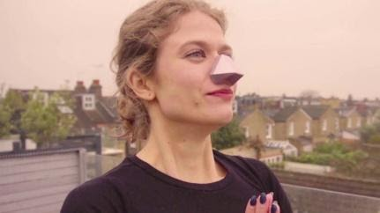
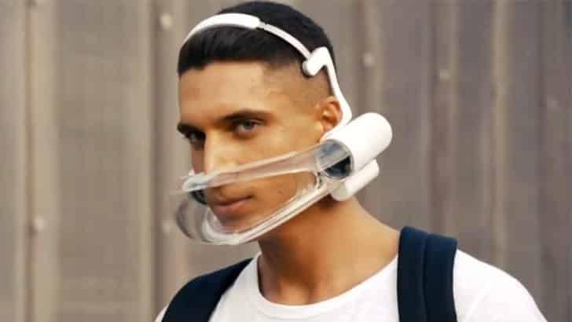
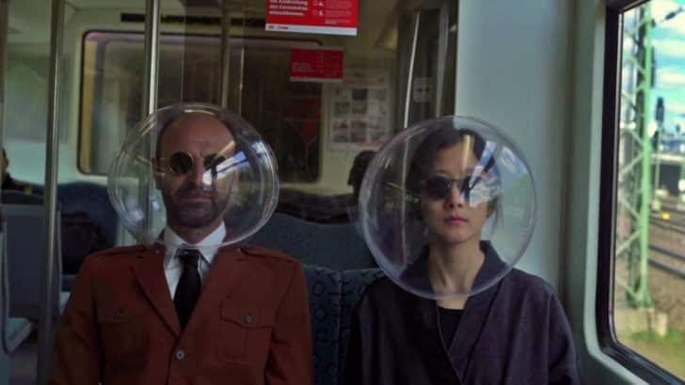
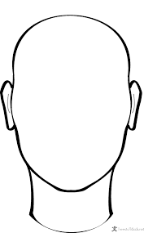

Your challenge: Design a brand-new face mask to help control the spread of future viruses. Rather than just material, we would like your masks to include a form of technology. Label your mask to explain how the tech works.
Think carefully about:
- How the tech in your mask is used to keep the wearer safe? Have a look at this example which uses heat to kill the virus: https://www.designboom.com/technology/mit-mask-heat-kills-virus-10-25-2020/
- How you can make sure people will like the design of your mask and it won’t look too scary? Have a look at this example of a mask with sunglasses built in and a clear face shield: https://www.designboom.com/design/joe-doucet-fashionable-face-shield-integrated-sunglasses-launches-for-sale-10-02-2020/
- How could you add extra tech in your mask, maybe for entertainment purposes or navigation? Could your mask be multi purpose?
- How your design would make people want to wear your mask over others? Have a look at this example of a biodegradable face mask: https://www.designboom.com/design/geochanvre-mask-biocompostable-hemp-fibers-08-20-20/
Please ask your parents to share your work on social media using #TechWeCan or email us at info@techshecan.org
Tech We Can | Tech for Pandemics
Notes:
Time for your Tech for Pandemics Challenge. We would like you to design a brand-new face mask to help control the spread of future viruses. Rather than just material, we would like your masks to include a form of technology. We would like you to label your mask to explain how the tech works and how it protects the user. There are some points on the slide for you to think carefully about and some links to help give you ideas. The points include … (read some out from slide and look through the links if presenting to a class).
Please draw and label your design either on paper or on a computer programme and label your design to explain all of the techy features it has and how it keeps the user safe. You could do a front and side profile to show exactly what your mask looks like from different angles.
We absolutely love to see your Tech We Can challenges and if you would like us to give you feedback on your work then please email it to us or ask your parents/teachers to share it on social media using the #TechWeCan.
I can't wait to see what you come up with. You never know, you could see your design created in future – protecting people all over the world.

Slide 13


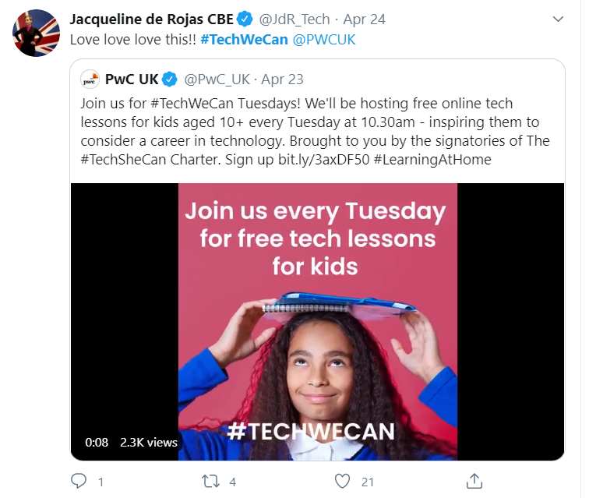
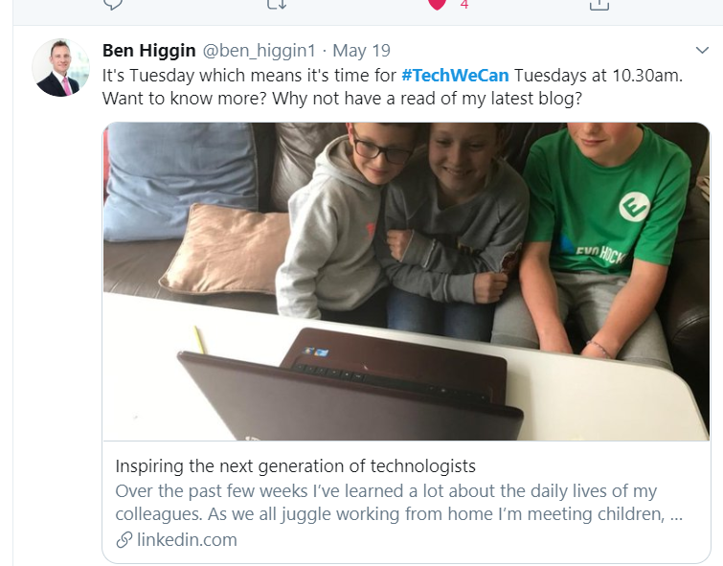
“Our Tech We Can lesson plans are part of our commitment to upskill the communities we’re part of - without urgent attention, many risk getting left behind as technology changes how we live and work. The current crisis we face has provided a stark reminder of the critical value of skills in science and technology.”
Sheridan Ash, Co-CEO Tech She Can
For more information about Tech She Can and free access to all of the Tech We Can resources we have spoke about today, please visit: https://www.techshecan.org/
Follow the hashtags #TechSheCan and #TechWeCan to stay up to date with us on social media.

