Slide 1
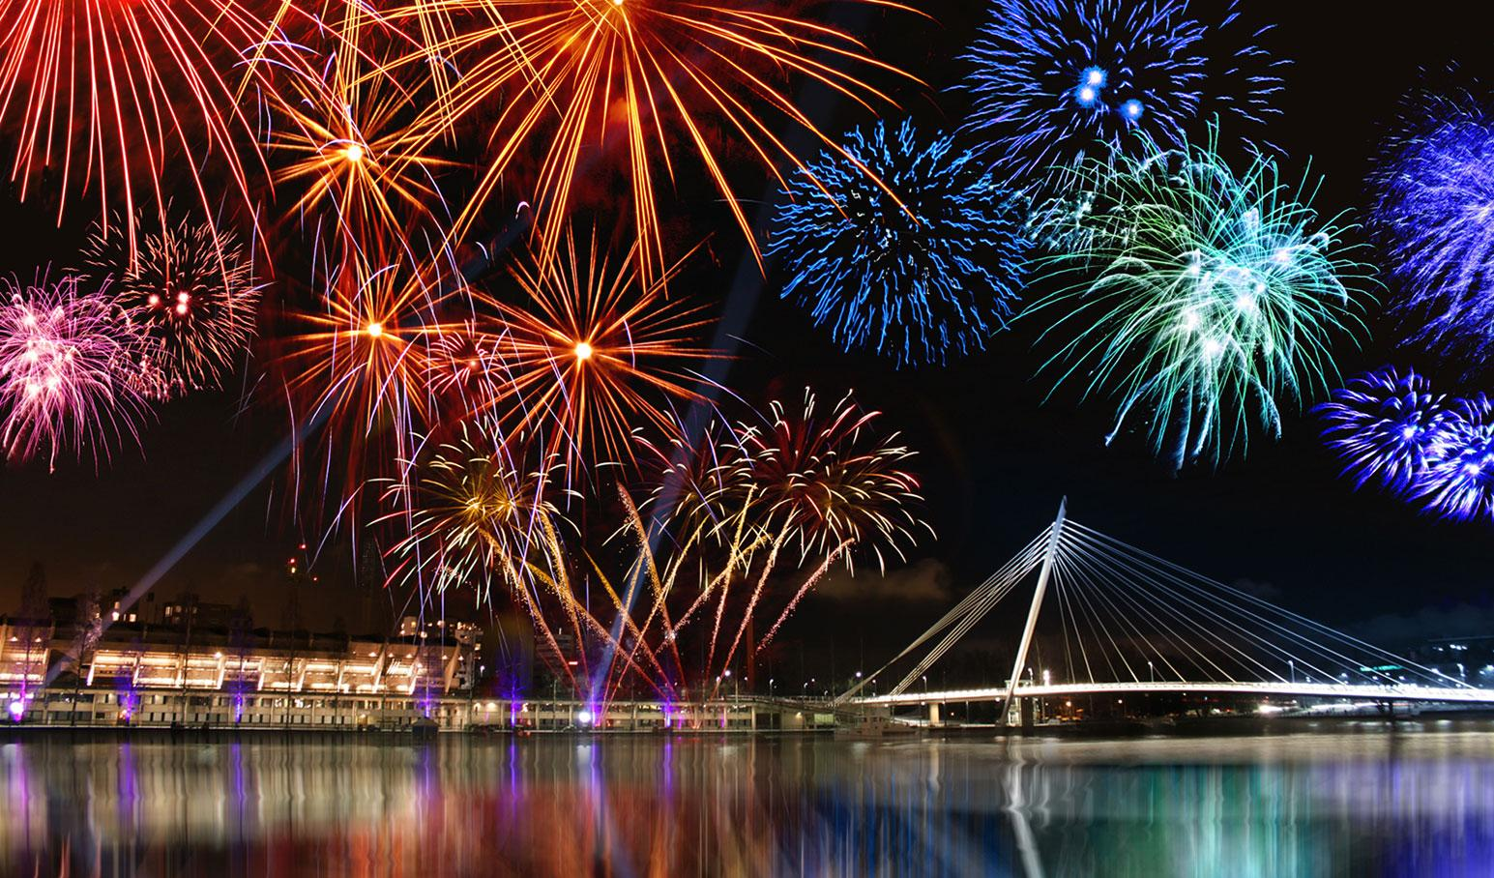
Celebrations
TECH FOR
To understand how technology is used in celebrations and broaden my knowledge of careers available in this field
Notes:
Hi Everyone, my name is ?????? and this Tech We Can lesson is Tech for Celebrations.
So …. our aim today is to show you lots of different and interesting ways technology is being used to celebrate all around the world and in many different countries, cultures and religions. We want to highlight the people behind this tech and the types of jobs they have. Hopefully you might consider one of these jobs for your future.
Today we are going to focus on Tech for Celebrations but we have lots of other Tech We Can lessons available for you to choose from. We want to show you how your interests and passions could lead you into a career in tech.

Slide 2
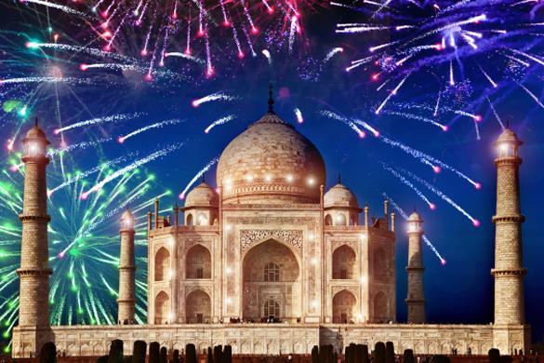
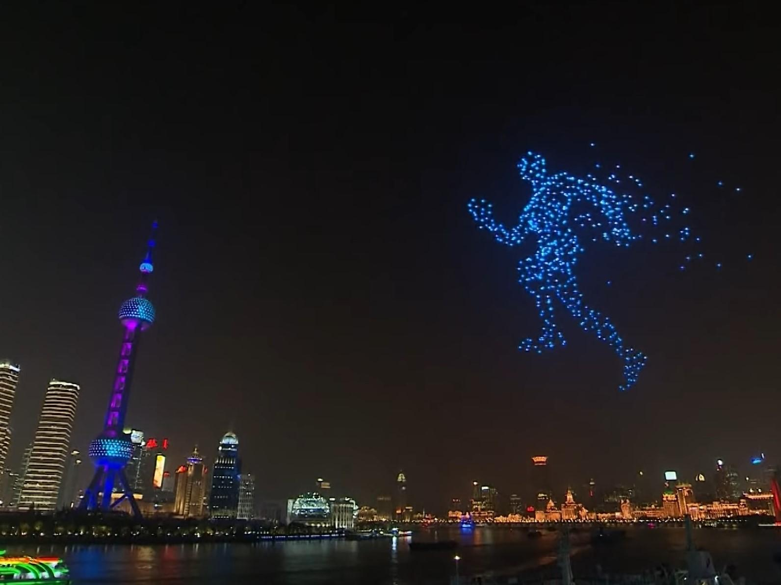
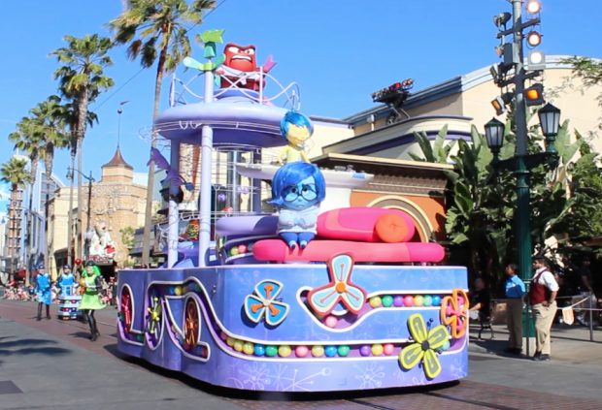
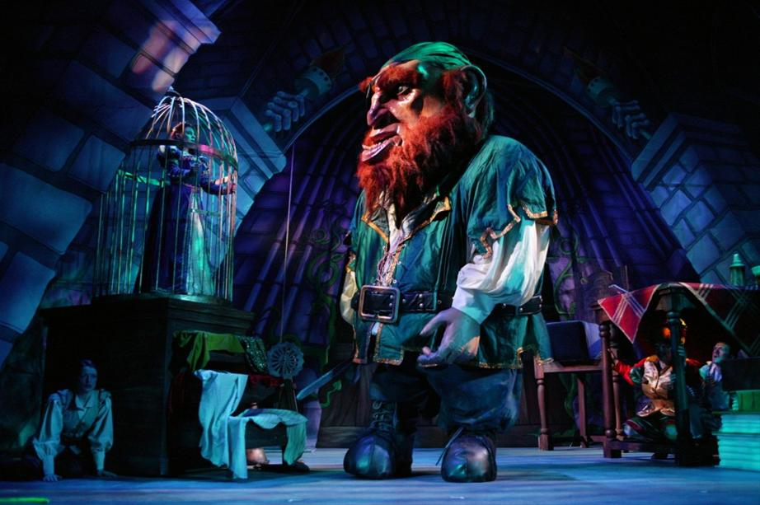
Technology used in displays, carnivals and performances
#TechWeCan | Tech for Celebrations
Notes:
We are going to start today by having a look at how technology is used in celebratory displays, carnivals and performances.
The picture in the top left is of a firework display over the Taj Mahal to celebrate the festival of Diwali. Fireworks were first created in 6th century and they have come a long way since then. They might just look like beautiful colours in the sky but there is actually a lot of technology behind firework displays. They are a combination of chemistry, physics, electronics, and even computer simulations. For the large displays like in the picture, there are a whole team of engineers and technicians working behind the scenes to make it all possible. For really large displays, the fireworks are actually choreographed (sort of like a dance) and the technicians use computer software to time the release of each firework perfectly. Next time you watch a firework display, think about all of the engineers and technicians who make it such a cool thing to watch.
The top right picture was in China to celebrate New Years 2020. Rather than use fireworks, they flew nearly 2000 drones together to make patterns and art in the sky. One of my favourite parts was when they made the drones work together to look like a running man (as you can see in the picture). Rather than individual pilots flying each drone, they used computer programmes to control them. Let’s have a look:
Play Clip https://www.youtube.com/watch?v=Zh3-Mvrp1Lc
I can’t wait to see what they do this year and years to come – keep a lookout!
The picture in the bottom left is of a float use in a parade at Disney world. Floats are large moving platforms which can be driven or controlled to move along a street (often people will stand on them and dance on them). The technology used on floats is really advancing. The example in the picture is of a float from the movie Inside Out and each one of those characters actually moves and speaks. They have been programmed by an animatronics engineer to look as if they are actually alive. The tech behind Disney magic is amazing!
And the last picture on this slide is of a giant made by a company called Imagine Theatre. They specialise in creating special effects for pantomimes and theatre productions. Traditionally at Christmas people will go to see a pantomime to celebrate the holiday period. Just like on the float, effects like this in the theatre involve lots of hidden technology to make the characters look alive and create that theatre magic.

Slide 3
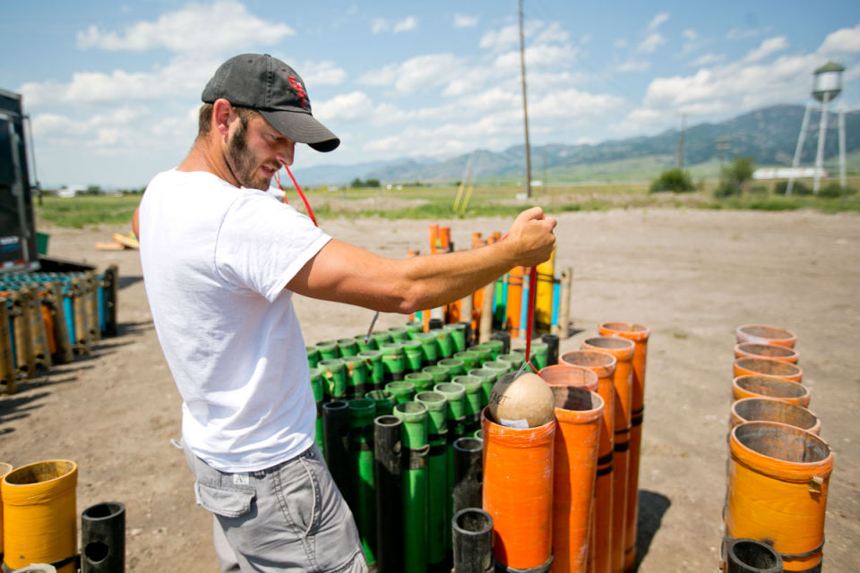
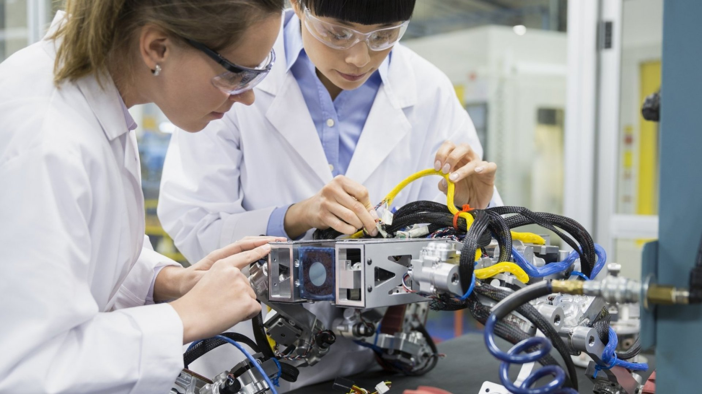
Careers in tech used for displays, carnivals and performances
Pyrotechnician
Animatronics Engineer
As a pyrotechnician, you could be responsible for planning, designing and choreographing firework displays. You would need a good knowledge of how the chemicals all work together and how you could make a show great to watch but also safe for the audience.
As an animatronics engineer, you could create robotic devices which are designed to act and look just like a real life animal, person or imaginary character.
#TechWeCan | Tech for Celebrations
Notes:
So here are a couple of jobs you could have if designing and using technology for carnivals and performances interests you.
You could be a pyrotechnician. As a pyrotechnician, you could be responsible for planning, designing and choreographing firework displays. You would need a good knowledge of how the chemicals all work together and how you could make a show great to watch but also safe for the audience.
You could also be an animatronics engineer. As an animatronics engineer, you could create robotic devices which are designed to act and look just like a real life animal, person or imaginary character. These could be used in places like theme parks or in celebratory parades and carnivals.

Slide 4
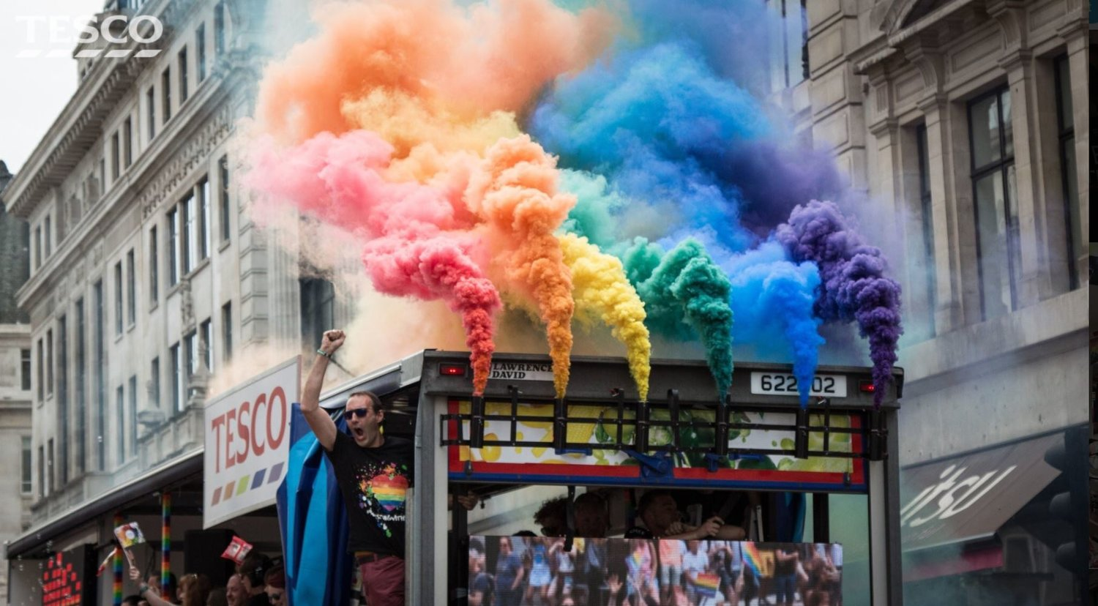
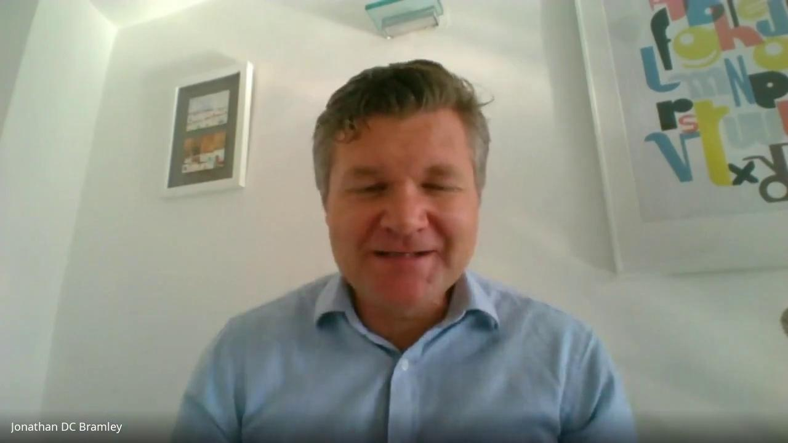

Meet today’s first role model
Jonathan Bramley
Managing Director
The Clear Idea
#TechWeCan | Tech for Celebrations
Notes:
We are now going to meet our first Tech for Celebrations role model. We are to hear from Jonathan who is the managing director of a company called The Clear Idea. Jonathan's company specialise in designing and creating state of the art features for events. These include vehicles with big see through boxes, floats and many other techy features for events.
Katie spoke to Jonathan to find out more about his company and how they use technology to make products for his clients (that means customers). Let’s have a listen to what he said.
PLAY VIDEO from 7:24 - 14:55 (image hyperlinked)
I found it really interesting when Jonathan mentioned all of the fantastic things he has created for his clients and also how many different job roles there are a company like his. It definitely sounds like a fun area of tech to work in.

Slide 5
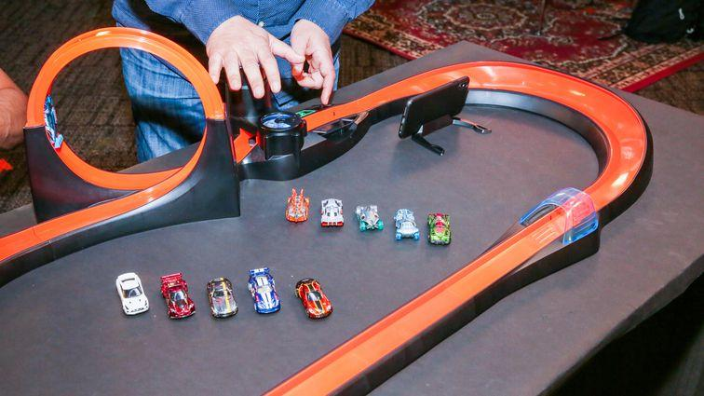
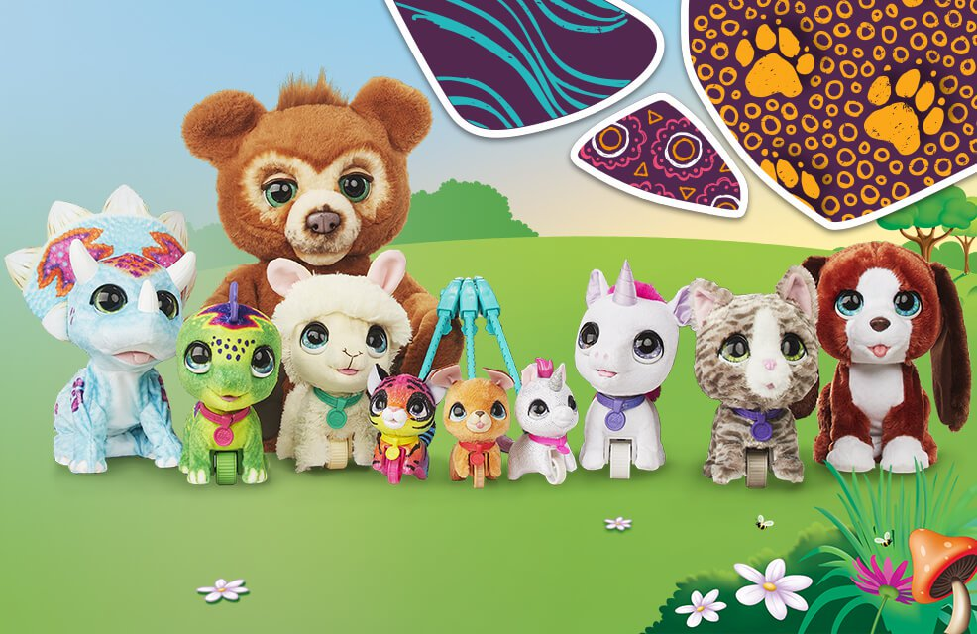
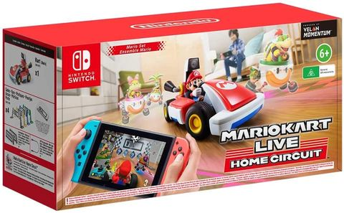
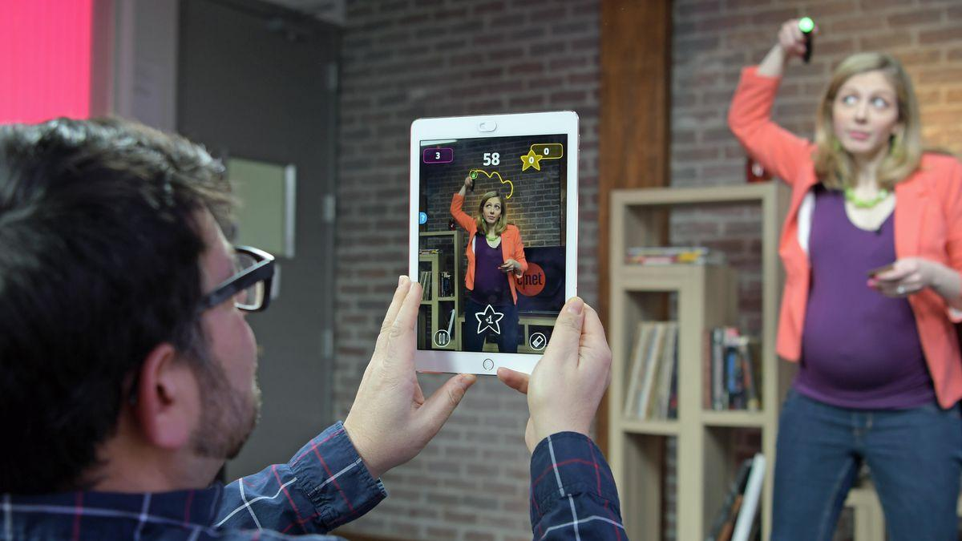
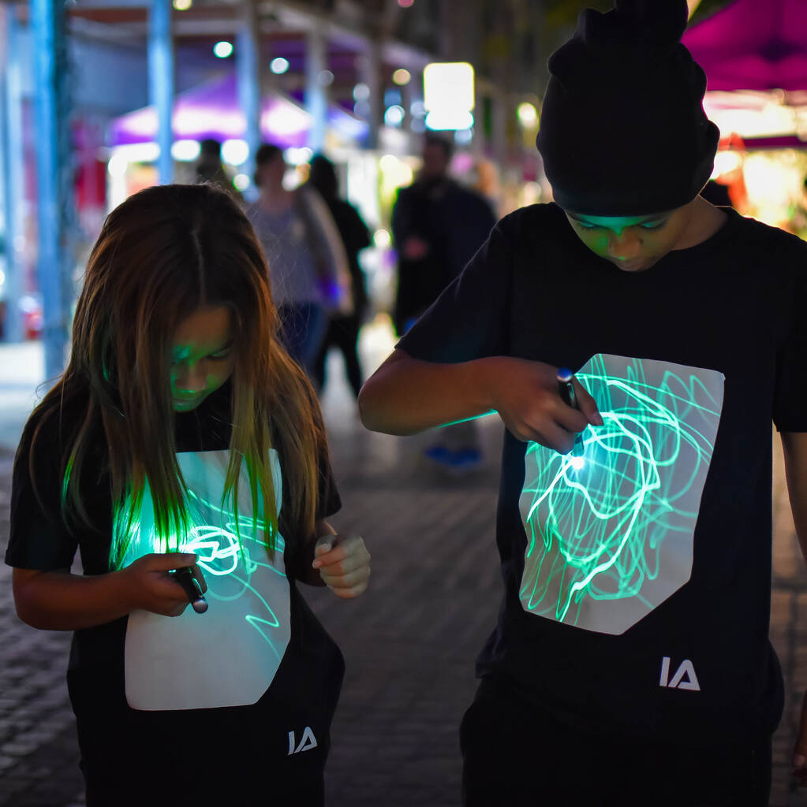
Technology used in toys
#TechWeCan | Tech for Celebrations
Notes:
For some celebrations people send gifts to each other and for children these are often toys.
I still love some of the traditional toys and board games like Monopoly for example but advancements in technology has meant that toys are changing all of the time and new techy toys are being developed each year.
Here are some of the top techy toys released recently.
So… in the top left we have what looks like a standard Hot Wheels car track but each of those cars actually has a hidden piece of tech in them called a NFC chip. That stands for near field communication. The chip connects to an app on a phone or tablet and accurately records things like lap times and sets you challenges to complete. A very clever feature is that it allows you to play games on the app away from the toy but after a while it asks you to ‘refuel’ and go back to the actual toy. I love the fact this will encourage people to use both the toy and the tech and also no more arguing about who’s car was the fastest.
In the middle at the top are a selection of the Hasbro FurReal pets. These are interactive pes with have lifelike sounds and movements. The large brown bear at the back is called Cubby and it has sensors all over its body to detect when he is tickled or fed. He even has a night time mode and will turn all of the sensors off and play noises to help children get to sleep.
In the top right is Mario Kart Live Home Circuit. My son really wants this one. This game uses mixed reality to turn your actual house into a race track for Mario. You use your games console to control an actual remote control car around your house but on the screen you can still use all of the normal features of Mario kart like throwing things at other drivers to knock them off course. When you place the arrow signs down in your house, they actually become moving arrows like in the original game. Here’s a little clip of the advert so you can see what I mean:
https://www.youtube.com/watch?v=NKE39Tg9oQY (Play clip from advert)
The bottom left picture is of a game called Pictionary Air. You have a special pen in your hand and rather than draw on paper, you draw in the air. Your teammates then use an app to be able to see what you are drawing. It looks like so much fun but also probably a bit trickier than it looks.
And finally, in the picture in the bottom right the children are wearing Interactive Green glow t-shirts. Using the Glow Torch which comes with the t-shirt or a mobile phone torch you can draw your own designs onto your t-shirt. It then lasts 5-10 mins, fades away and you can start again. I love that idea.

Slide 6
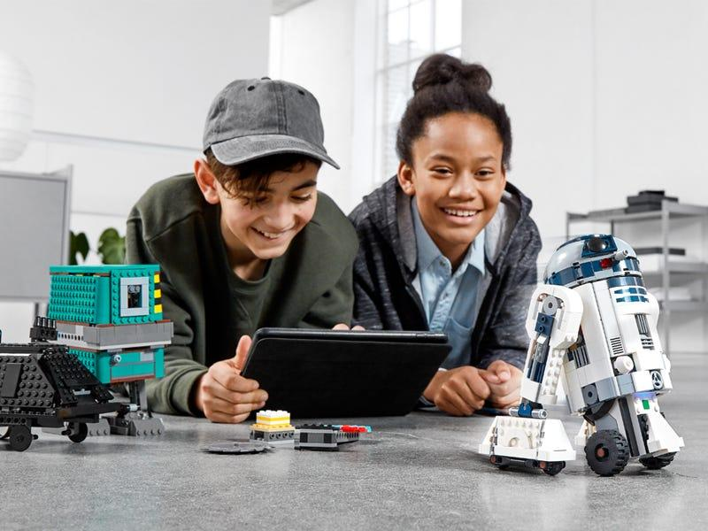
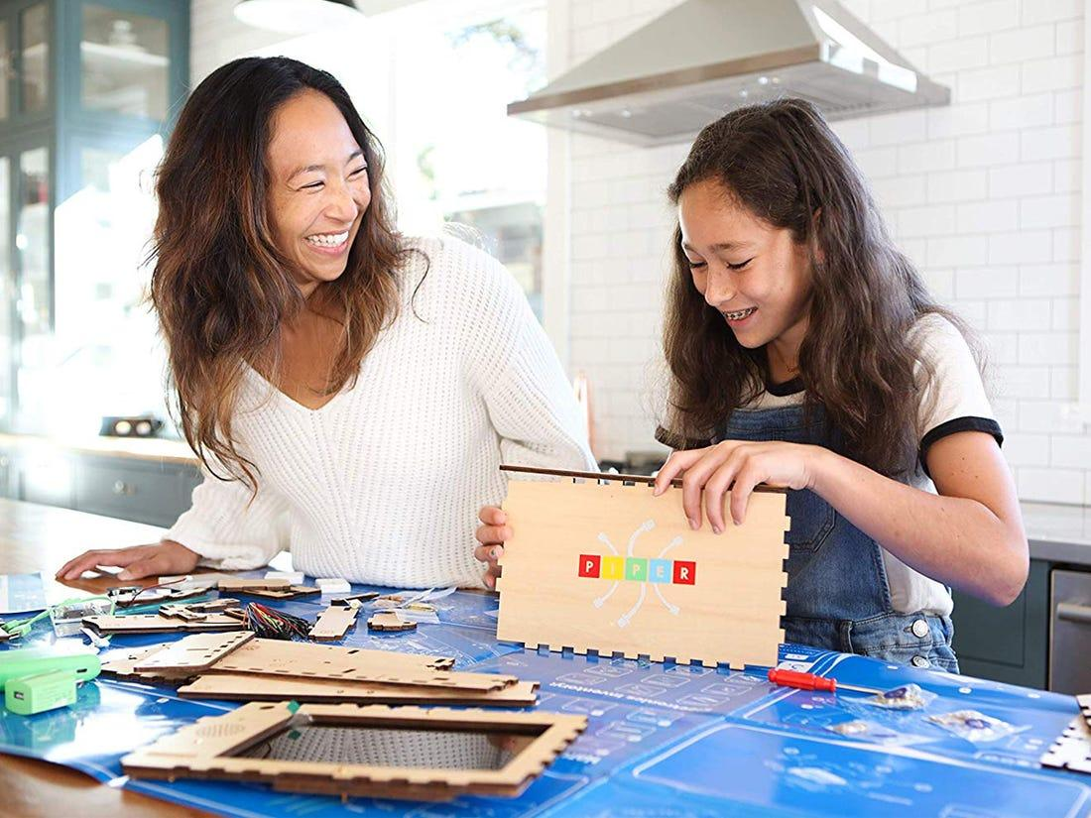
Careers in tech for toys
Toy Designer
Game Programmer
As a toy designer, you could be responsible for researching and designing the toys of the future. You will research how children interact with toys, create prototypes and try to design toys which are safe and enjoyable to play with.
As a game programmer, you could be responsible for writing the code which makes a game or toy fun to play with. You would be responsible for programming the tech inside the toy so it knows what to do.
#TechWeCan | Tech for Celebrations
Notes:
If working with technology and toys interests you then here are a couple of jobs you could have.
You could be a toy designer. As a toy designer, you could be responsible for researching and designing the toys of the future. You would research how children interact with toys, create prototypes and try to design toys which are safe and enjoyable to play with. You could try and figure out how to include advancing technology into your toy designs.
You could also be a game programme. Toys which contain tech, like the ones we just looked at, all need to be programmed so they know how to react and what to do when children play with them. Game programmers write the code so the tech within the toy knows what to do .

Slide 7
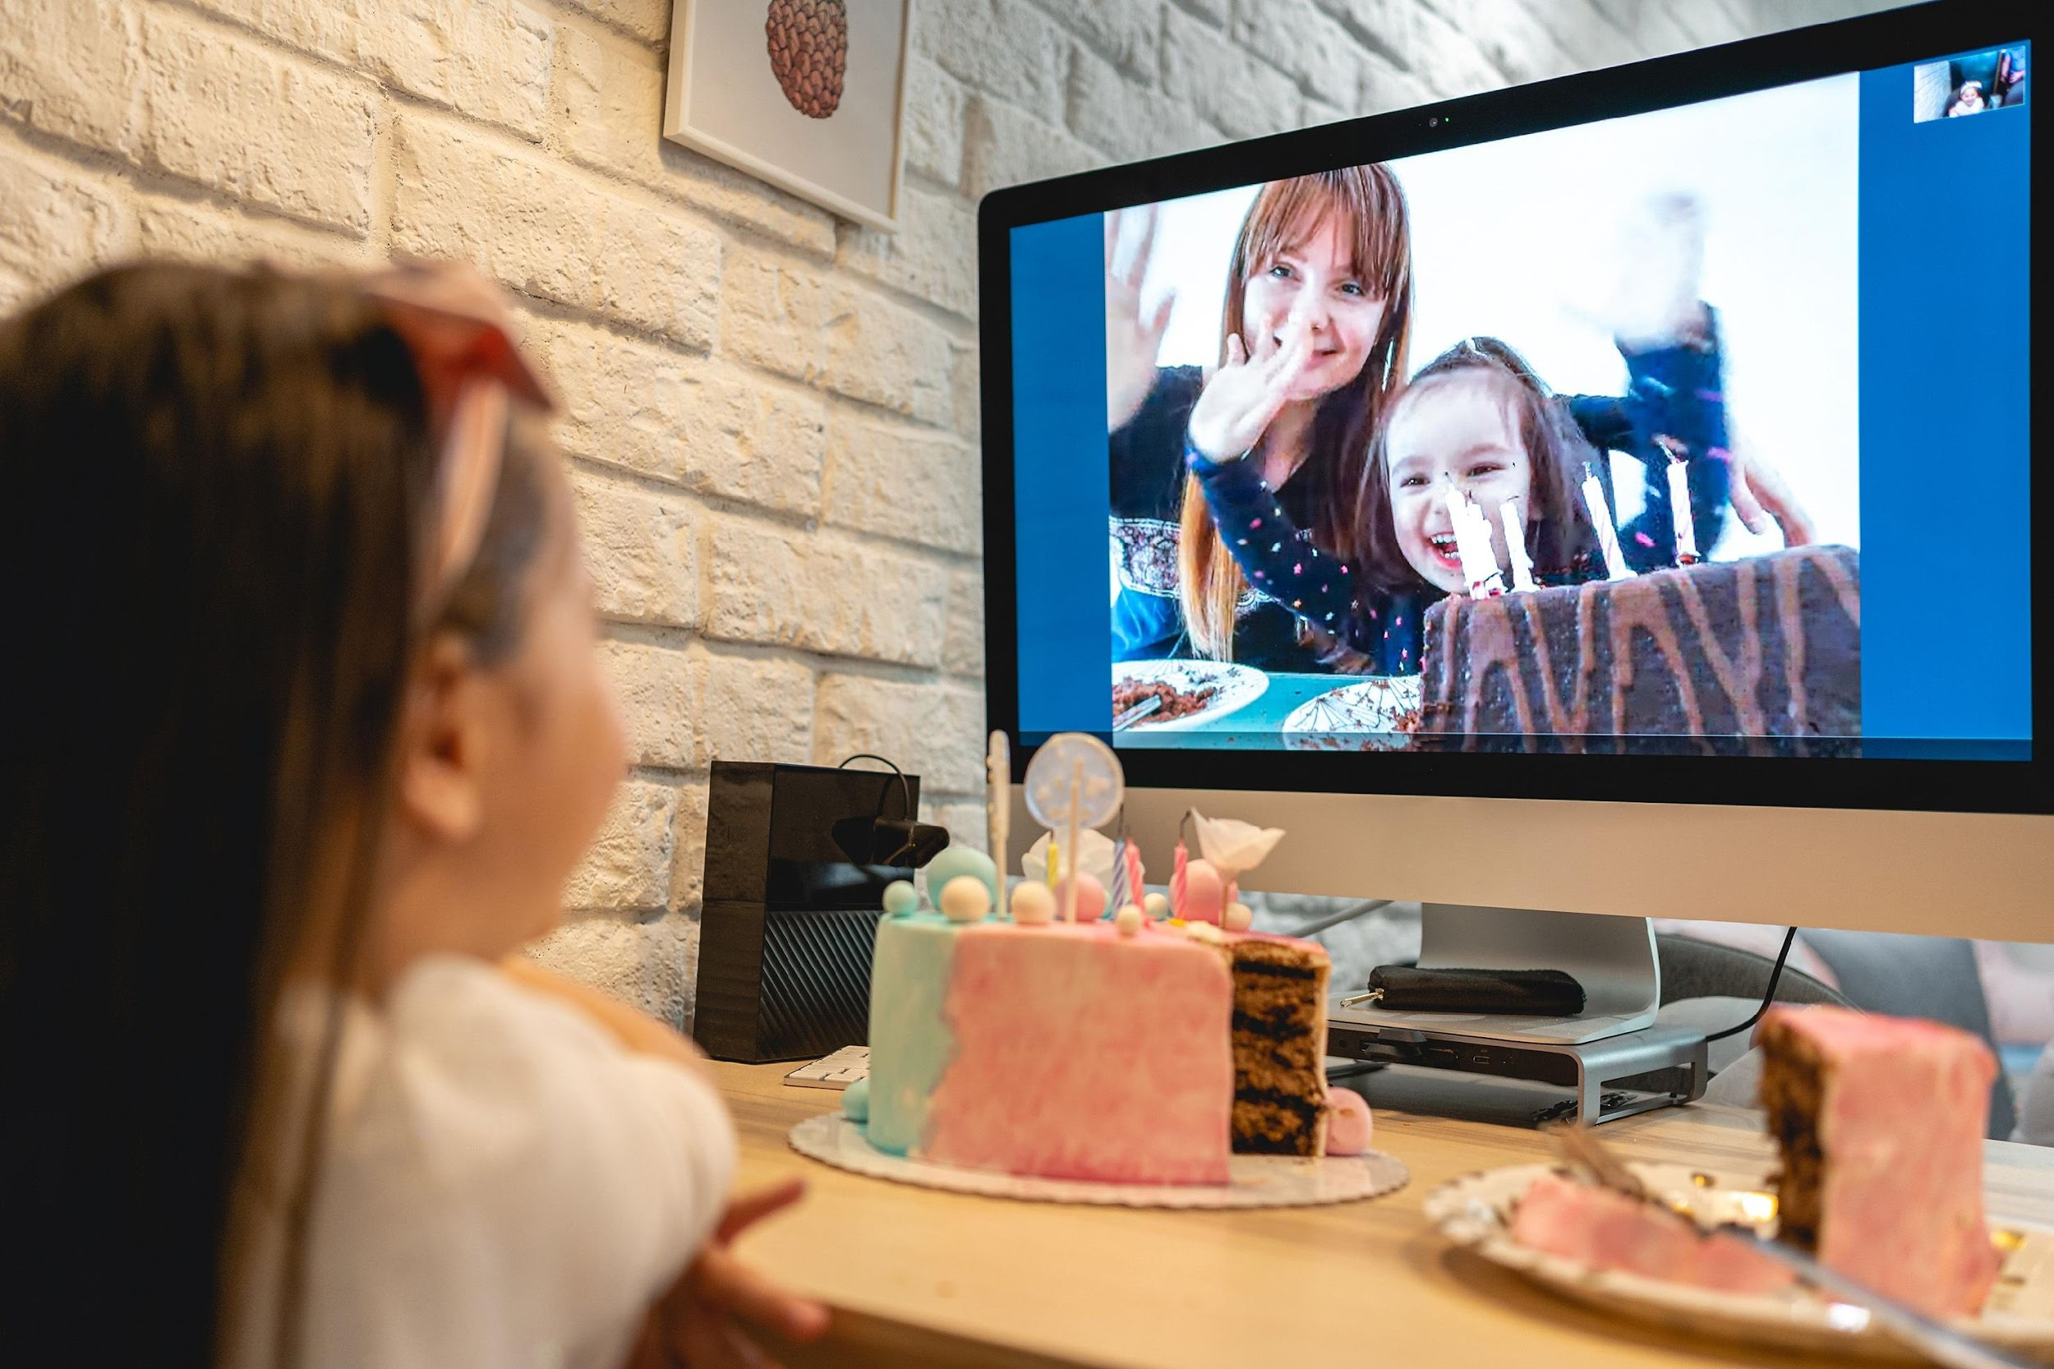
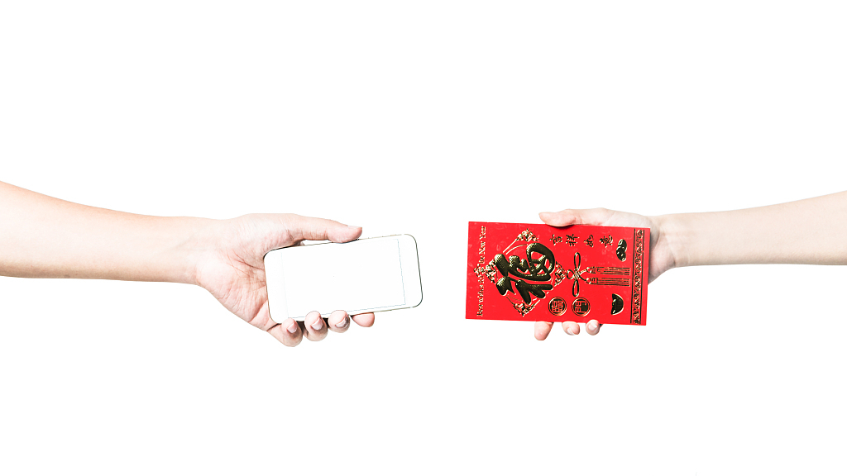

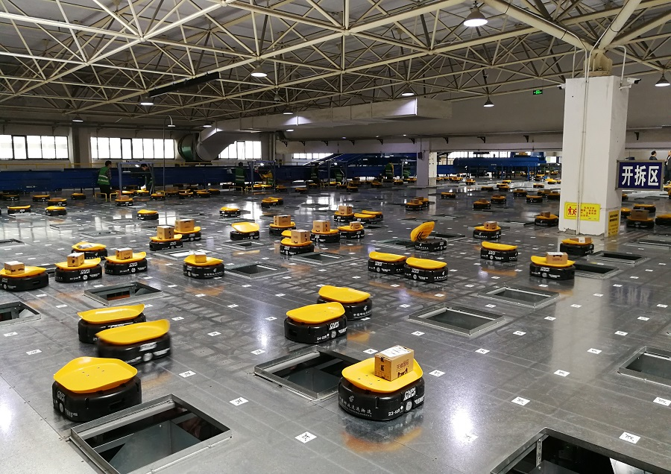
Technology used for buying and sending gifts and greetings
#TechWeCan | Tech for Celebrations
Notes:
We are now going to move onto how tech is used for buying and sending gifts and greetings during celebrations.
I think it’s key to mention here how important technology is and has been during times when we are in lockdown and can’t physically be with our family and friends to celebrate. Many of you may have had to celebrate birthdays and festivals apart from your family. As you can see in the top left picture, luckily technology still allows us to see and communicate with family and friends even when we have to be apart. This can be through tech such as Zoom calls or FaceTime. The tech companies have had to work fast this year to keep up with everyone using these platforms and they are adding new features all of the time. I wonder what the future of this type of communication technology will be? Perhaps little holograms popping up from our phone – who knows!? Could you design this tech of the future?
The picture in the top right shows a Chinese red envelope. For the Chinese Lunar New Year it is traditional to give red envelopes with money in to family and friends. In 2014 red envelopes were digitised and people were able to send these via messages. Every year, billions of Chinese Yuan are sent in digital red envelopes.
The little girl on her Dad’s back in the bottom left picture has sent him an e-card for Father’s day. Rather than send physical cards many people now use tech to send greetings to their family and friends. My favourite ecard to send around Christmas time is the Elf Yourself ECards where you can make the whole family look like dancing elves. They always make me smile.
And finally for this slide, the picture in the bottom right is of a set of very clever robots called the Mini Yellows. They are being used in Sorting offices in China to send parcels to different destinations. Around the time of popular religious festivals and cultural celebrations sorting and post offices get extremely busy with people sending gifts and cards to each other. These robots can actually sort 22,000 parcels in only 1 hour. Here’s a little clip of the robots at work:
PLAY CLIP: https://www.dailymail.co.uk/video/news/video-1445461/Chinese-company-uses-ROBOTS-sort-packages-efficiently.html

Slide 8

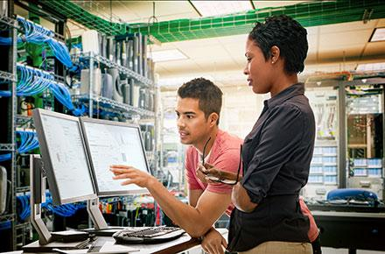
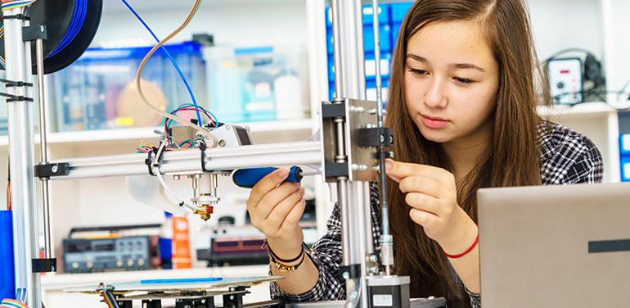
Careers in Tech for buying and sending gifts and greetings
Solutions Engineer
Graphic Designer
Robotics Engineer
As a solutions engineer, you could work for a company who specialise in video calls. Your job would be to find out what customers want and work with designers and developers to create something to make the customers happy and want to use your programme more than any other.
As a graphic designer, you could be responsible for designing greeting cards. These could be physical cards people buy in the shops or e-cards.
As a robotics engineer, you could design robots to help sort and send parcels, gifts and cards.
#TechWeCan | Tech for Celebrations
Notes:
So if any of those tech examples sounded interesting to you then here are 3 potential future jobs.
You could be a solutions engineer. As a solutions engineer, you could work for a company who specialise in video calls. Your job would be to find out what customers want and work with designers and developers to create something to make the customers happy and encourage them to want to use your programme more than any other.
You could also be a graphic designer. As a graphic designer, you could be responsible for designing greeting cards. These could be physical cards people buy in the shops or e-cards. Every card you buy or receive has had someone think carefully about the design of it.
And then there’s the people working on robots. Earlier in the lesson, we mentioned animatronic engineers working with robots but there are lots of different projects robotic engineers can work on. As a robotics engineer, you could design robots to help sort and send parcels, gifts and cards.

Slide 9
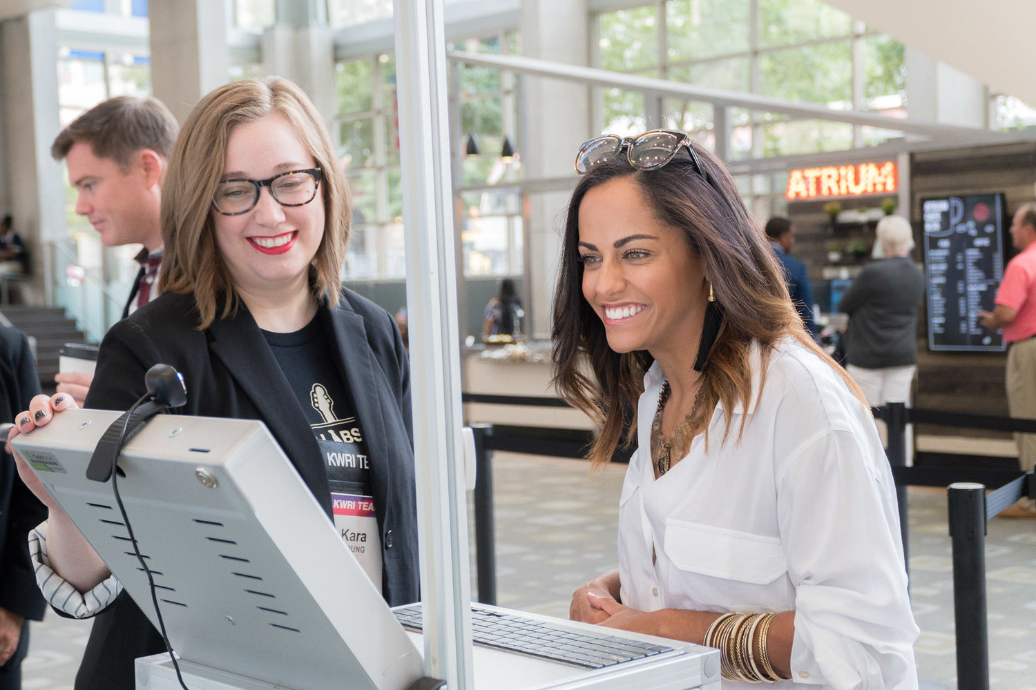
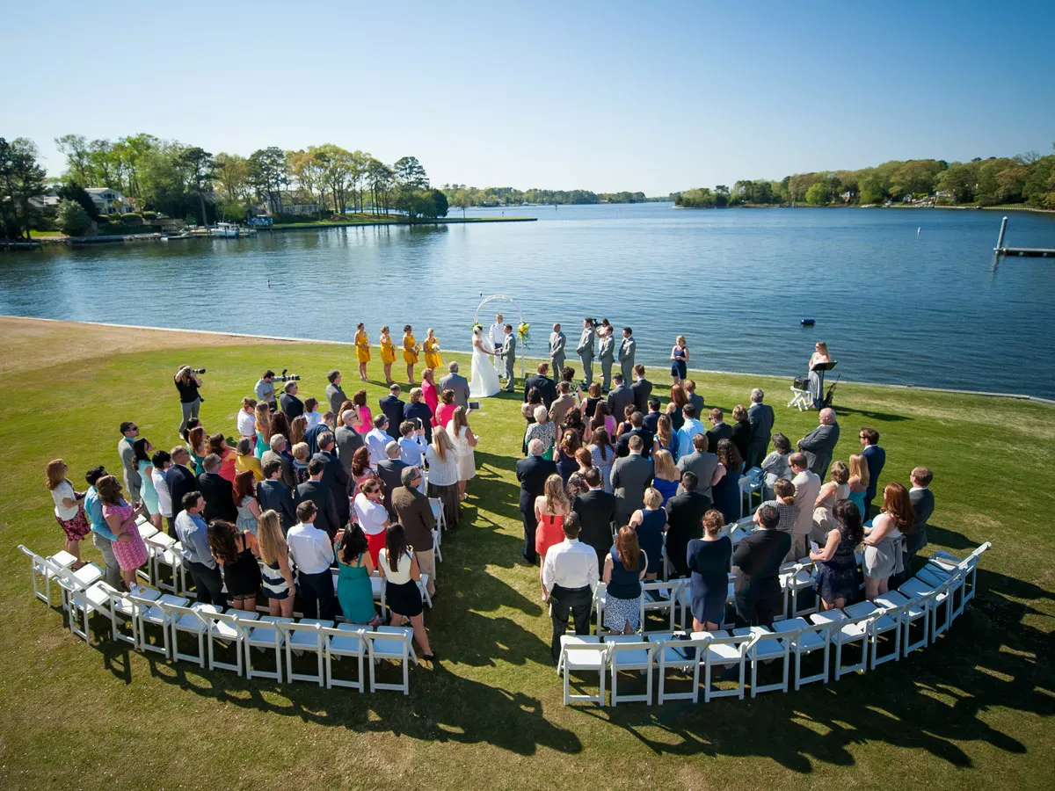
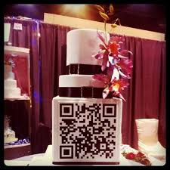

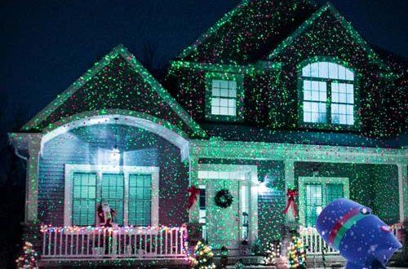
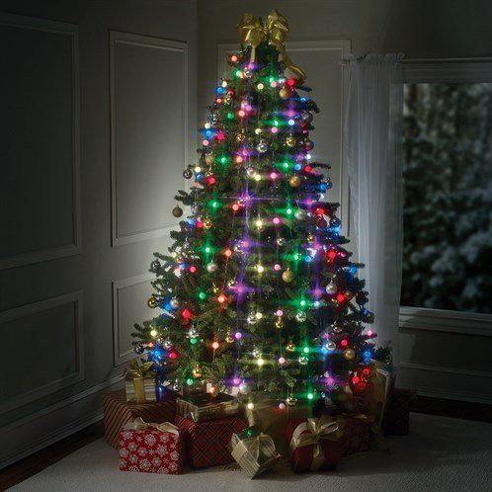
Technology used for celebratory events and decorations
#TechWeCan | Tech for Celebrations
Notes:
Often for celebrations, people have big events with family and friends together. This could be things like weddings, birthday parties and religious festivals. On this slide, we are going to have a look at some of the ways technology is used at these events for things like photography, decorations and the organisation of the event.
The top left picture shows a lady registering at an event using facial recognition software. Rather than signing in, large events are now using this kind of software to register people when they arrive.
The picture in the middle at the top is of a wedding cake but with a difference. This wedding cake has a QR code on it. You might have seen QR codes before on packaging or letters. You scan the codes with your phone and the unique code redirects you to another webpage. For weddings and birthdays people have even used these so guests can find out about the day or transfer them money as a gift.
The picture in the top right was taken using a drone. Photographers and videographers are now using drones at celebrations and events to take photos and videos which they usually wouldn’t be able to (well without a HUGE ladder). The drones allow them to be even more creative and get shots like this.
For many celebrations people of all cultures use lights to decorate their rooms and houses. This often includes fairy lights like you see on the christmas tree in the middle picture at the bottom and the Eid and Ramadan lights you can see in the bottom left picture. Rather than decorate a house or room, some people even use projectors to give the illusion that somewhere is covered in decorations when in fact it's a picture projected. What’s important to remember is it’s someone's job to design and create this kind of tech. Some of you might even have lights at home which you can change from flashing, to looking like they are chasing each other and many other effects. Remember those effects have been coded to make them have that effect. Similar to the projections, someone has to design what they look like and programme the projector to create the effect.

Slide 10
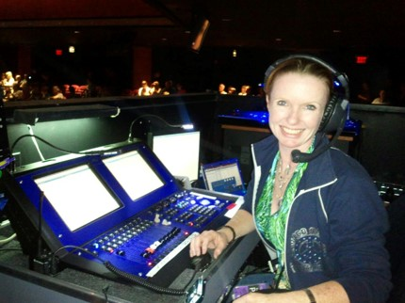

Careers in Tech for events and decorations
Lighting Programmer
Event Technologist
As a lighting programmer, you could be responsible for deciding how and where to use lights in an event to achieve the best look and effect. Lighting programmers work on things like theatre productions, sporting events, concerts and large celebrations.
As an event technologist, you could be responsible for organising and overseeing everything technology related for an event. You would have to keep up to date with all of the brand new technology being invented and be able to advise people on how, when and where they could use these technologies in their events or celebrations.
#TechWeCan | Tech for Celebrations
Notes:
If you think you might be interested in using technology to plan, design or decorate future celebrations and events then here are a few future jobs you could have.
You could be a lighting programmer. As a lighting programmer, you could be responsible for decided how and where to use lights in an event to achieve the best look and effect. Lighting programmers work on things like theatre productions, sporting events, concerts and large celebrations. I think this is a pretty cool way of combining a love for art and technology into one role.
As an event technologist, you could be responsible for organising and overseeing everything technology related for an event. You would have to keep up to date with all of the brand new technology being invented and be able to advise people on how, when and where they could use these technologies in their events or celebrations.

Slide 11

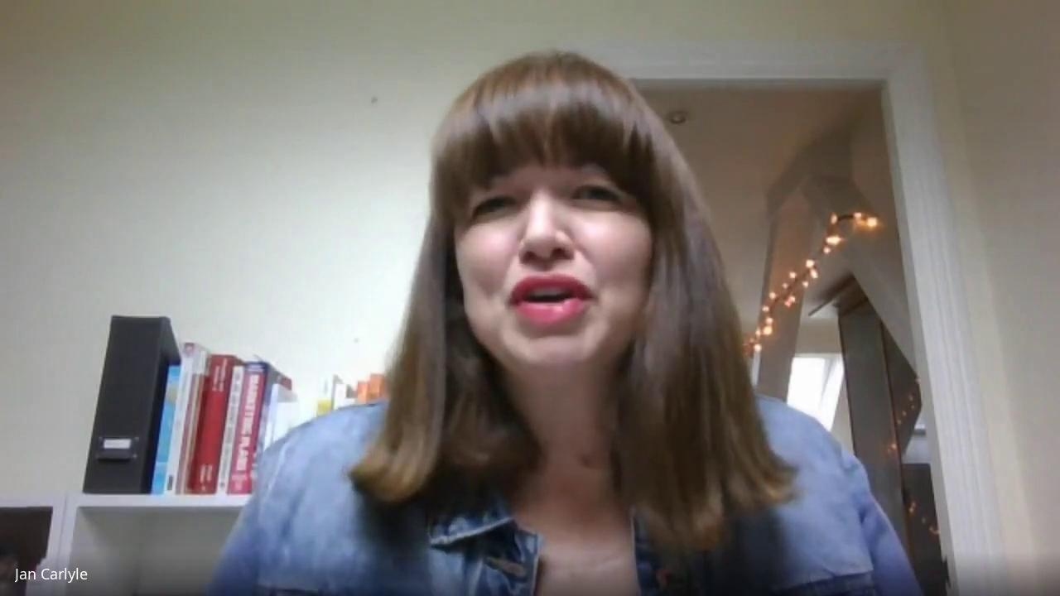

Meet another of today’s role models
Jan Carlyle
Founder and Director
of Autumn LIVE
(Events Company)
#TechWeCan | Tech for Celebrations
Notes:
And finally, we are now going to meet our second Tech for Celebrations role model. We are going to hear from Jan who is the founder and director of a company called Autumn Live. Jan and her team organise events both online and in person so she uses lots of tech in her role and has built her company around using technology for events.
Katie spoke to Jan to find out more detail about Autumn Live and Jan’s job. Let’s have a listen to what she said …
PLAY Role Model video from 37:47 - 43:47 (image hyperlinked)
I found it really interesting when Jan worked with the developers of Pokemon Go to create an event learning about the history of Chester. What a cool way to use that tech. Both Jan and Jonathan mentioned how important it it to follow your passions into a future job and I also think that’s great advice.
So as we have learnt today, celebrations and events use technology in so many different ways and there are so many different people who work behind the scenes to make them happen. Next time you are at a wedding, religious festival or any other big celebration or event. Think about the technology which is being used and all of the people who have worked to make it enjoyable for you and everyone else there.

Slide 12
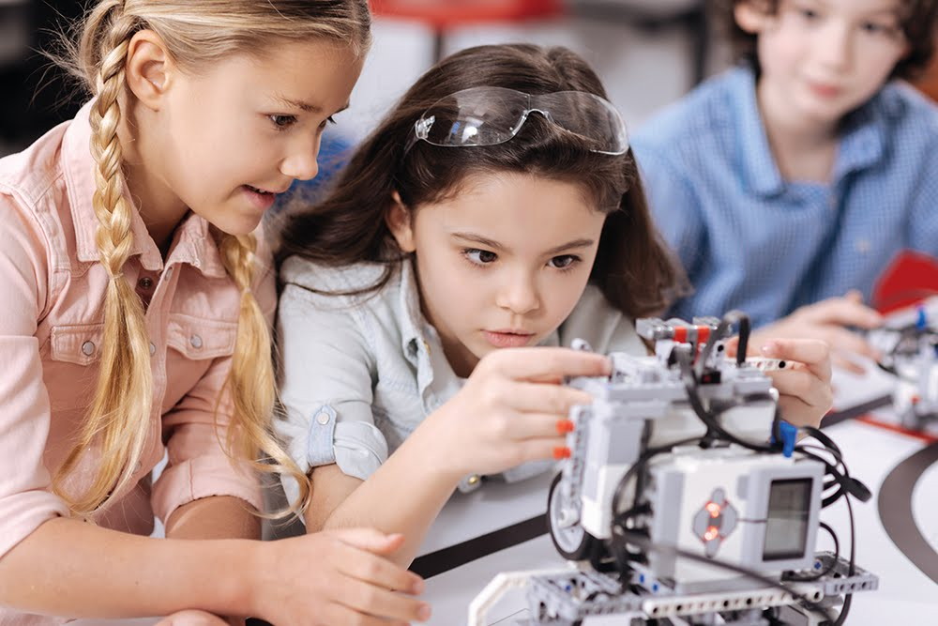
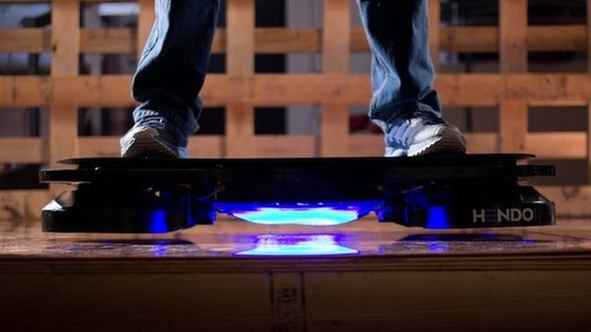
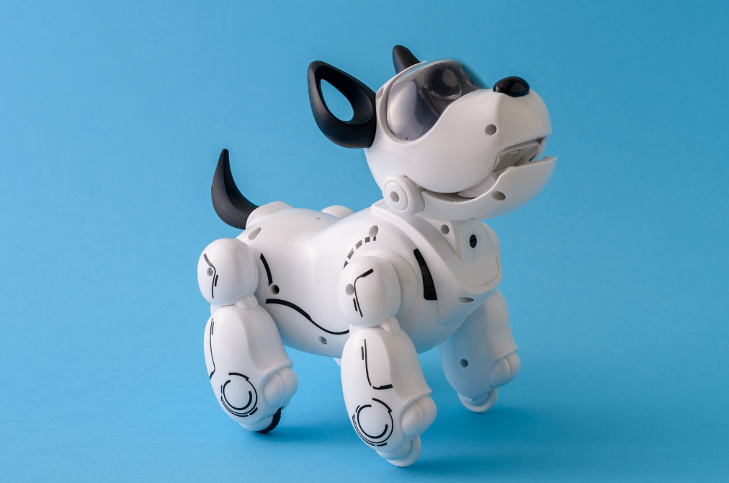
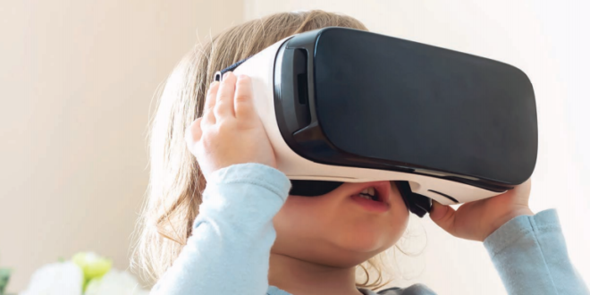
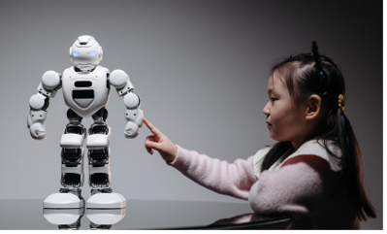
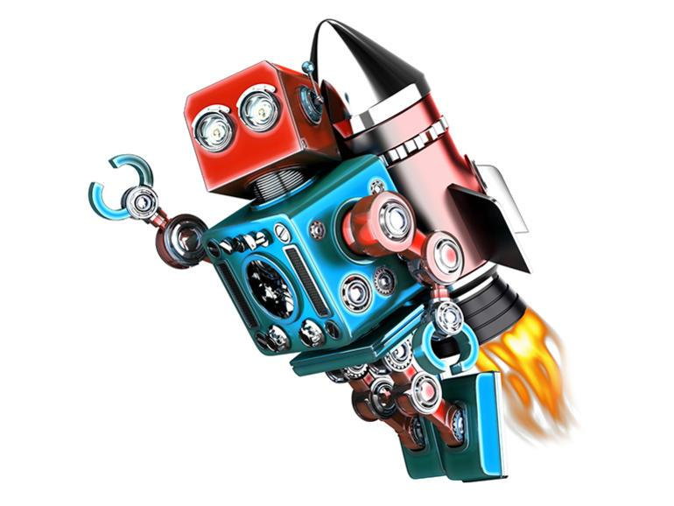
Your challenge: Design a brand new techy toy for 2035. What kind of toys do you think children will be playing with in 10 years time?
Please ask your parents or teachers to share your work on social media using #TechWeCan or email us at info@techshecan.org
#TechWeCan | Tech for Celebrations
Notes:
Time for your Tech for Celebrations Challenge. We would like you to design a techy toy of the future. We would like you to think about the kind of toys that will be given for gifts in 10 years time. What do you think the children of the future will be playing with? Think about the tech that might be available then.
Remember there is no right or wrong answer to this and no silly suggestions as no one can predict exactly how fast the world of technology will move or what will be available to us. I’m thinking hoverboards, how virtual reality might evolve and maybe techy pets with really cool artificial intelligence.
Please draw and label your design either on paper or on a computer programme and label your design to explain all of the techy features it has and how someone could play with it.
We absolutely love to see your Tech We Can challenges and if you would like us to give you feedback on your work then please email it to us or ask your parents or teachers to share it on social media using the #TechWeCan.
I can't wait to see what you come up with. You never know, you could see your design created in the not too near future. How cool would it be if you gave a toy designer an idea.

Slide 13


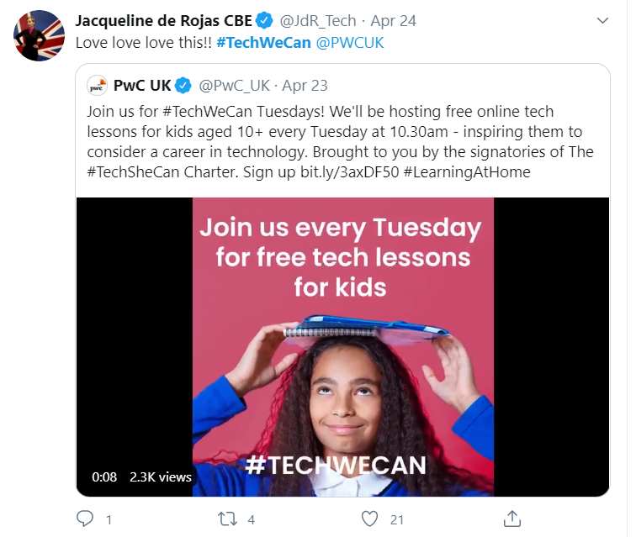
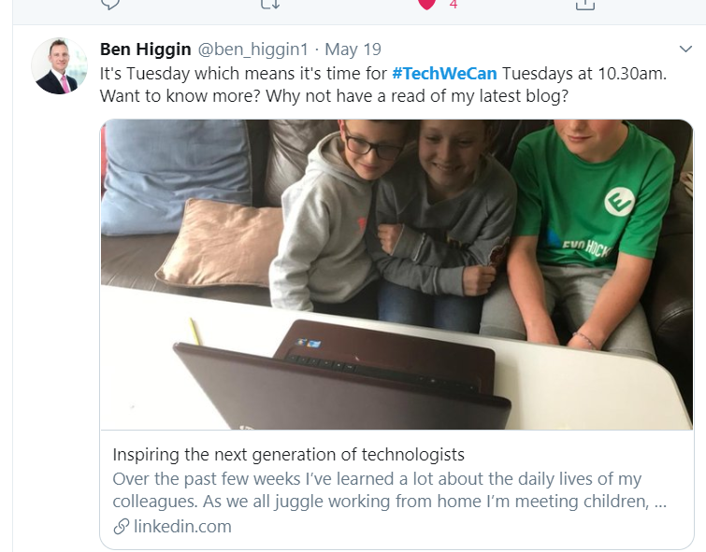
“Our Tech We Can lesson plans are part of our commitment to upskill the communities we’re part of - without urgent attention, many risk getting left behind as technology changes how we live and work. The current crisis we face has provided a stark reminder of the critical value of skills in science and technology.”
Sheridan Ash, Co-CEO Tech She Can
For more information about Tech She Can and free access to all of the Tech We Can resources we have spoke about today, please visit: https://www.techshecan.org/
Follow the hashtags #TechSheCan and #TechWeCan to stay up to date with us on social media.

