Slide 1
the Planet
TECH FOR
To understand how technology is used to protect our planet and broaden my knowledge of careers available in this field
Notes:
Hi Everyone, my name is ________ and I’m here to share a Tech We Can lesson with you all.
Today we are going to focus on Tech for the Planet but we have lots of other Tech We Can lessons available for you to choose from. We want to show you how your interests and passions could lead you into a career in tech.
In our Tech for the Planet lesson, my aim today is to show you lots of different and interesting ways technology is being used to protect our planet. I will also talk about the people working in jobs designing, creating and using this tech, and the types of jobs they have. Hopefully you might consider one of these jobs for your future.

Slide 2
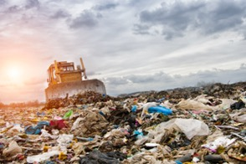
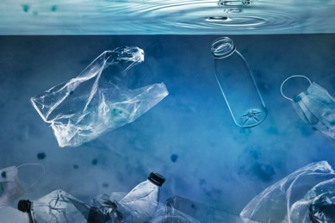
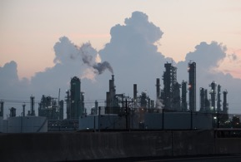
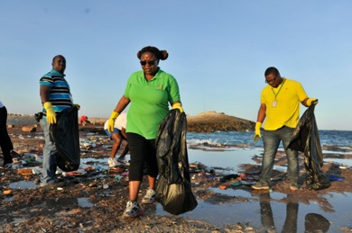
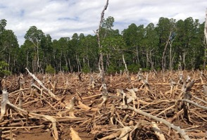
What negative impacts do humans have on our environment?
#TechWeCan | Tech for the Planet
Notes:
Before we look into how technology is helping to protect our planet, let’s see why we need this kind of technology and people working in these areas.
Unfortunately, humans impact the environment in many ways. We cause pollution not only on the ground, but also in the oceans and air around us. You’ve probably also heard of global warming, which is causing our climate to change. Global warming is caused by a gas called CO2 which stands for carbon dioxide – sometimes you may hear people refer to this as carbon emissions. Humans release carbon dioxide in many different ways including using cars, burning fossil fuels to produce electricity, and manufacturing products we use. The extra CO2 in the atmosphere acts as a blanket around the Earth, trapping the sun’s heat, and causing the average temperature of our planet to rise much more quickly than it naturally would.

Slide 3
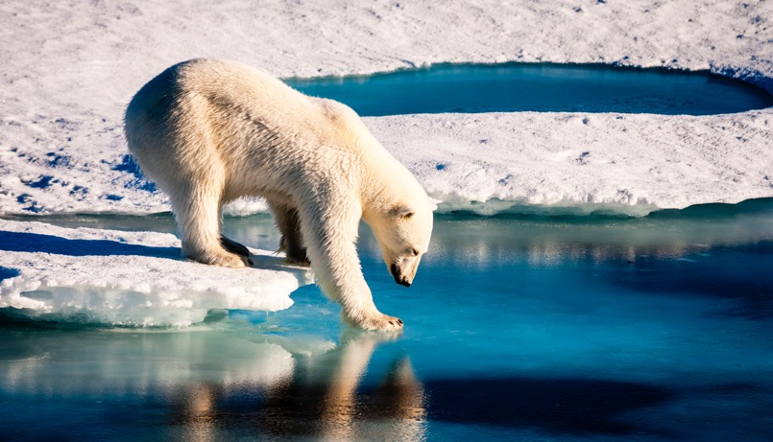
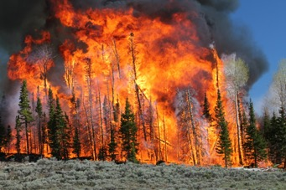
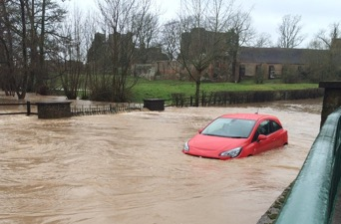
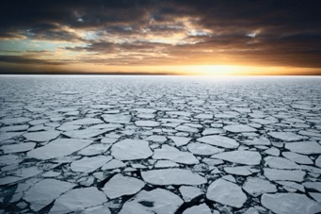
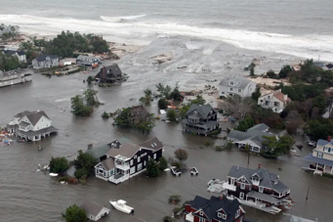
Global warming has many negative impacts on our planet
#TechWeCan | Tech for the Planet
Notes:
Although this does mean we have warmer days, unfortunately this increase in temperature has lots of negative effects on our environment, these effects include:
More severe weather such as storms, floods and droughts
The warmer weather causes the acidity in the oceans to rise, which damages marine life
The huge stores of ice in the Arctic and Antarctic melt much quicker than they naturally would, which causes the sea levels to rise
The more pollution we put into our atmosphere, the worse global warming will become, and the greater the effects will be. Over the next 10 years, we won’t be able to stop climate change completely, but we can slow it down. If we manage to keep the global temperature rise to 1.5 degrees celsius over the next decade, we can help prevent all of these things from getting worse.

Slide 4
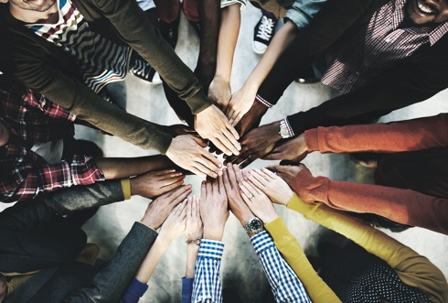
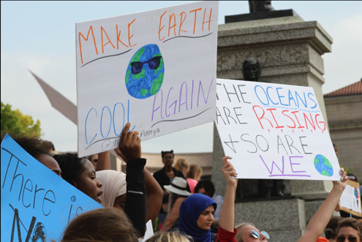
Climate change is a global problem, and we need to work together to change this
#TechWeCan | Tech for the Planet
Notes:
Climate change is not a problem we can solve alone, we need individuals and governments all around the world to work together to change this. We all need to lead a more sustainable lifestyle which means interacting with the environment in a way that makes sure there will be enough resources left for future generations. Yearly events like COP bring together leaders from all around the world to decide how to act to prevent climate change and protect the future of our planet.
We also need lots of people working in this area to invent technology which can help reduce the effects of climate change, and help us all live more sustainably. Today we are going to look at some of the really clever ways that people all around the world are using technology to help protect our planet.

Slide 5
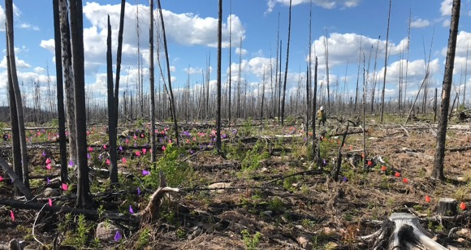
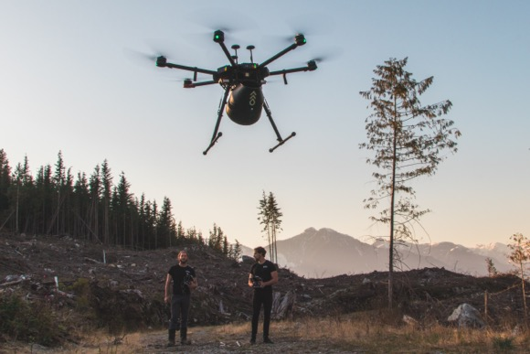
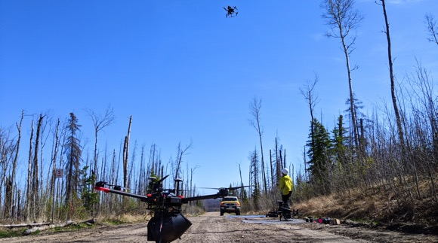
Tech to protect the air and atmosphere
#TechWeCan | Tech for the Planet
Notes:
The key to reducing global warming is by finding ways to reduce the amount of CO2 that we release into our atmosphere. Our air and atmosphere are precious to all life on Earth.
Protecting our trees is one key way we can help fight climate change. Plants and trees take in carbon dioxide so the more we have on our planet, the more CO2 they will take in. It can take a long time to plant entire forests by hand, but there are clever ways that companies are using technology to replace the trees lost to deforestation. In 2020, a Canadian company called Flash Forest used drones to fire seed pods into the ground to help replace an area of trees which had been burned down in a wildfire. Flash Forest states that using drones is 10 times faster than planting trees by hand, and they aim to have planted 1 billion trees in the next 7 years – that’s a lot of trees!

Slide 6
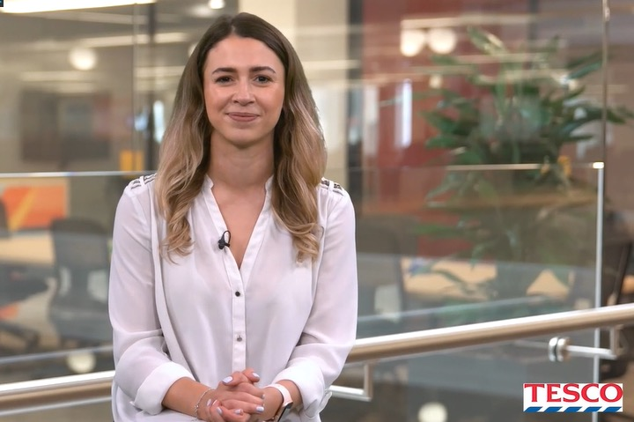
Meet today’s first role model
Mikya
Tesco
#TechWeCan | Tech for the Planet
Notes:
Many organisations are also finding ways to use technology to help them reduce their carbon emissions and protect our planet for the future. Tesco is one of those organisations who are striving to find new and innovative ways to make their organisation more sustainable.
We are now going to meet our first Tech for the Planet role model, Mikya, who works at Tesco. Becky and Katie from Tech She Can spoke to Mikya to find out more about how Tesco are trialling using technology to deliver shopping in a more environmentally friendly way. Let’s have a listen to what she said.
PLAY VIDEO (picture hyperlinked) from 6:16 – 7:32
Since this interview was recorded, Tesco has expanded it’s drone and robot delivery trials to more areas, so this is something that may become more common in the future

Slide 7
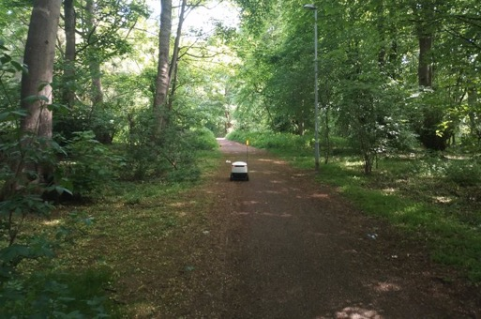
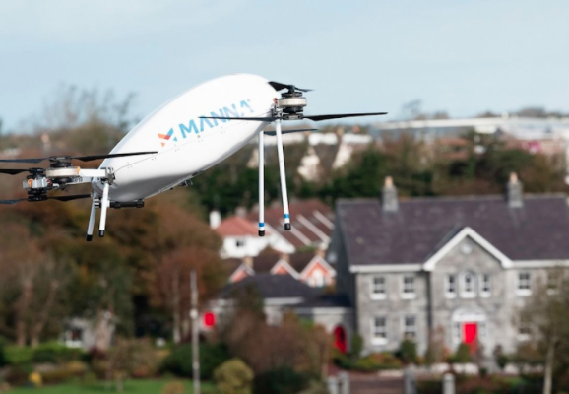
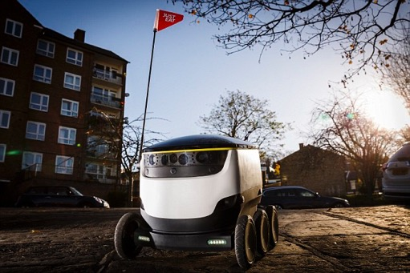
Tech to protect the air and atmosphere
#TechWeCan | Tech for the Planet
Notes:
Since the interview with Mikya was recorded, Tesco has expanded it’s drone and robot delivery trials to more areas. Because these methods of delivery are more sustainable, other supermarkets and even food delivery companies like ‘Just Eat’ are also beginning to trial similar things. It may seem like something from a futuristic film, but if you haven’t already, you may see robots and drones like those in the photos delivering your milk, bread and takeaways in the not too distant future!

Slide 8
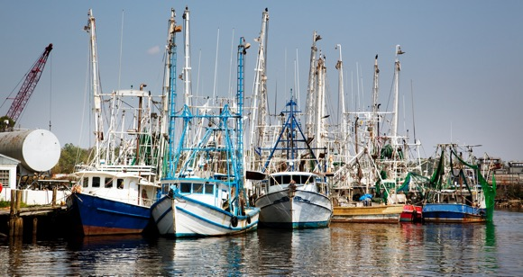
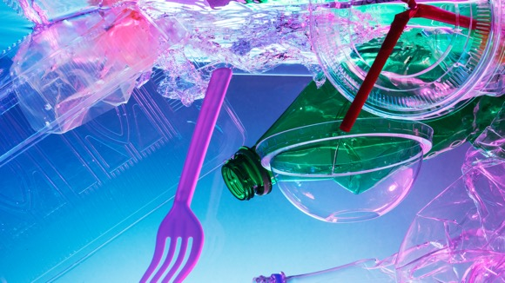
Environmental issues facing our oceans
#TechWeCan | Tech for the Planet
Notes:
Our oceans on Planet Earth actually help us fight climate change as they absorb up to 30% of the carbon dioxide which humans produce. As we’ve already mentioned, carbon dioxide is the gas which causes global warming. Unfortunately though this has led to warmer and more acidic water in the ocean. Each year we also dump about eight million tons of plastic into the ocean.
The warmer water, plastic and more acidity in the ocean harms the plants and sea life who live there. And whilst we are talking about sea life, it’s also important to note that overfishing is another environmental issue with the oceans. When we take too many fish out of the ocean, we put certain fish species at risk of extinction as we do not allow the fish to reproduce and build their numbers back up. This means we are not protecting this really important source of food for future generations.

Slide 9
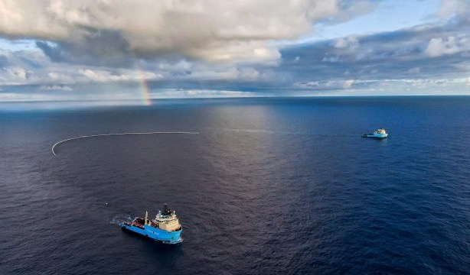
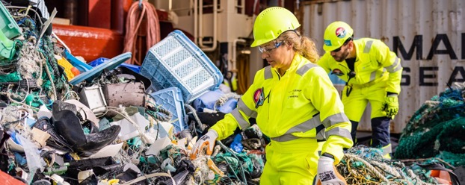
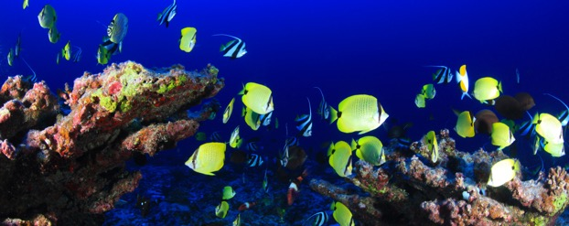
Tech to protect the oceans
#TechWeCan | Tech for the Planet
Notes:
We are now going to look into a couple of examples of how technology is being used to protect the oceans.
An organisation called The Ocean Cleanup is on a mission to clear 90% of the floating plastic pollution in our oceans by 2040. The Ocean Cleanup was started by a 20 year old called Boyan Slat. Boyan and his team use floating barriers which move along with the ocean currents collecting the floating plastic before it breaks down and becomes too small to be able to find and remove from the water. The floating barriers move so slowly and are specially shaped to try and minimise the amount of disturbance they cause to the sealife. They also have special cameras attached to them so the crews on the boats nearby can spot any sea life nearby and stop the barrier. Once The Ocean Cleanup team has removed the plastic from the ocean, they then go on to recycle it.
Another vital thing to protect in the oceans are the coral reefs which grow there. Over a quarter of the sea life in the oceans depend on the coral reefs for their food and habitats. They also benefit people all around the world as they are a source of food for us and they help protect our coast from storms and erosion. The increase in the sea temperature and acidity which I mentioned earlier is causing the coral reefs to die. A company called Coral Vita is on a mission to restore and protect the planet’s coral reef. Their organisation grows coral on land and then replants this coral back into the ocean. The special methods they use to grow the coral on land mean they can grow coral up to 50 times faster than traditional methods. Coral Vita aims to build their farms all around the planet to restore and protect the world’s dying coral reefs.

Slide 10
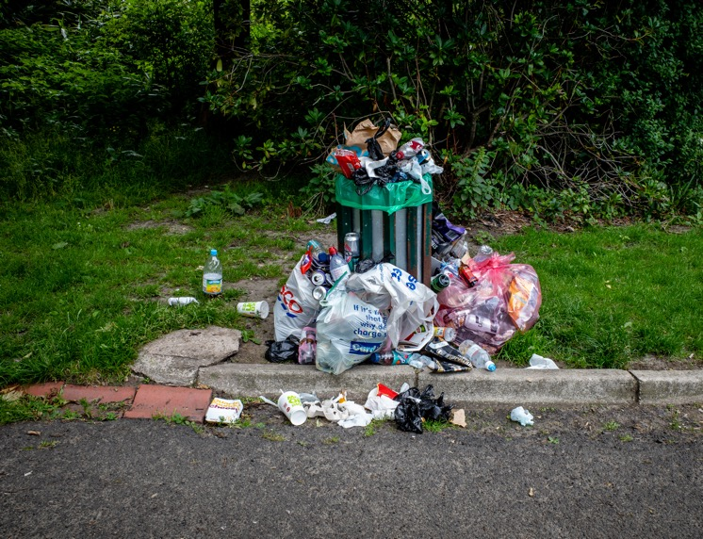
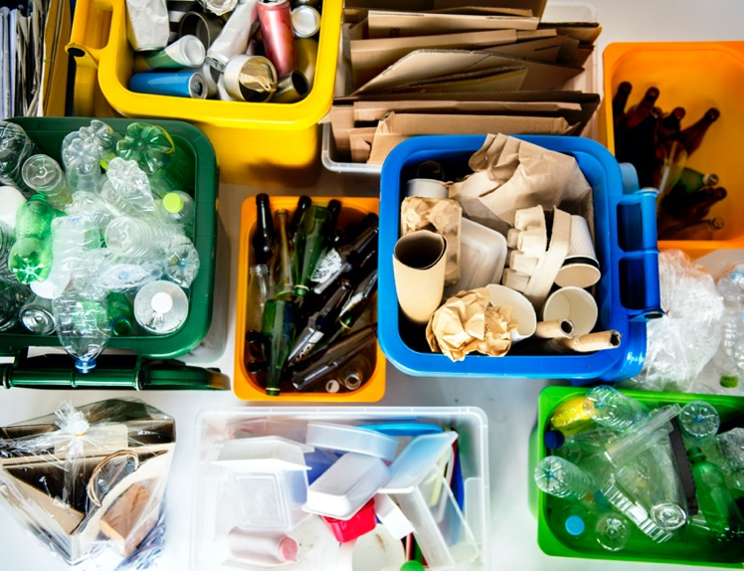
Reducing waste
#TechWeCan | Tech for the Planet
Notes:
One of the ways we can all help protect our planet is by reducing the amount of waste we produce. When we throw items away, everything which cannot be reused or recycled goes to a place called a landfill. Landfills are large holes in the ground where rubbish is left to decompose (this means break down). For some types of materials, this can take many years. Landfills release pollution into the air as the rubbish decomposes and they also release pollution into the local water sources as some of the rubbish leaks out. If we reduce the amount of waste we produce then we also use less natural resources such as trees. And not only that, the more you reuse and recycle then the less we have to transport goods around in things like lorries and planes which also cause pollution. So reducing waste is most definitely good for our planet.

Slide 11
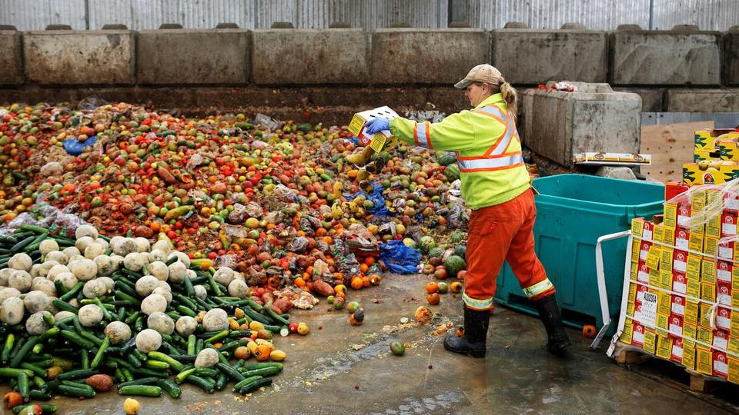
Tech to reduce waste
#TechWeCan | Tech for the Planet
Notes:
Positive Carbon is a company who are using technology to help restaurants reduce their food waste. They have special bins with sensors and scales connected to them. The sensors use AI (artificial intelligence) to monitor all of the foods which the chefs throw away and the scales weigh the amount of food in the bin. Positive Carbon can then provide the companies with a report like you can see in this image. The kitchen staff can then clearly see the types and the amounts of foods they are throwing away. Companies can then use this information to not only save money but also reduce their food waste and save on rubbish collections.
Another example of technology helping to reduce waste is related to clothing. The fashion industry and the creation of the clothes we wear is actually considered one of the largest polluters in the world. Dress X is another company trying to reduce both waste and pollution through digital fashion. They offer their customers digital clothes which they can buy and then overlay onto a photograph. Their customers can then post pictures of themselves on places like social media wearing the Dress X clothes. In actual fact, the person isn't wearing the clothes and has never even physically tried the clothes on which means they still get to look cool in the picture but avoid having to actually buy lots of different outfits for their pictures.

Slide 12
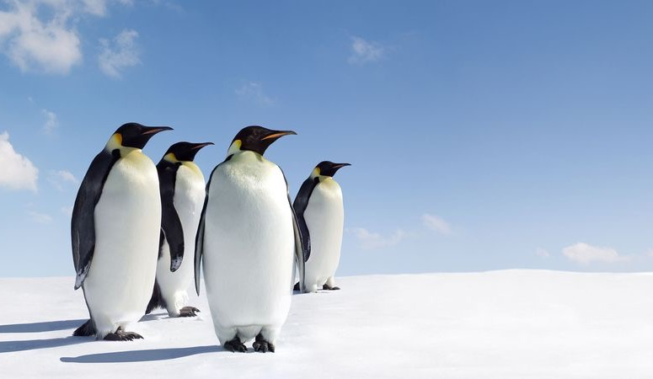
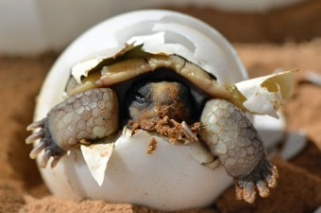
Environmental problems affecting animals
#TechWeCan | Tech for the Planet
Notes:
When we talk about protecting our planet, we must also remember that we are not the only ones living here. We share the planet with millions of species of plants and animals and our actions can often cause them harm. Climate change affects the animals who live on the planet with us. According to the World Wildlife Foundation, if we don’t take action on climate change, we could lose almost 50% of the species from the world's most important natural areas - areas like rainforests for example.
Climate change affects animals in many different ways. Examples include the fact that elephants need to drink a whopping 150 - 300l of water a day. Less rain, hotter temperatures and more droughts means not as many elephants will be able to survive. Turtles, for example, are also significantly affected by climate change. Rising sea levels, higher tides and extreme weather events have been destroying turtle nesting sites.

Slide 13
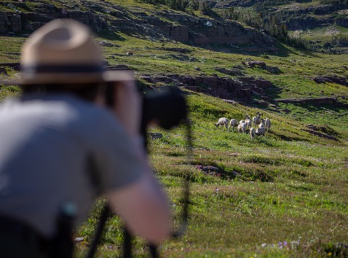
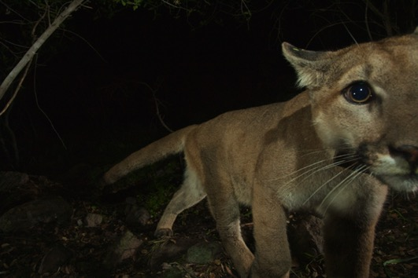
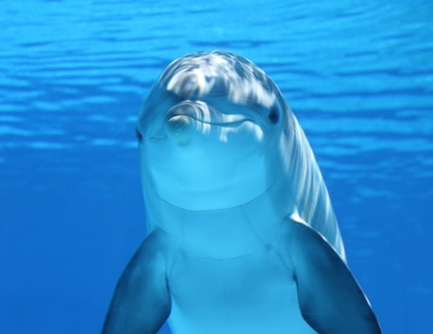
Tech to protect animals
#TechWeCan | Tech for the Planet
Notes:
There are many people around the world trying to protect and save these animals through the use of technology. One of the most effective ways to protect animals is through the use of data collecting information about them. The more we understand about how climate change is affecting animals, the better we can work out how to help them. One example is the SMART software, which was created by the World Wildlife Fund, the Wildlife Conservation Society, and the London and Frankfurt zoos. SMART stands for Spatial Monitoring and Reporting Tool (this is a bit of a mouthful!) and it was created to protect animals like elephants, rhinos, snow leopards and dolphins. SMART is computer software that gathers data from lots of different places to build a bigger picture of what is happening to the animals. Rather than using only information from a ranger on the ground, or a camera in a tree or a survey, SMART software collects all of this data together and analyses it. People trying to protect the animals then have a much better idea of what’s going on and how the animals are affected as they have lots of information all in one place.
There are many other examples of how technology is being used to protect animals. To learn more about this, have a go at our Tech for the Planet challenge which I’ll share a little later.

Slide 14
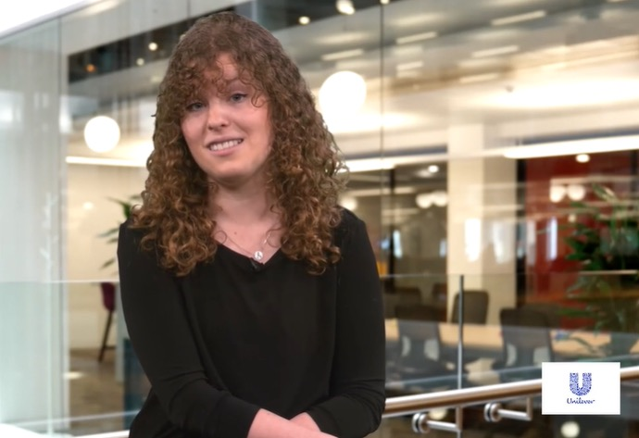
Meet another of today’s role models
Lucinda Jones Digital Manager (Sustainable Sourcing) Unilever
#TechWeCan | Tech for the Planet
Notes:
We are now going to meet our second Tech for the planet role model. We are going to hear from Lucinda who works in a tech for the planet role for a large company called Unilever.
Katie spoke to Lucinda to find out more about her job, and what she enjoys about it. Let’s have a listen to what she said …
PLAY VIDEO (picture hyperlinked) from 17:05– 21.18
Lucinda followed her passions of sustainability and technology and it's clear from the video that she really enjoys her job. All of the technology we have spoken about today would not be possible without the brilliant people working in those areas designing, creating and using the tech to protect our planet. We are now going to have a look at some of the roles and jobs available in this area.

Slide 15
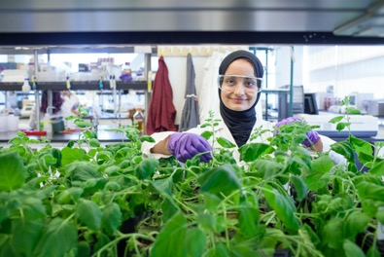
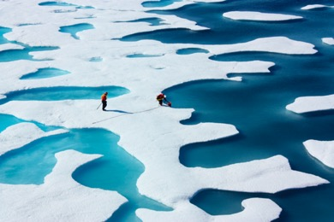
Careers in tech for the planet
Ecologist
Climatologist
As an ecologist, you could survey environments and ecosystems to learn about the different plants and animals who live there. You could use and develop technology to help you to understand and monitor the environment.
As a climatologist, you could design and use technology to help you study our atmosphere and weather patterns. You would also analyse and interpret past and present weather and climate data to help us to better understand the effects of our actions on the climate.
#TechWeCan | Tech for the Planet
Notes:
If using and creating tech to protect animals sounded interesting to you, you could be an ecologist. Ecologists are specialist scientists who survey environments and ecosystems to assess the behaviour, quantity and diversity of the different plants and animals who live there. Ecologists develop and use a variety of technology to help them better understand and monitor the environment.
Or you might like to be a Climatologist. Your job would involve designing and using technology to help you to study our atmosphere and weather patterns. You would analyse and interpret data about the weather and climate from the past and present so we have a better understanding of how our actions are affecting the climate.

Slide 16
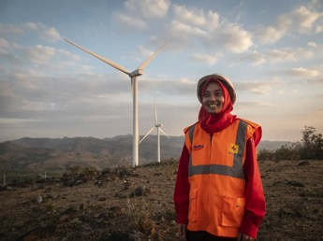
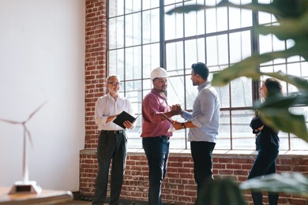
Careers in tech for the planet
Renewable Energy Engineer
Environmental Engineer
As a Renewable Energy Engineer, you could work to design, develop and build ways of producing energy without releasing lots of carbon dioxide into the atmosphere.
As an environmental engineer, you could help to develop solutions to environmental problems using engineering, soil science, biology and chemistry skills. You could help to improve things like recycling, waste disposal, water and air pollution.
#TechWeCan | Tech for the Planet
Notes:
If you are interested in helping to protect our planet, you might like to be a Renewable Energy Engineer. In this role, you would work to design, develop and build ways of producing energy without releasing lots of co2 into the atmosphere.
Perhaps you could be an Environmental Engineer. They use engineering, soil science, biology and chemistry skills to develop solutions to environmental problems. They work to improve things like recycling, waste disposal, water and air pollution.
So as we have learnt today, there are lots of people using technology in many different ways to try to help us to look after the atmosphere, oceans and animals, and to live in a more environmentally friendly and sustainable way. In the future, there will be lots of jobs in this area as there are so many important challenges to be worked on to protect our planet. Maybe you could work in a job where you help to make the world a better place?

Slide 17
Your challenge
Find the answer to at least one of the following questions, then find an interesting way to present your findings.
Please ask your parents or teachers to share your work on social media using #TechWeCan or email us at info@techshecan.org
#TechWeCan | Tech for the Planet
Notes:
Now it’s time for your Tech for the Planet Challenge!
We would like you to find out the answer to at least one of the following questions, and then find an interesting way to present what you have found out.
You could use the computer and create a powerpoint to present your findings, or you could use pencils and paper to create a poster – you can present it however you’d like to.
We absolutely love to see your Tech We Can challenges and if you would like us to give you feedback on your work then please email it to us or ask your parents to share it on social media using the #TechWeCan.
I can't wait to see what you find out, and how you choose to present your work.

Slide 18
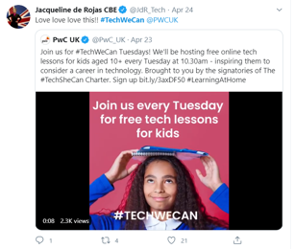
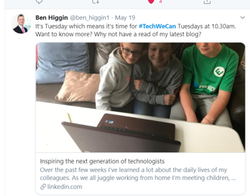
“Our Tech We Can lesson plans are part of our commitment to upskill the communities we’re part of - without urgent attention, many risk getting left behind as technology changes how we live and work. The current crisis we face has provided a stark reminder of the critical value of skills in science and technology.”
Sheridan Ash, co-CEO of Tech She Can
For more information about Tech She Can and free access to all of the Tech We Can resources we have spoke about today, please visit: https://www.techshecan.org/
Follow the hashtags #TechSheCan and #TechWeCan to stay up to date with us on social media.

