Slide 1
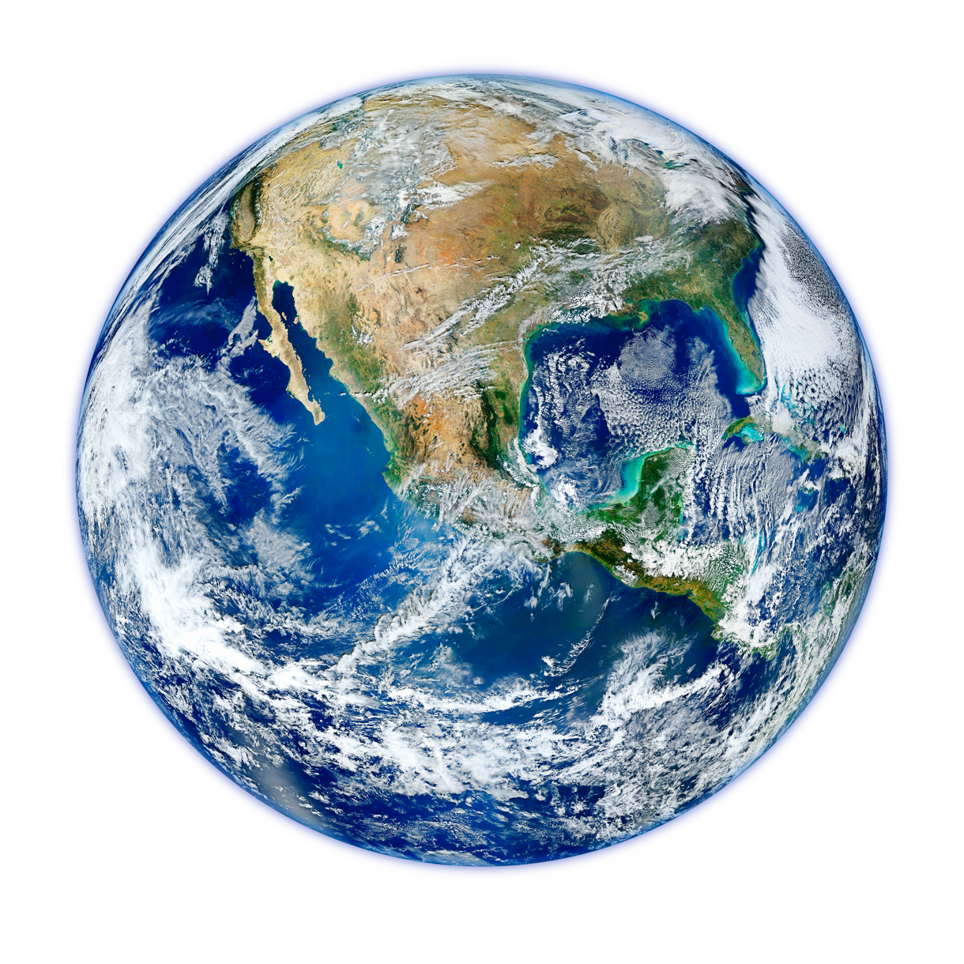
Tech for the Planet
AFTER SCHOOL
CLUB
Learn about some of the amazing ways in which technology is helping to keep our planet safe for the future, and find out about jobs in this area.
In this lesson you will:
Learn about why we need to develop tech to protect our planet.
Find out how tech is being used to protect the oceans, animals and air
Discover how tech is being used to help us to reduce and recycle waste.
Explore a variety of careers involving designing, creating and using tech to protect the planet.
1. Watch
2. Task
3. Tech Extras
Watch a fun lesson including a short animation.
Lesson: Tech for the Planet (24 mins)
Animation (featured in the lesson, link incase you’d like to watch again): Katie and Tex explore drones (5 mins)
Have a go at one of these fun tasks.
Tech for the Planet Challenge: Research how tech is being used to help protect animals
Complete the task set in Katie and Tex explore drones. Design a drone that could help someone in their daily life. Remember to label it to explain what it would do to help and how it would work. Supporting info can be found here.
Explore these online games:
CBBC Plastic Planet Marine Rescue Game
Blue Peter Environmental Quizzes and Games
Online Environmental Games
Feedback: Complete the form before and after the task to see how the children’s understanding changes.
Children’s University Code: green7699

