Slide 1
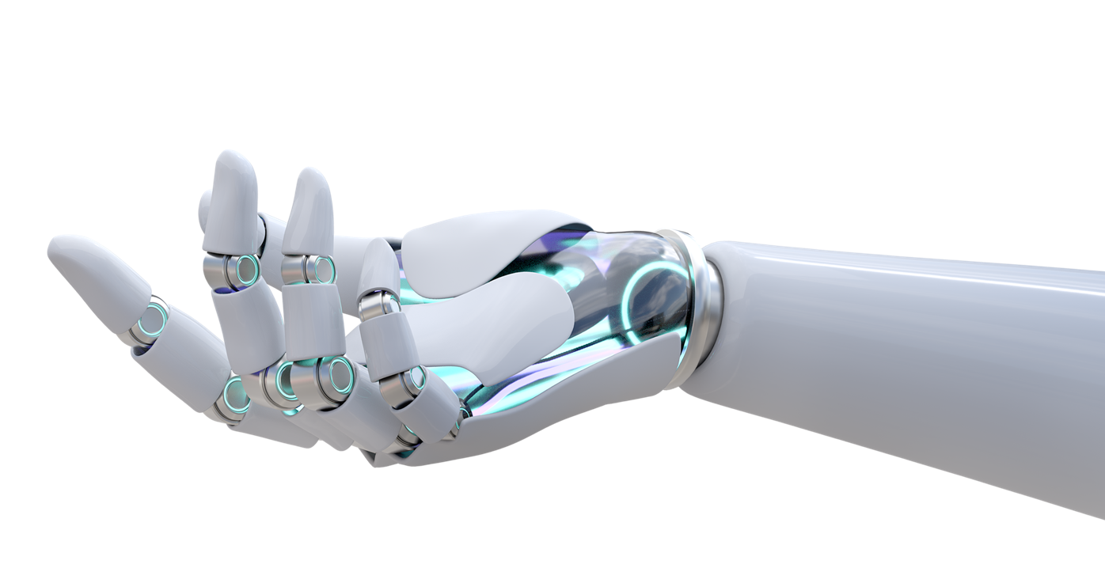
Tech for Helping People
AFTER SCHOOL
CLUB
Discover some of the different ways in which technology is being used to help people and learn about different jobs working in this area.
In this lesson you will:
Learn about how the emergency services are using robotics, AR and jet powered devices to help people.
Explore how smart devices and robotics are being used in healthcare.
Learn how assistive and adaptive technologies are helping people with disabilities and the elderly.
Discover of a variety of future careers in these areas.
1. Watch
2. Task
3. Tech Extras
Watch a fun lesson including a short animation.
Lesson: Tech for Helping People (20 mins)
Animation (featured in the lesson, link incase you’d like to watch again): Katie and Tex explore robotics and AI (4 mins)
Build, draw or model a robot which could be used to help someone in some way.
Supporting info available here.
Check out this fun online resource:
Build your own robot: Build a Bot
Feedback: Complete the form before and after the task to see how the children’s understanding changes.

