Slide 1
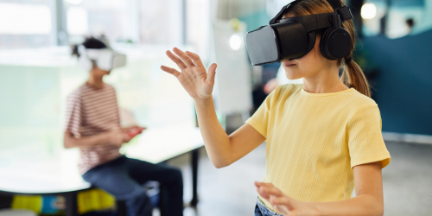
Tech for Fun
AFTER SCHOOL
CLUB
Learn about how technology is used to design and create toys that are fun and exciting to play with and discover amazing jobs including toy designer and animatronics engineer!
In this lesson you will:
Learn about different types of technology used within toys including animatronics, coding and AR.
Explore how tech is being used to create educational toys.
Find out how techy toys are being used to help others.
Hear from our role model Nadia about codeable and wearable toys created by imagiLabs
Discover of a variety of careers in this area.
1. Watch
2. Task
3. Tech Extras
Watch a fun lesson and a short animation.
Lesson: Tech for Toys (14 mins)
Animation: Katie and Tex explore virtual reality (3 mins)
Have a go at one of these creative tasks.
Tech for Toys Challenge: Design a new tech toy
Twinkl Worksheet: Design a VR game
Download an app or try the online game.
ARVid: Explore augmented reality
Quiver: Bring drawings to life in 3D
Explore STEAM skills with the Science Museum’s Total Darkness game (approx. 20 mins to complete)
Feedback: Complete the form before and after the task to see how the children’s understanding changes.
Children’s University Code: red3536

