Slide 1

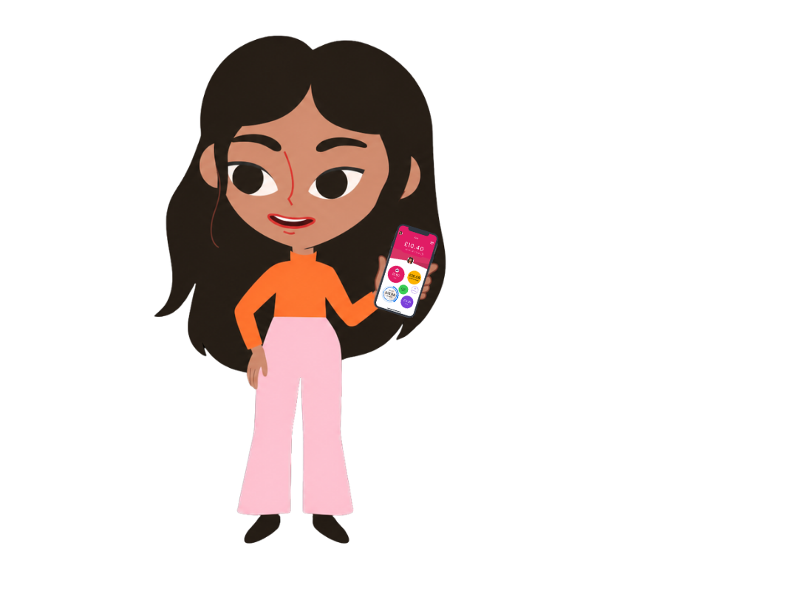
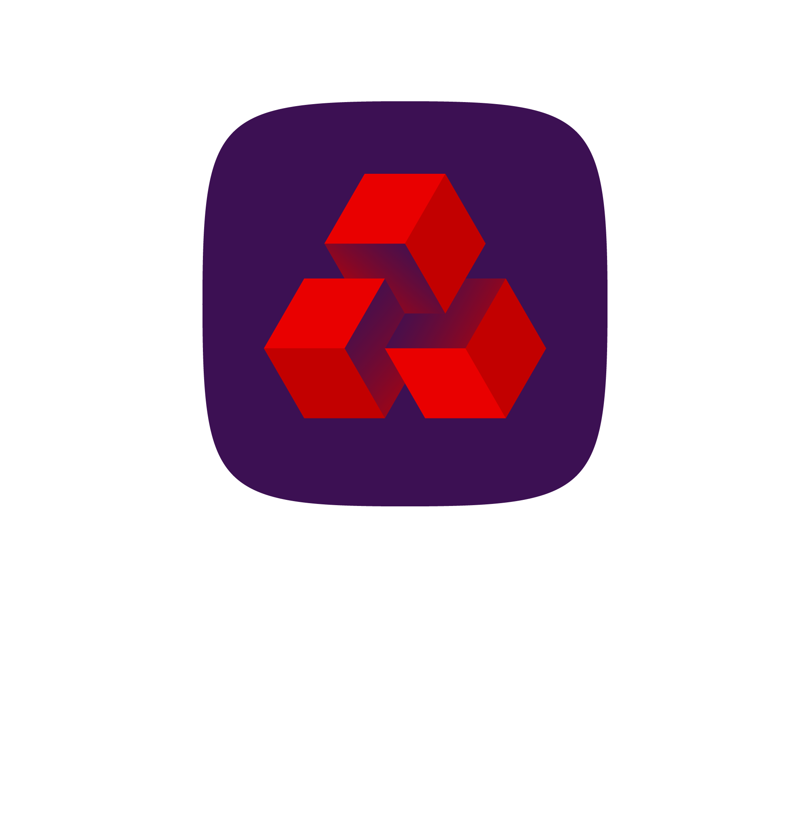
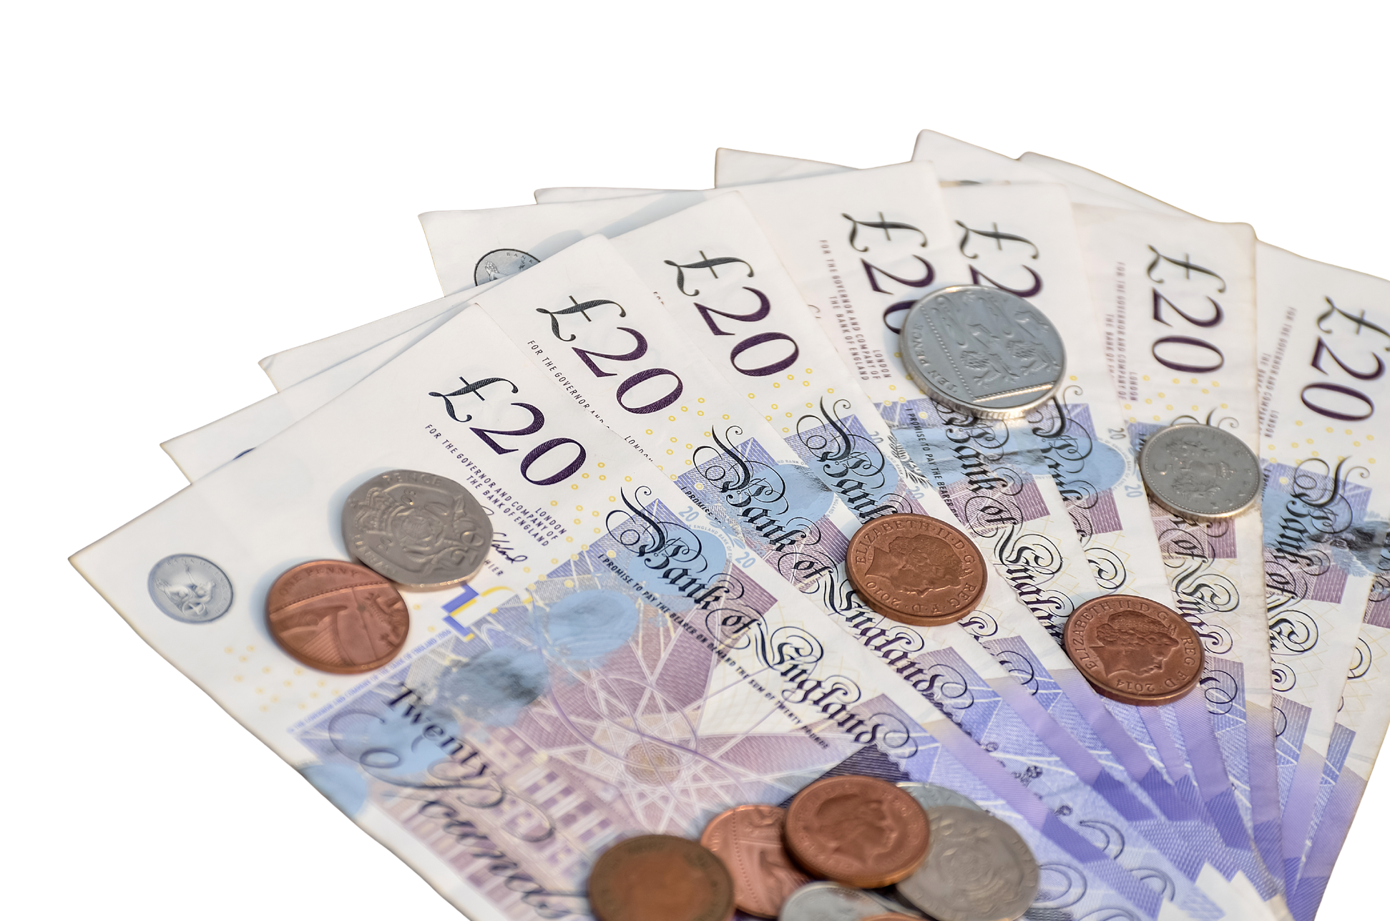
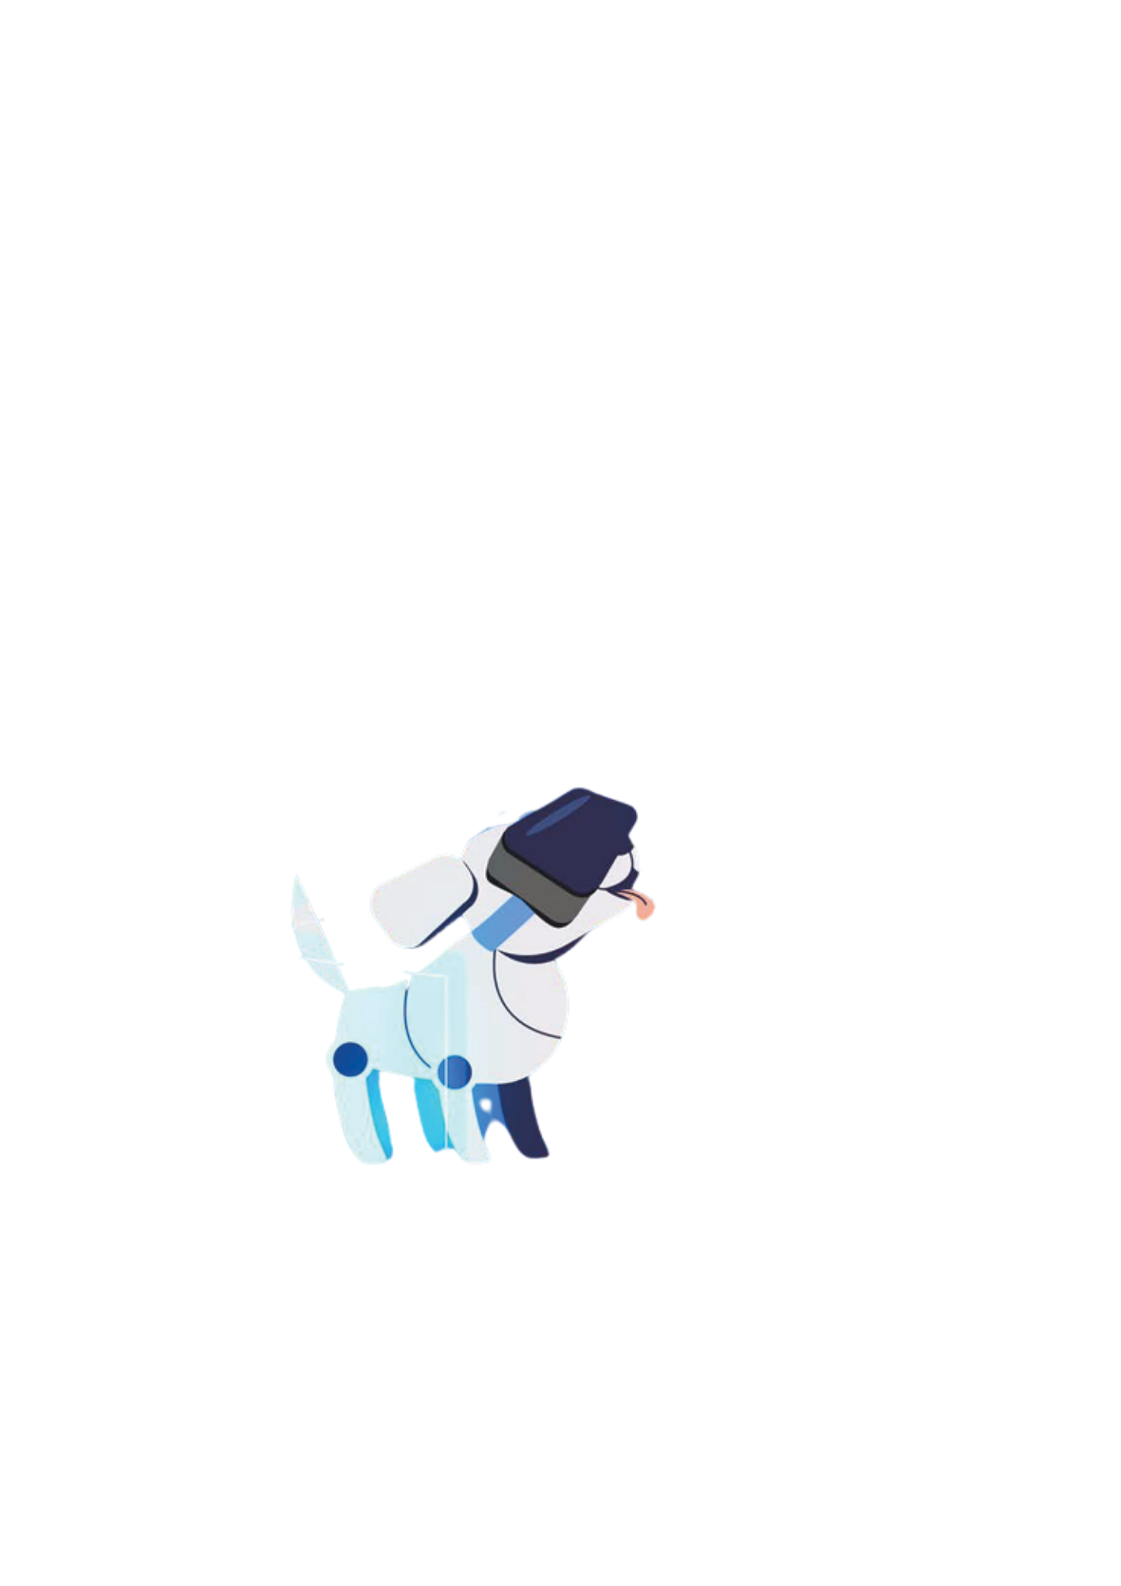
In partnership with:
Thanks for joining us for
Tech for Money
techshecan.org
@Tech_She_Can
#TechSheCan
Registered charity number: 1195284
© Tech She Can 2025
Notes:
Introduce yourself, your role and the organisation you are from.
Today’s Tech We Can lesson is all about how technology is used for money! We will also be exploring some interesting jobs which you could do when you’re an adult.
We have created today’s lesson in collaboration with NatWest Rooster Money, who want to help children just like you, to learn more about money, how it works and how to look after it.
If you or your organisation work with tech for money, it would be great to mention this here too.

Slide 2
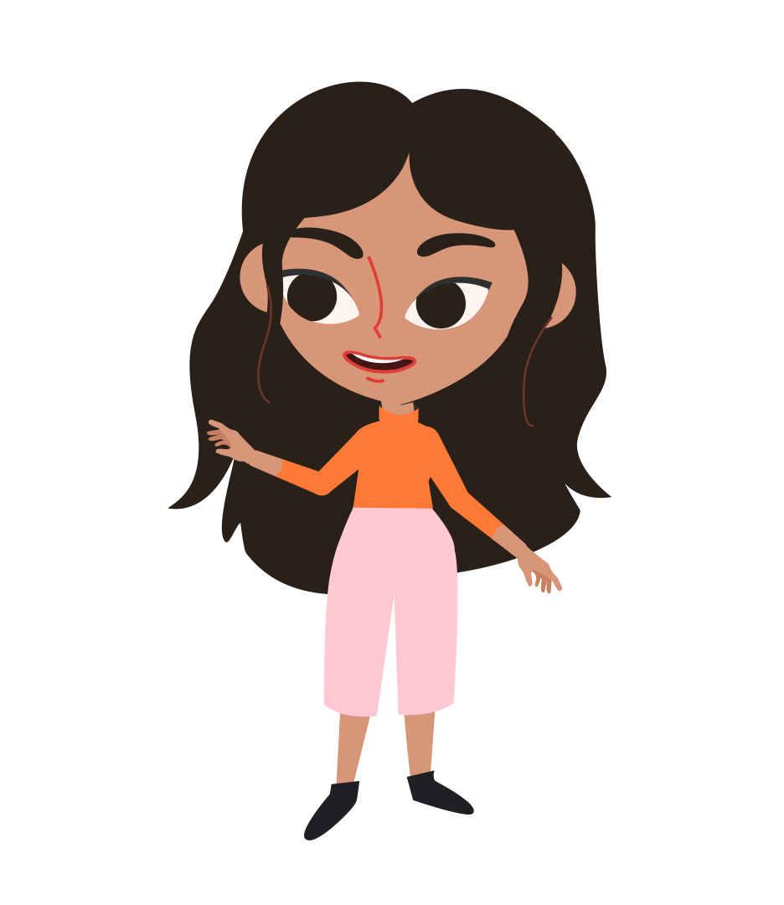
What is Technology?
Tex
Technology is the use of science and knowledge to solve problems or invent useful tools.
Katie
Notes:
So what do we mean by technology? Well there are lots of different definitions of technology, but I think this one explains it well:
‘Technology is the use of science and knowledge to solve problems or invent useful tools.’
Technology is changing very quickly, with new tech being invented all of the time. Many of the jobs you will do when you are adults don’t exist yet. Tech is being developed to help us across different areas of our lives. New technology is being invented all of the time. The future of tech will be shaped by some of you.
Take Tex here! Tex is an advanced and very clever robotic dog created by Katie as a research experiment. He's programmed to know lots of facts and to help Katie around the lab.
Katie is a research scientist who loves learning about technology. Together, Katie and Tex are going to help us through this lesson and learn with us about money and technology.

Slide 3

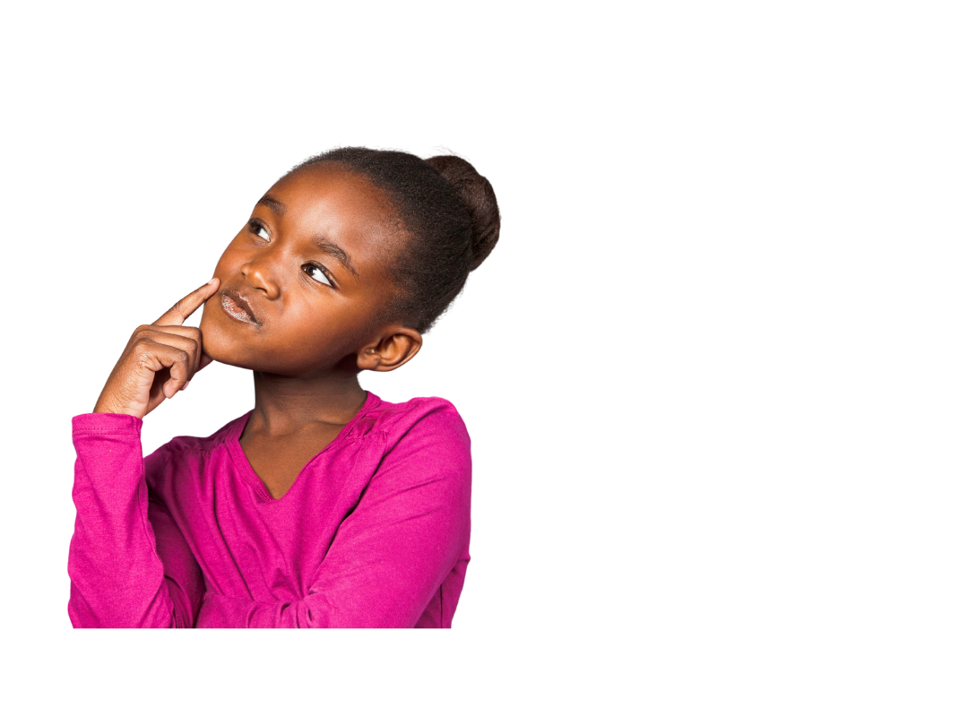
Have you ever thought about what you would like to do for a job when you are an adult?
Would you like a future job working with technology?
Notes:
Before we start learning about tech for money today, I’ve got a couple of questions for you to think about. ​
​
Have you ever thought about what you would like to do for a job in the future?
CLICK
Put your hands up if you would like a future job that involves working with technology?​ (You can ask the teacher to take a picture of the backs of the students' heads here if you'd like to, or ask the teacher to do a quick count and note the number down)
​
By the end of today’s lesson, hopefully a few more of you will think that technology jobs that link to tech for money sound quite interesting.

Slide 4
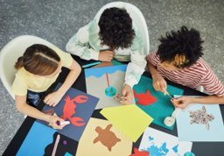
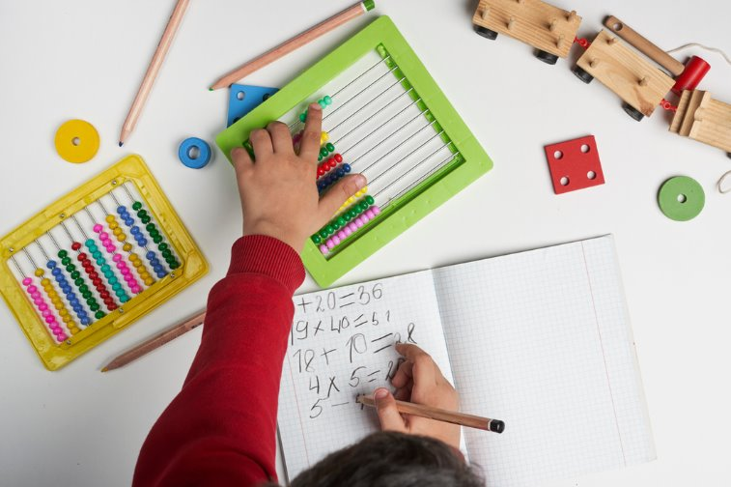
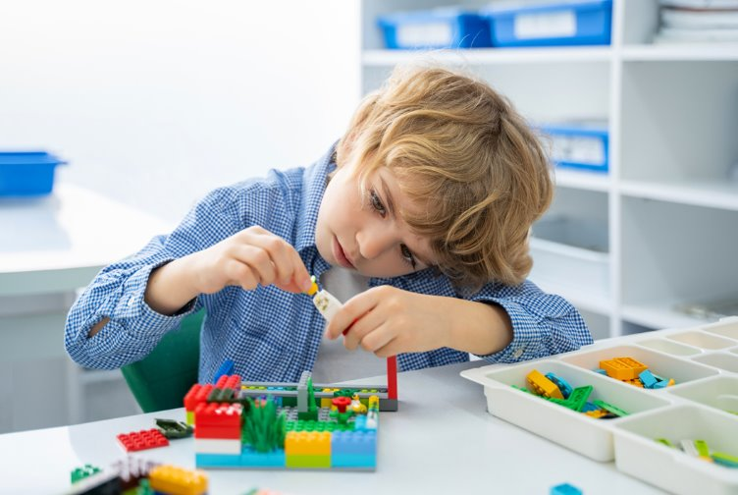
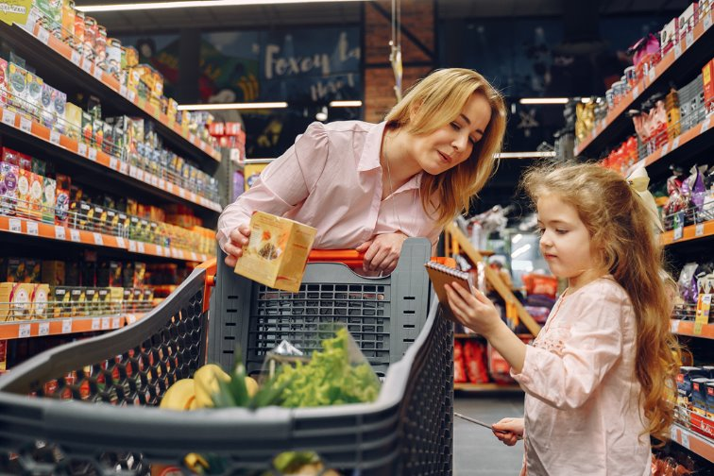
Do you know how your hobbies and interests are related to jobs in technology?
Notes:
On the slide are some pictures which show some hobbies and interests which you might have. ​
​
Can you put your hand up for me if you like… ​
Art and designing things? Ah I can see a lot of creative people today! Great, hands down.
Exploring numbers and using numbers and calculations? Amazing, lots of people who like to work with numbers! Hands down again please.
How about building and creating things? Maybe you like Lego or junk modelling? Fantastic, hands down.
And finally, how about shopping and visiting different shops? Great, shopping can be lots of fun! Hands down now everyone.
If you would like to, here is a good place to tell the children a little bit more about you and share some of your hobbies/interests
If you mention gaming and talk about any specific games, please only mention games which are age appropriate for the students.
Today I want to show you that there are lots of different technology jobs which involve different interests and hobbies you might have. Maybe one of these will sound interesting for you to have when you’re older!

Slide 5
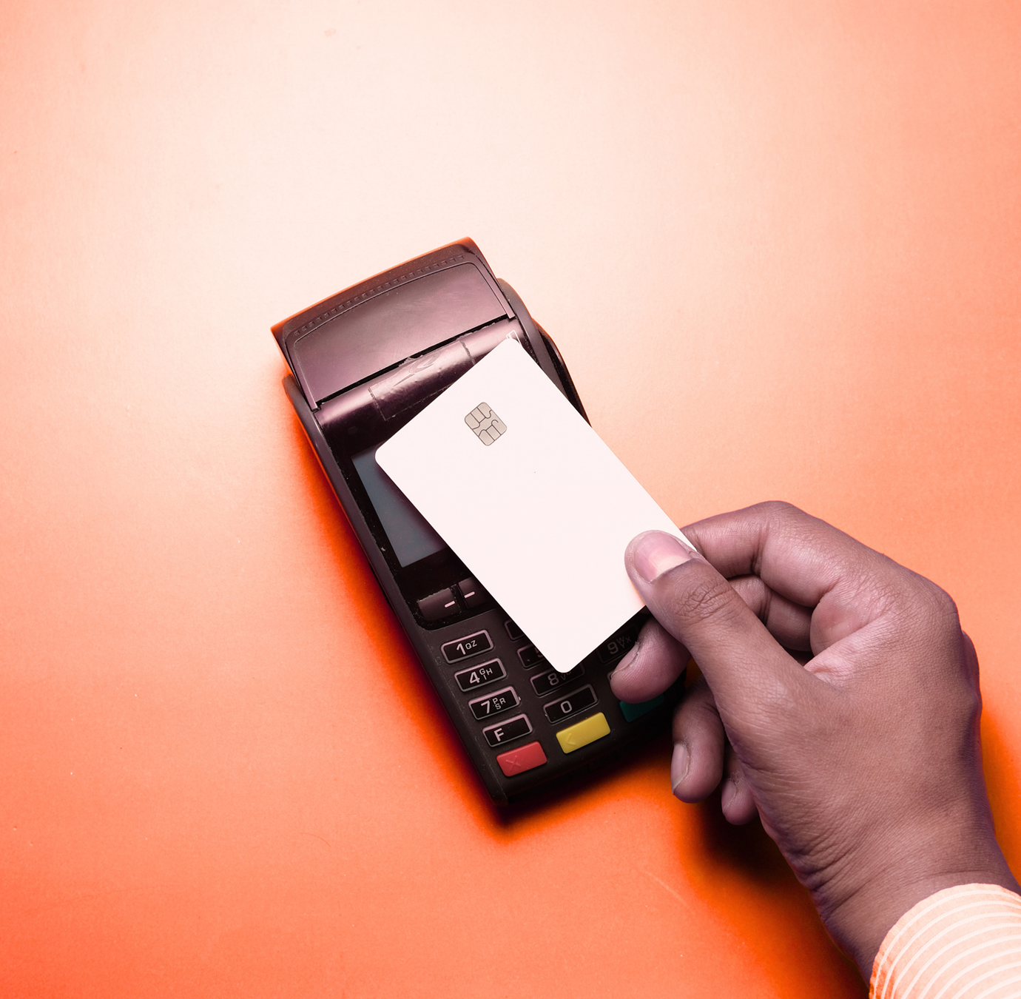
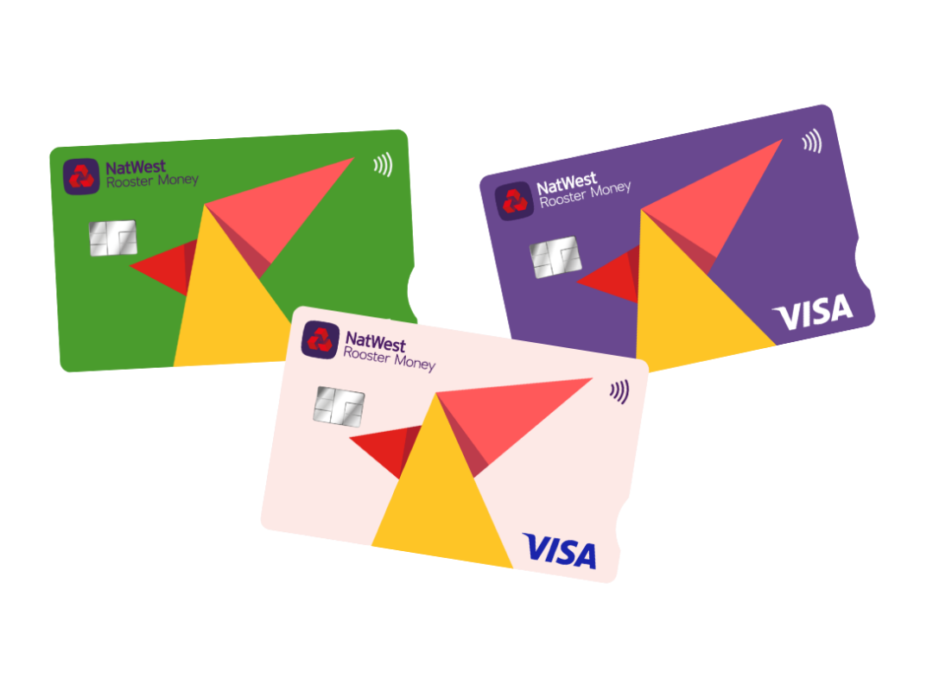
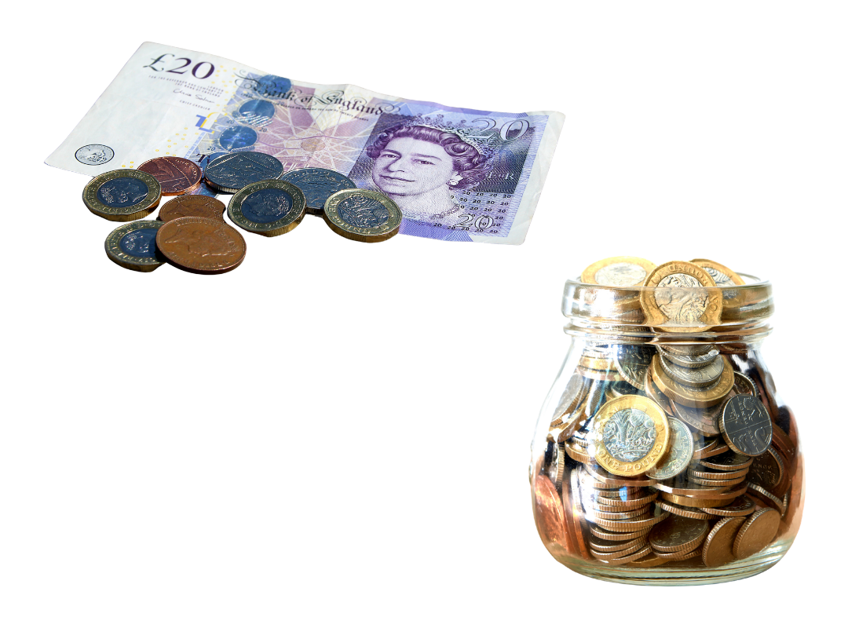
What is money?
We use money to trade for something we want.
Physical: we can touch it - coins or notes
Digital: we cannot touch it - saved on computers
Notes:
We have all seen money and may have seen different types if you have visited different countries.
Money has a value - which means it is worth something. We use it to trade or swap for something we want
We can use money to pay for things – we’ll find out more about that in a minute.
CLICK Money can be Physical. This means we can touch it, like coins and notes.
CLICK Or it can be Digital. This means we cannot touch it, because it only exists on computers. You can still use it though, for example by using a card or your phone to pay for things

Slide 6
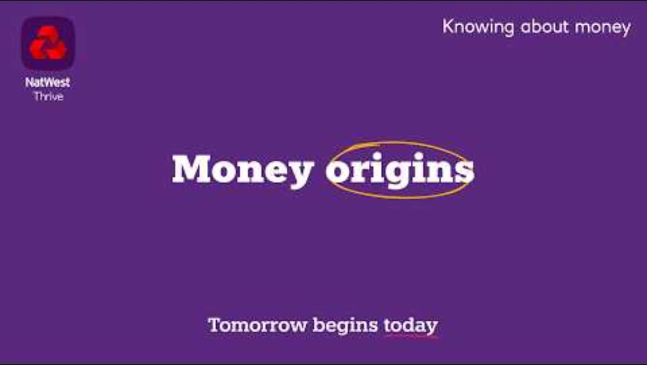
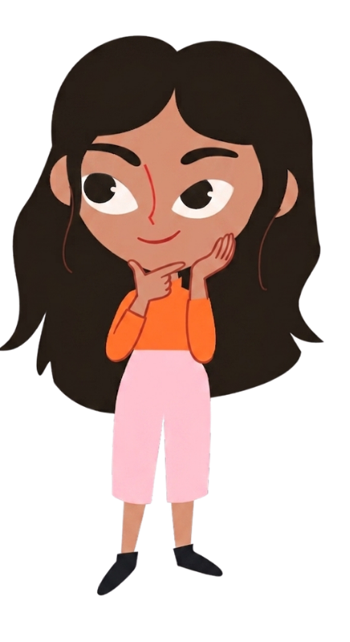
History of money
Why are people using fewer coins and notes, and more cards or contactless payments?
Notes:
Now that we know what money is, let’s travel back in time to see how it started and watch this short video!
Click to play video - 2.38 mins
https://youtu.be/eDIQDLNdhaM?si=Z4qCdUVw513LBMxk
Money has come a long way from trading cows
CLICK Katie is wondering “Why are people are using fewer coins and notes, and more cards or contactless payments?” I’m going to give you 30 seconds to chat about this with the person next to you. Off you go!
Pause for 30 seconds
I bet you had some interesting discussions there. So why do you think people are using fewer coins and notes now? Well, one reason is we don’t want to carry around money all the time. Using technology like our phones or a card is easier and we carry it with us most of the time anyway!

Slide 7
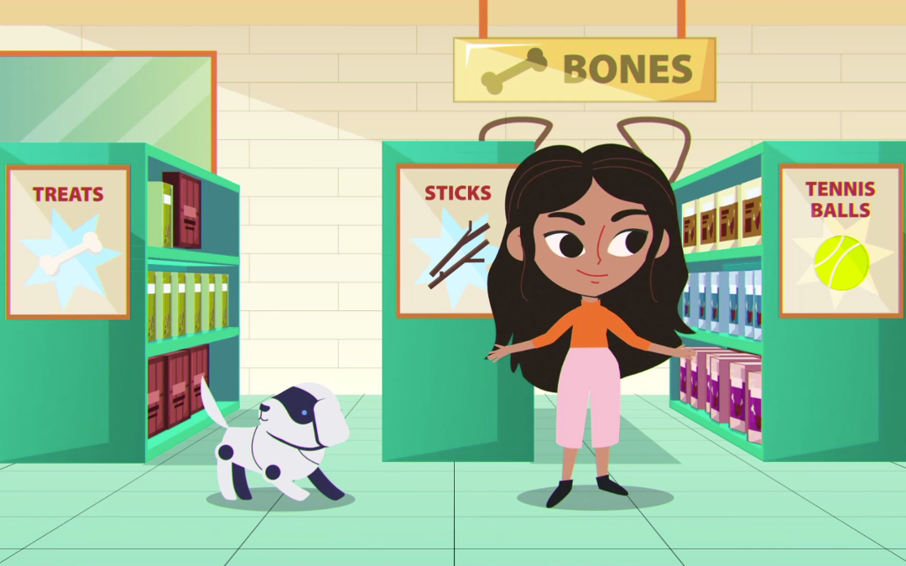
Why do we need money?
To pay for goods (physical things we can touch)
To pay for services (when someone does something for us)
For things we need to keep us safe and healthy
For things we want
If you had £5 today, name one need and one want you might have.
Notes:
So, we’ve learned what money is and where it came from, but why do we actually need it? Why can't everything just be free?
Click - Every day, we need to use money to buy 'Goods’ – these are physical things we can touch, like food, Tex’s bones or our clothes.
Click - We also use it for 'Services' like paying a hairdresser to cut our hair.
Money acts as a fair way to make sure everyone gets paid for the work they do or the things they sell.
Click - Most importantly we need money to pay for the things that we need that keep us safe and healthy. This includes our homes by paying rent or mortgages, the electricity that powers our lights and our food and water.
Click - Finally, money can help us buy the things we want. If we have a little bit left over after buying what we need, we can use that money to get something special – perhaps a new toy or game.
Click – If you had £5 today, can you think of one NEED and one WANT you might have? In a moment, turn to the person next to you and see if you can name one want and one need. I’ll give you 30 seconds to talk about this. Off you go.
Give students 30 seconds to a minute (no more to keep to time) to talk to their partners. (Great opportunity to walk around and hear students ideas as they discuss)
After time is up: I am sure you all thought carefully there and came up with your own needs and wants for spending your money. They are probably different to your friends! (This is a partner discussion task, so doesn’t need students to give you an answer at the end, however if your class is very engaged you may want to take a couple of ideas here.)

Slide 8
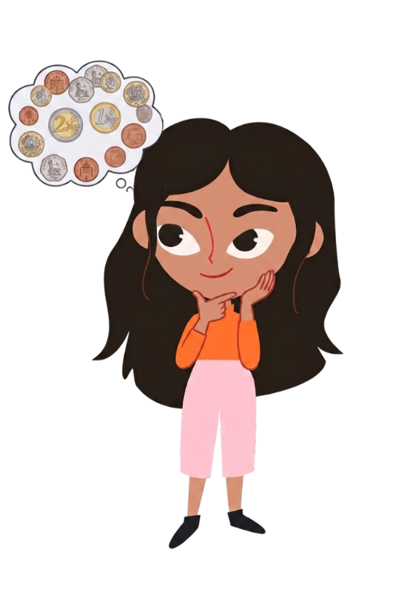
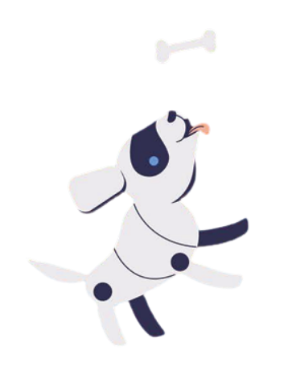
What would you like to save up for?
Notes:
When we save money, often when we’re younger it is for something we want, like a new toy or game. But sometimes, especially when you’re a grown up, you might save for something you need, like having spare money for emergencies or moving house.
Katie is thinking about her money and what she would like to save up for.
What about you? What would you save up for?
Turn to the person next to you and tell them one thing you would like to save up for?
Give students 30 seconds (no more to keep to time) to talk to their partners. (Great opportunity to walk around and hear students ideas as they discuss)
I am sure you all had some great things you would save up for. (This is a partner discussion task, so doesn’t need students to give you an answer at the end, however if your class is very engaged you may want to take a couple of ideas here.)
Click - Katie has decided to save up for a bone for Tex. Tex will be pleased!

Slide 9
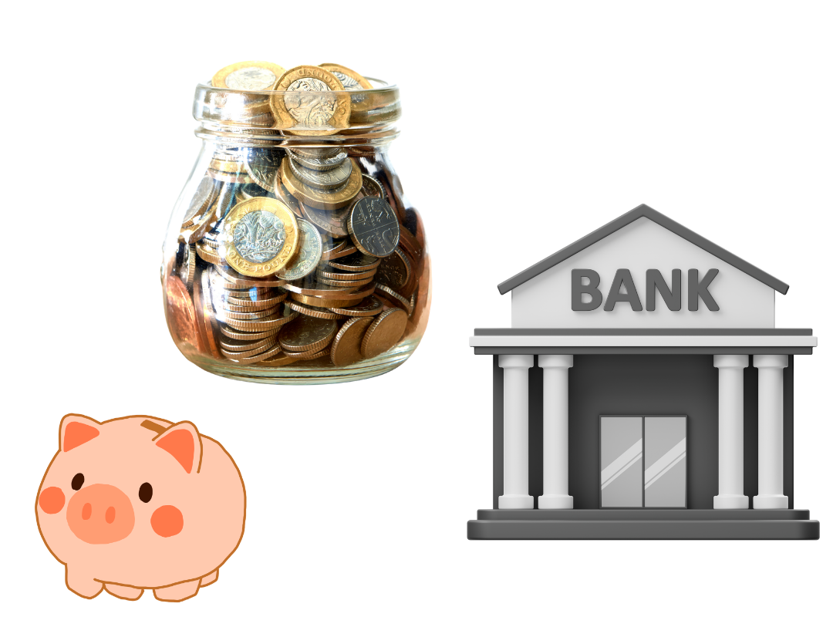
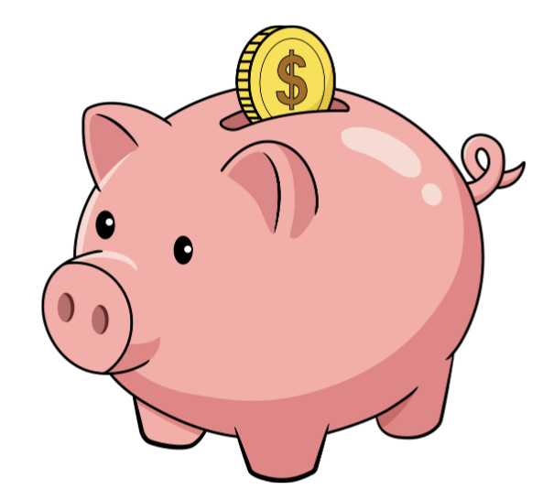
What is a bank?
Somewhere safe to keep your money safe
Notes:
Now that we know Katie wants to save up for a new bone for Tex, she needs somewhere to keep her money.
Click - She could keep her money in a jar or CLICK piggy bank in her kitchen
Click - Or she could use a bank. A bank is like a high-tech fortress for your money. People who work there keep track of every penny so it's always safe and there when you need it.
You all thought of something you wanted to save up for, where would you keep your money?
Let’s have a think together about this.

Slide 10
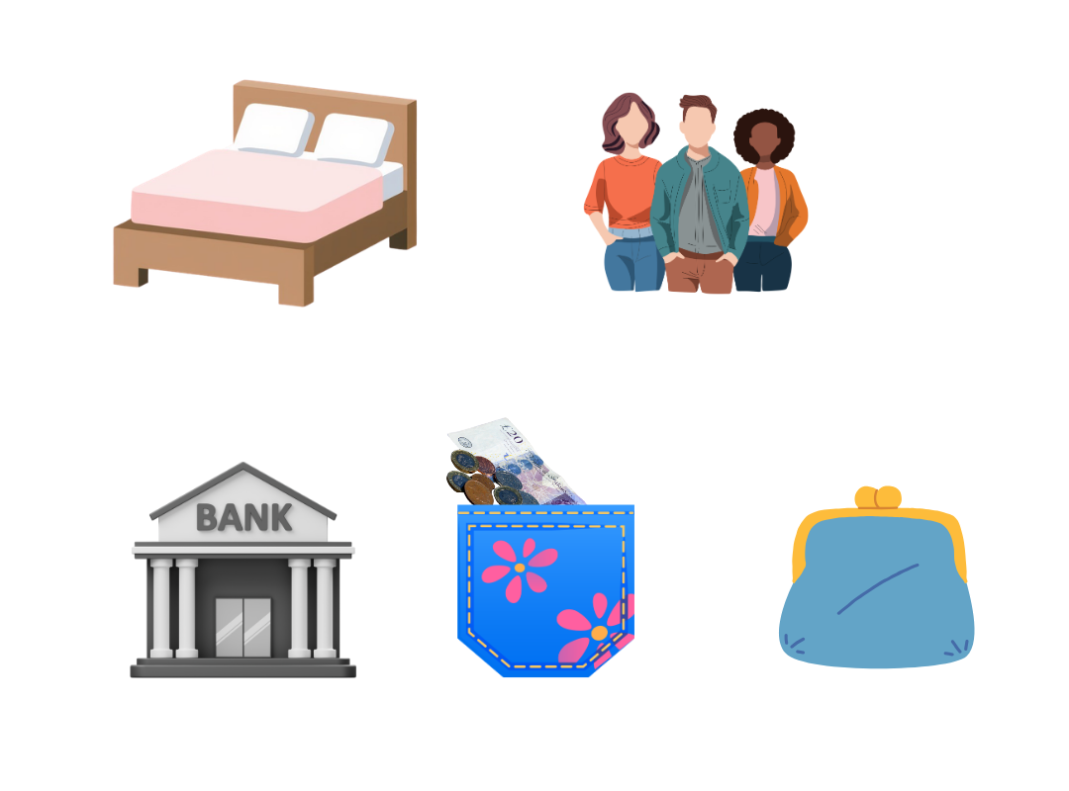
Keeping money safe
Where should Katie keep her £10.40 safe?
Notes:
Katie has started to save money to buy Tex the new bone and maybe some new toys too. She has got £10.40 saved and now needs to think about where to keep it and make sure it is somewhere safe.
Katie has had a think and come up with 6 possible places
click - under her bed
click - give it to an adult she trusts
click - in a bank
click - in her pocket
click - in a piggy bank
click - in a jar
Which place is best for Katie to keep her money safe? I’m going to give you about 30 seconds to turn to the person next to you and discuss which you think is best. Off you go!
Give students 30 seconds (no more to keep to time) to talk to their partners. (Great opportunity to walk around and hear students ideas as they discuss)
Okay time to stop talking now. I’m sure you had some great ideas there about the safest places to keep Katie’s money.
You could take a show of hands here for each place and see which is the most popular choice from the students.
I imagine lots of you at home have a piggy bank or money box – that can be a great place to keep smaller amounts of money safe. Some of you might have said with your trusted adult – absolutely! They can keep cash or cards safe if you need them to. I wonder which places you decided we NOT safe? I know if I kept my money under the bed I would probably vacuum it up or forget it was there! And I never keep money in my pockets, as I worry it will fall out. Did any of you say the bank? Banks are super safe as they use lots of technology to keep your money super safe. We’ll find out more about this today.

Slide 11
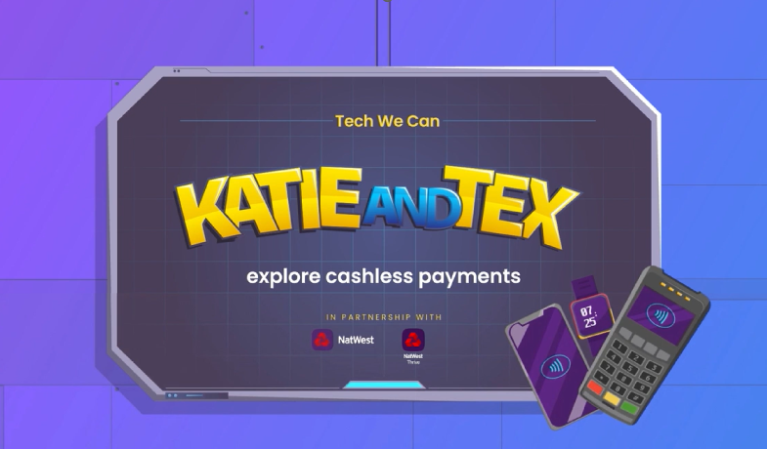
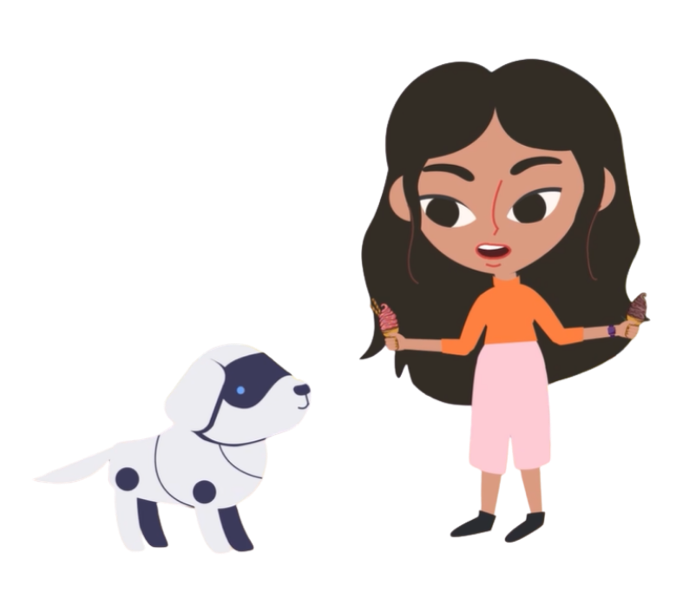
Katie and Tex explore cashless payments
While you are watching, decide if the following statements are TRUE (T) or FALSE (F): ​
A digital wallet is when you link a device like a phone or watch to your card to pay for things.
If someone steals your card, they could spend as much of your money as they want.
Anyone could use your phone to spend your money.
Notes:
Katie has very sensibly decided to keep her money with the bank. But she doesn’t want to have to walk to her bank and get out a load of coins and notes out every time she wants to buy something!
So how else could she get her money to pay for things?
We’re going to find out more about that from our animation shortly.
But before we watch it, take a look at these statements on the screen. While you watch, if you listen carefully, you will find out if they are true or false. Let’s read them together now (read statements from the screen)

Slide 12

Katie and Tex explore cashless payments
Write the numbers 1, 2 and 3 down your page like this:
1)
2)
3)
Notes:
Before we start, write the numbers 1 to 3 on your paper, just like you can see on the screen now.
I’m going to give you a little bit of time to do this, off you go. Pause for 20 seconds to allow children to write the numbers down
Great!

Slide 13
Katie and Tex explore cashless payments
While you are watching, write TRUE (T) or FALSE (F) next to each number: ​
A digital wallet is when you link a device like a phone or watch to your card to pay for things.
If someone steals your card, they could spend as much of your money as they want.
Anyone could use your phone to spend your money.
1)
2)
3)
Notes:
Now, when you listen to the animation, all you need to do is write a T for ‘true’ or an ‘F’ for false next to the numbers! You don’t need to write the whole statement down, just the T or F.
Let’s quickly remind ourselves of those statements again: read from screen again
So, listen carefully and let’s find out more about cashless payments with Katie, Tex and Grace from NatWest Rooster Money!
Go to next slide to play video
If delivering virtually, mute mic and turn off camera for playing video.

Slide 14

Katie and Tex explore cashless payments
While you are watching, write TRUE (T) or FALSE (F) next to each number: ​
A digital wallet is when you link a device like a phone or watch to your card to pay for things.
If someone steals your card, they could spend as much of your money as they want.
Anyone could use your phone to spend your money.
1)
2)
3)
Notes:
If delivering virtually, mute mic and turn off camera for playing video.

Slide 15

What are cashless payments?
Using your card, phone or watch to pay for something instead of coins or notes!
A digital wallet is when you link a device like a phone or watch to your card to pay for things.
If someone steals your card, they could spend as much of your money as they want.
Anyone could use your phone to spend your money.
T
F
F
Notes:
Great listening everyone! So now we know, cashless payments are when you use your card, phone or watch to pay for something instead of coins or notes!
I wonder if you heard the answers to those statements? Let’s go through the answers together now.
When I read the statement out, if you thought it was true, show me your thumbs up, like this. If you think it was false, put your thumbs down, like this!
Are you ready?
A digital wallet is when you link a device like a phone or watch to your card to pay for things. CLICK I can see lots of thumbs up there – well done everyone this is true! It’s really easy to use our devices to spend our money now – look out for this next time you go to the shops!
If someone steals your card, they could spend as much of your money as they want. CLICK Great work – that’s right this is false. Remember – you should always keep your bank card safe, but if someone steals it, they can only spend a limited amount of money. And of course, you should tell someone as soon as you notice your card is missing so they can ‘freeze’ it which stops anyone using it straight away.
Anyone could use your phone to spend your money. Do you remember Tex trying to use Katie’s phone? He couldn’t because it didn’t recognise his face – so this one is CLICK False again. Things like facial recognition, finger print scanning and using a password all help stop your device being used by other people to spend your money.
Super work everyone – you obviously listened really well.

Slide 16

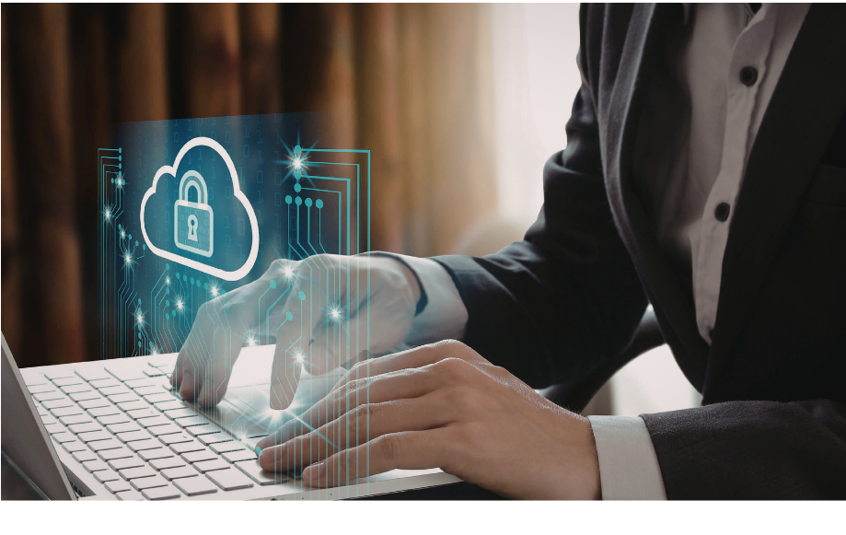
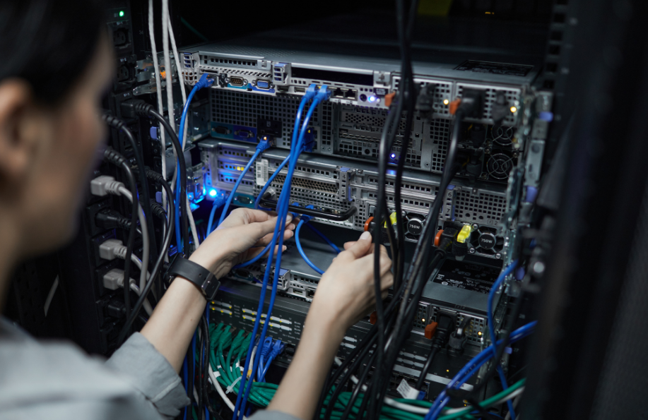
Careers in tech for money
Software Developer
Cyber security expert
Network Engineer
What they do: They write the code which is like the instructions, that tells the bank’s computers how to move money from one person or place to another.
What they do: They act like digital police officers stopping cyber attacks - keeping the bank’s computers, and your money, safe.
What they do: They help connect the bank’s computers to each other and to the internet so customers can use banking apps and websites.
Notes:
Lots of people, like Grace, have jobs helping to look after people’s money using technology.
So, if you like the idea of being someone who creates or works with the technology we use to manage our money, here are three careers that might interest you.
You could be a Software Developer - They write the code which is like the instructions, that tells the bank’s computers how to move money from one person or place to another.
Or if you like the idea of using tech to look after people’s money, you might like to be a Cyber security expert – They use technology to protect computers and bank accounts from people who might want to steal money or information. They find and fix security problems and act a bit like digital police, stopping cyber attacks and keeping the bank’s systems safe.
Lastly, as a Network Engineer, you would make sure all the bank’s computers can connect to each other and the internet so that they work together properly. This means customers can use things like banking apps and websites without problems.
Banking apps or mobile banking are really helpful for looking after our money. Let’s find out more about that now.

Slide 17
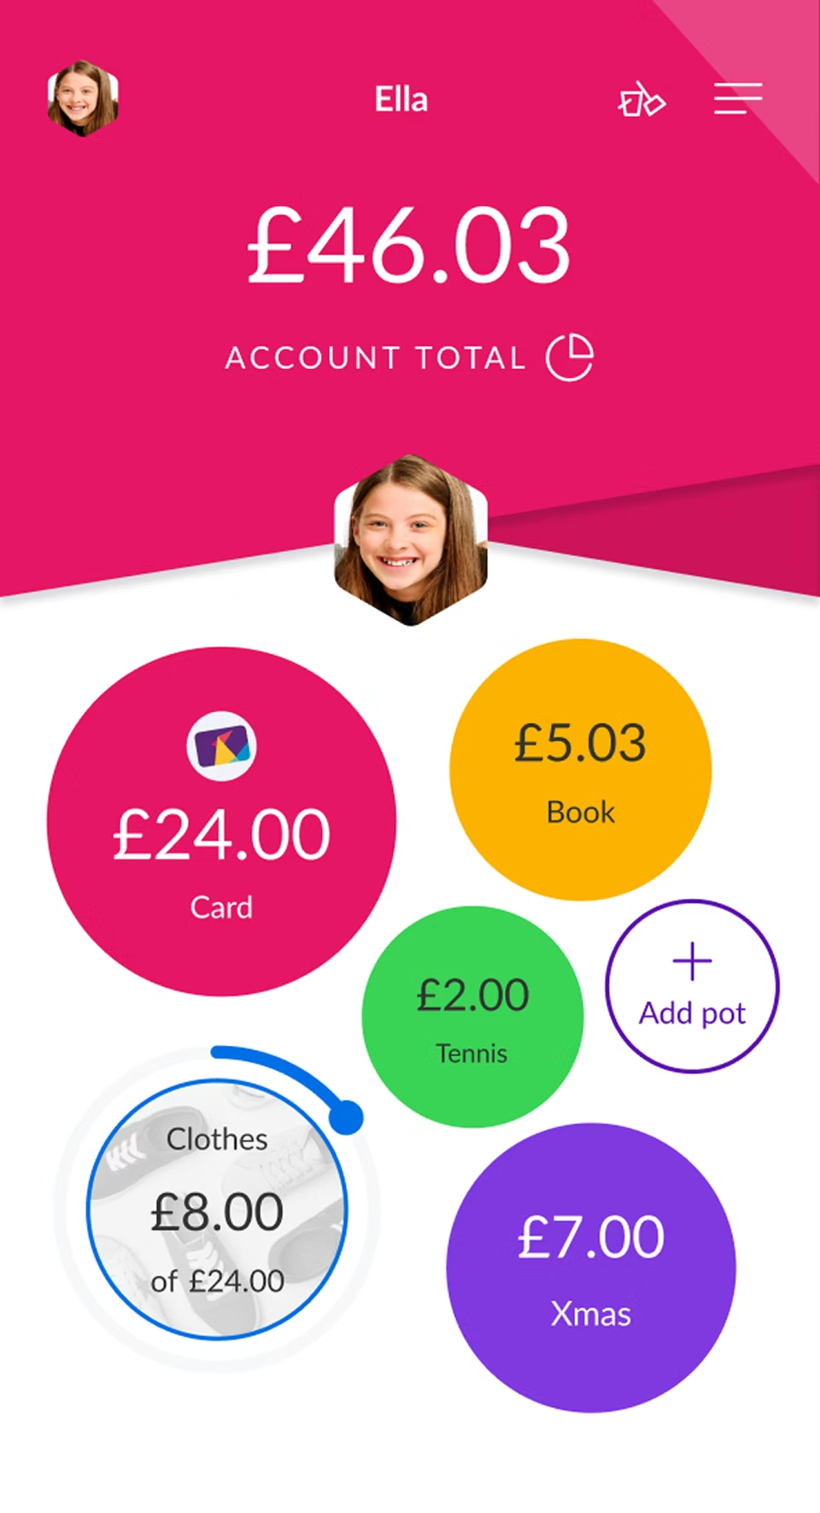
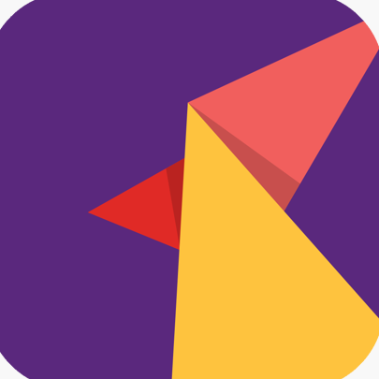
What is mobile banking?
It is like having the bank in your pocket
You can check it anytime and anywhere
You can pay for things and access your account fast and easy
It can be an app
Notes:
Now that Katie has her bank account, she wants to be able to keep an eye on how much money she has. So how will she do that?
Well, have you ever seen an adult checking their phone and saying 'I'm just doing some banking or checking my balance'? They aren't playing a game, they are using mobile banking!
Mobile banking is like having the bank in your pocket to get your money. You don't have to wait for the bank to open or stand in a queue. It's fast and easy, you can access it anytime and anywhere – all you have to do is tap the icon on the screen (like the square picture of the NatWest Rooster you can see here).
You do this through an app on your phone or online on a website. You have to have the correct login details and the bank must keep the app and website safe so only you can access it. We will look more at the safety side in a minute.

Slide 18
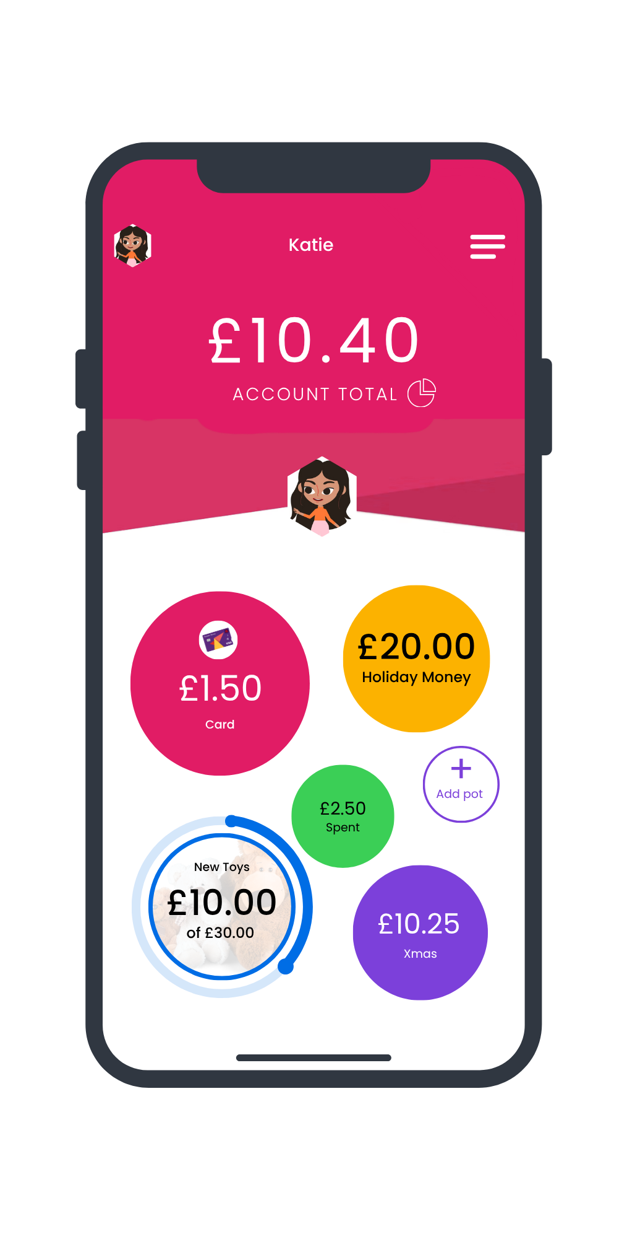
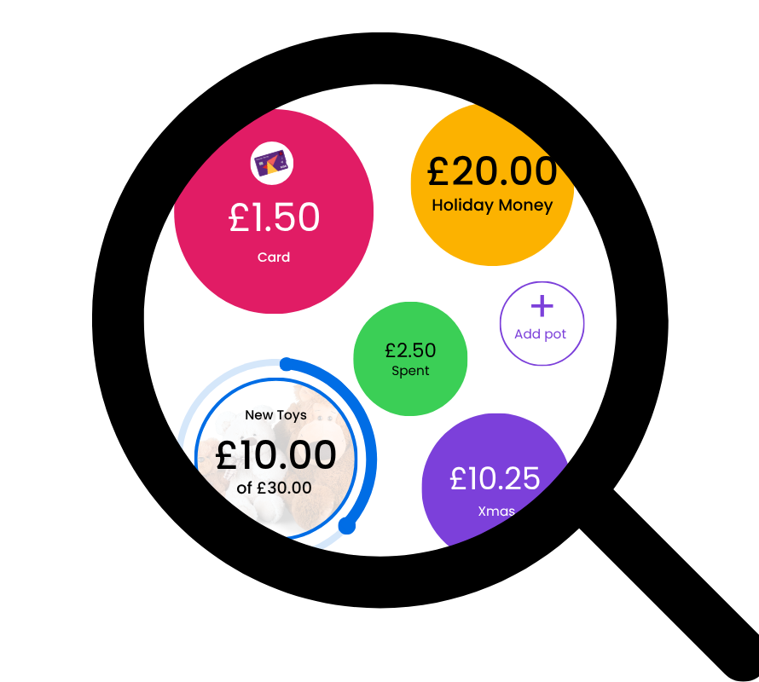
Katie’s new online account
Katie has a new online bank account
What is Katie’s account balance?
What is Katie saving for?
How much has Katie saved so far?
How much has Katie got left to save?
Notes:
Katie has a new NatWest Rooster Money account. With this account Katie gets a mobile banking app.
Katie has set this up to show the different things she is saving as well as keeping track of how much money Katie has, how much is spent and how much is saved. We’ve used a magnifying glass so you can see the screen a bit better.
The balance is how much money Katie has available to spend.
What is Katie’s account balance? Pause for a short time to allow students to work this out. Take ideas with hands up.
Yes, correct it is £10.40 - the main amount is displayed at the top
Each savings pot is separate to the main account balance and is used to save money for specific things. Each looks like a circle on the screen and holds different information.
Can you see what Katie is saving for?
Pause again to allow students to find the answer. Once again take suggestions from the students.
That’s right, Katie has a savings pots for new toys, Christmas and also a savings pot for holiday money.
Can you see what is different about Katie’s new toys savings pot?
Pause again to allow students to find the answer. Once again take suggestions from the students.
Well spotted, the pot says that Katie has saved £10 out of the £30 needed. There is a line round the edge to show how far away from the total she is.
And finally. can you tell Katie how much is left to be saved?
Pause again to allow students to find the answer. Once again take suggestions from the students.
Well done, Katie can now see that there is £20 left to save.
The saving pots are separate to the main account, so Katie has different pots of money!
If you had a mobile app for your money, what would you name one of your 'Savings Pots'?

Slide 19
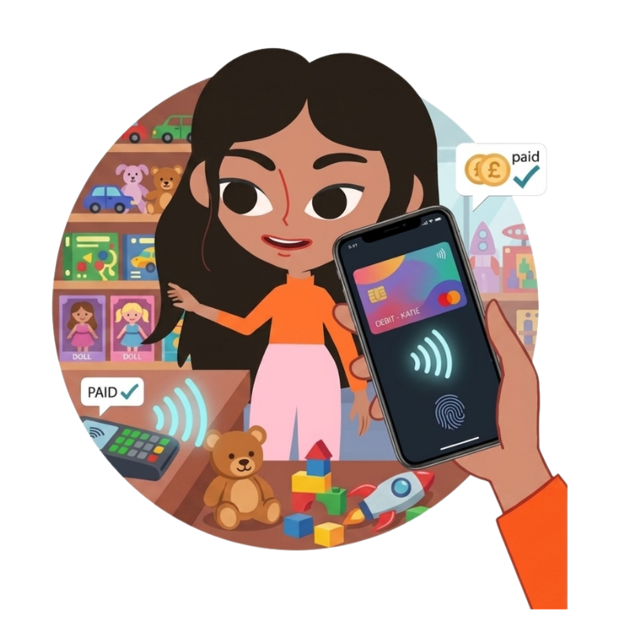
Managing money online
Katie can see everything she does on her online bank account
Keep track of money
Move and save money
Real time updates
Notes:
Now that we know what a bank is, how do we actually use it?
Like Katie, most people use an app on their phone.
The app is a bit like a 'Money Diary’. It tells you the date and time, the shop, and the exact amount you have spent. It will also tell you if money has been moved from one savings pot to another!
Real time updates means that when you use your card or a phone to pay, it is updated in your bank account automatically and really quickly, so that you can see the update on your app as well as how much money is left.

Slide 20
Careers in Tech for Money
UX designer
What they do: A UX designer is someone who designs the physical bank cards or the mobile banking app. They make it look amazing and easy to use!
​
The tech: Computers and design software
What do they do all day?
Researching
Designing
Experimenting with colours and fonts
Testing
Collaborating
Notes:
Ok, now it’s time to find out about another of the jobs that you could have when you’re older.
UX Designer stands for User Experience Designer. Their job is to make sure people can use everything in a mobile banking app easily. They don't just make things look pretty; they make sure the app is easy to use so you can find your way around, for example, making sure the right buttons are easy to find, how you see your savings, and how the screen looks, including the colours and shapes.
They may also design the physical card, choosing the colours and where the chip and numbers are placed so it looks great and people want to use it!

Slide 21
Passwords and safety
A secret sequence that should not be easy to guess
penzebraapple
carbreadhouse
texlovesbones
OR
colournotebookrocket
Which password is stronger for Katie to use?
Notes:
Because we can manage our money using apps on devices like mobile phones, it is really important to make sure that that access to these apps is safe and secure.
That means no one can access your online bank account without your permission.
When someone creates an account, they will have a username which is often an email address. Next, they’ll be asked to create a password.
A password is a secret that should not be easy to guess and should only be known by you and your trusted adult. It can be hard to set a password. One trick is to use three random words.
The words you choose shouldn’t have any information about you and shouldn’t normally go together.
Click: For example, penzebraapple or carbreadhouse
Click - Katie has started to think about which password she should use and has two options, Tex is asking which one is stronger for Katie to use? Is it texlovesbones or colournotebookrocket? I’m going to give you 30 seconds to talk to the person next to you and decide which one is best. Off you go.
Pause for 30 seconds for students to discuss. You could get students to vote for the password they thought was best and see if they can tell you why.
Okay time to stop talking now. Did you choose the second one? Well, you are right, ‘colournotebookrocket’ is stronger as it has three random words which aren’t connected and don’t have any information about Katie or her friend Tex.

Slide 22
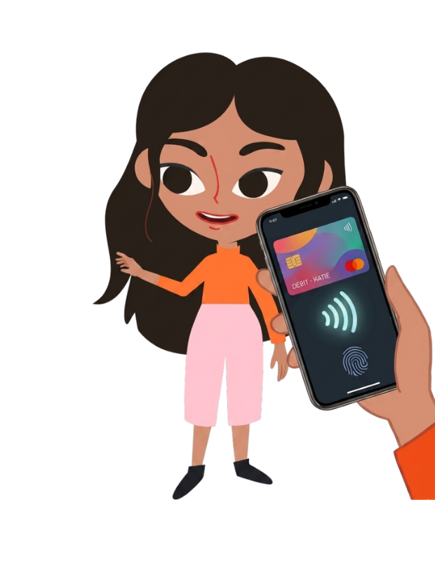
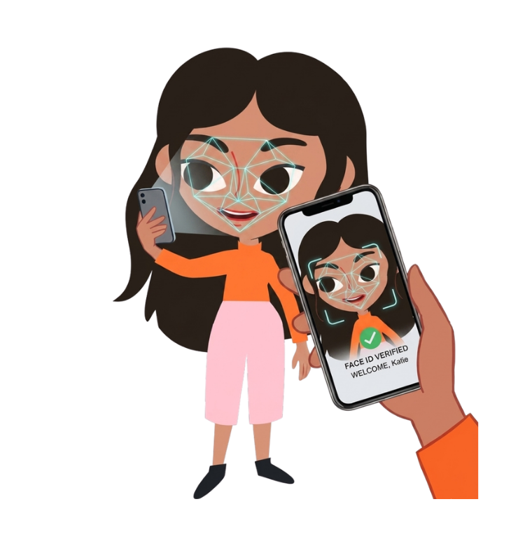
Biometrics and safety
Use your face, fingerprint or even your voice as a key!
Notes:
You saw in the animation that Katie and Tex were talking about using your fingerprints or face to get into a phone
That is called Biometrics! It's just like using your body as a key.
The mobile phone can look at an image of your face and remembers how it looks, like how big your eyes are and how far away your nose is from your mouth! If someone else tries to use their face, like Tex did in the animation, it’ll be different, so the phone wont work for them. Everyone's fingerprints and faces are different. This makes it a perfect way for the bank to know that it is really you and nobody else accessing your account.
Tex was hoping that barking could be used in the future, did you know some banks can even recognise your voice? Each voice has a special pattern, like a musical fingerprint!

Slide 23
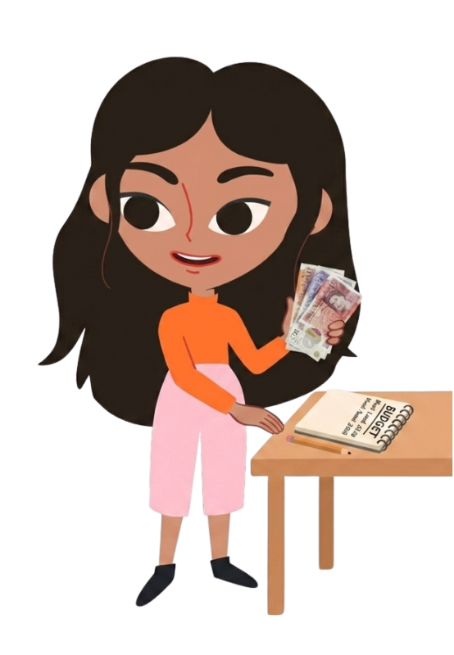
What is budgeting?
Income – the money you have coming in
Outgoings – money you have or will spend
Savings – the money left over you can save up
Notes:
It is very important that you look after your money so that you know how much you have got. When you know how much you have, you can choose whether to spend it or save it.
Budgeting is a bit like keeping a money diary. It means keeping track of your money so you know how much money you have, how much you have spent, as well as how much you’ve saved!
There are three important things to think about when budgeting:
click - Income – this is the money you have coming in. You can earn money through a job or perhaps by doing chores at home.
click - Outgoings – this is keeping track of how much you have spent. It can also be helpful to know if you are going to spend money in the future too – like getting your hair cut next week for example.
click - Savings – this is the money that you have put to one side to save for something like a new toy, a bone for Tex or for emergencies
Katie is doing some budgeting.
Look at Katie in the picture—she’s checking her list to see if she can afford the new bone for Tex. Using pen and paper like this and counting cash can take time and you could make mistakes.
How else do you think she could keep track of her money and do some budgeting? Take a few ideas here.
PAUSE then click x2 That’s right – by using a banking app!

Slide 24
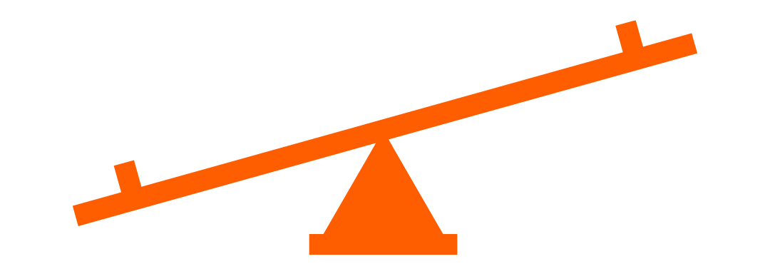
Balancing a budget
Income - Outgoings = money left
If you spend too much, the see-saw tips!
Notes:
We now know that a budget looks at what comes in (your income), what is going out (your outgoings) and what is being saved (what’s left).
When we budget, we should always make sure we do not spend too much. But how can we do that?
Imagine a see-saw. If you put something heavy (like Tex) on one side, it touches the ground, right? Money is the same! If your spending or outgoings are 'heavier' or more than your income (your money coming in) your budget is unbalanced.
It is important to remember that Income minus Outgoings (spending) = money left. To be a super saver like Katie, we want that 'money left' number to be as big as possible! That’s why banking apps are so handy for helping us keep an eye on our budgets quickly and easily!
If Katie wants to buy Tex his new bone faster, what could she do? She could earn more, maybe by doing a chore like washing a car, or spend less on her treats. Which one do you think is easier for her? You could take a hands up vote here or take a few suggestions.
A balanced budget keeps you in control. It means you are the boss of your money, instead of your money being the boss of you!

Slide 25
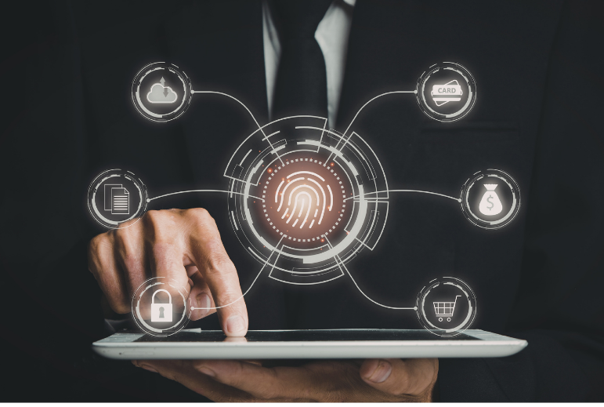
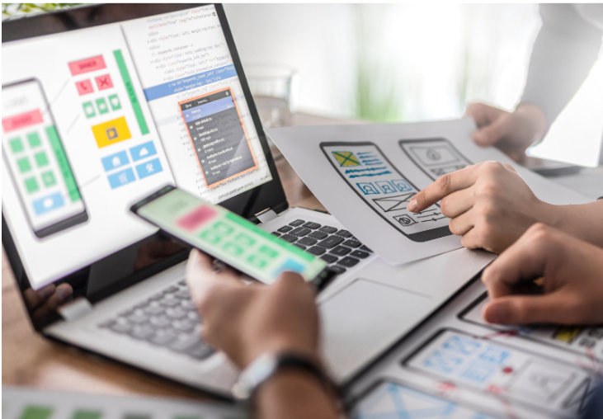
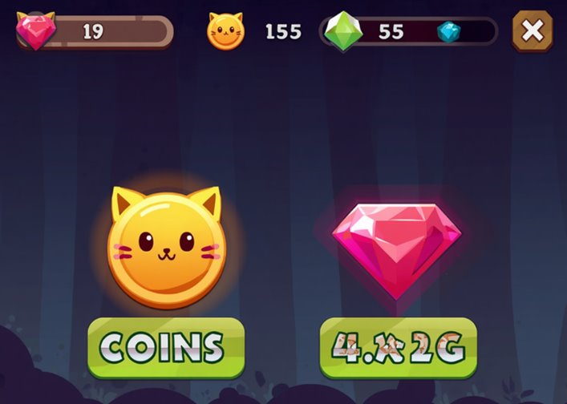
Careers in tech and money
Biometrics engineer
Money App Developer
Virtual Economy Designer
What they do: They build the security systems that use people’s bodies (like their face or fingerprint).
What they do: They write the code that makes the app work so that it can do things like show your balance or let you pay for things.
What they do: They decide how much gold or gems a player earns for finishing a level in a game and how much a new skin or sword should cost in the online shop.
Notes:
So if you want to be creating and developing the technology behind banking apps or their security systems, here are some jobs that you might like in the future.
If biometrics interested you, you could become a Biometrics engineer - They build the security systems that use people’s bodies, such as their face, fingerprints, eyes or voice. They make sure these systems work so only the right people can unlock phones or computers to pay for things or see important information .
App developer - A money app developer makes apps that help people save, spend, send, or keep track of their money safely. They write computer code so the app can do things like show your balance, pay for things, or help you budget. They also make sure the app is easy to use and keeps people’s money information protected.
Or if you love gaming and still want to work with money, you could become a Virtual Economy Designer. They decide how players collect pretend money in video games, like coins in Super Mario games or rings in Sonic. They can also choose how much things 'cost' in an online shop, like a new sword or clothes for your character. This can be tricky because they need to make sure the game is fair and fun to play.
There are going to be so many jobs in tech for money when you’re older. I wonder what the future of our money might look like with people like you working on that technology?

Slide 26
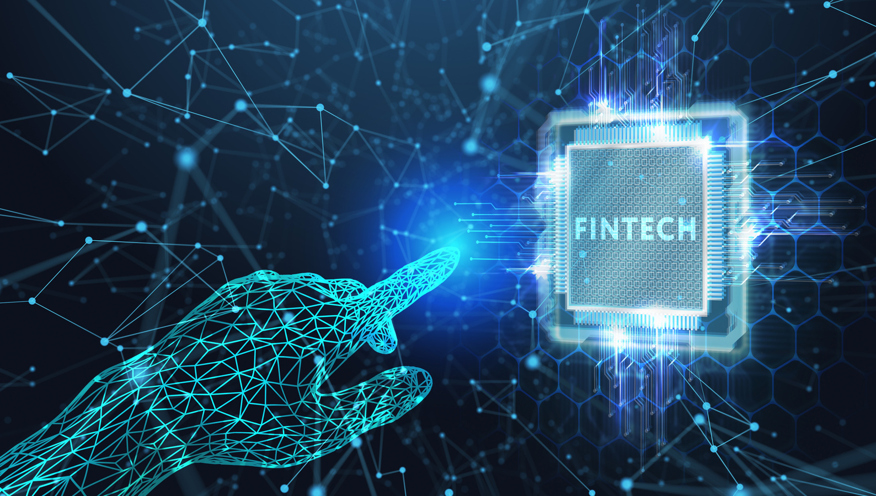

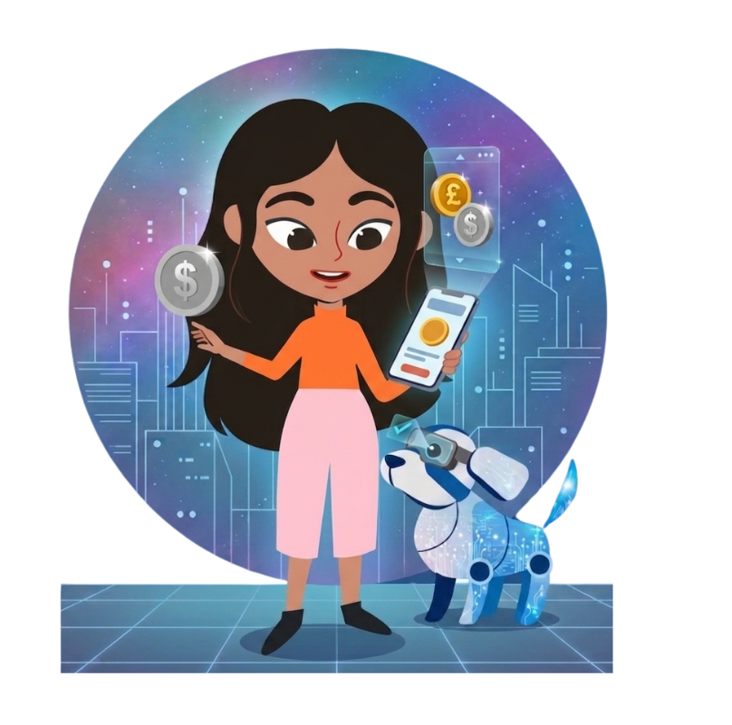
What is the future of money?
Become a Fintech Futurist!
5 mins
5
mins
Fintech Futurist
Imagines what the future of money might look like, helping companies come up with new ways to pay for things.
How will we pay for things?
How will we manage our money?
How will technology help us keep our money safe?
Notes:
We have now seen how money, and how we get our money, has changed so much over the years.
Tex was even looking at how barks could be used to access a bank account in the future.
We have looked at how technology is used to access money like with biometrics, as well as keeping our money safe with strong passwords. But what does the future hold?
Right now, we still use coins and notes. But in the future, people might use less cash or even none at all, instead using more digital tools.
Instead of coins and notes, we might use just cards, phones, or watches to pay for things or maybe something completely different that has not been thought of yet.
Will we use banking apps to keep an eye on our money on mobile phones, or will there be an even easier way to manage our budgets?
The more we use computers the more we will need help from technology to keep our money safe.
CLICK
Now is your turn to become a Fintech Futurist! In this job you look at new tech like digital wallets, contactless payments, or even paying with your face or voice and imagine what could come next. They help give companies new and exciting ideas to help them make better ways for people to pay.
So now, imagine the world when you’re a much older grown-up, maybe in 50 years time. I’d like you to think about these questions:
How will we pay for things? Will we still use cash? Will we just plastic cards, phones and watches? Or will it be something completely new?
How will we manage our money? Will we still use banking apps?
What about security? How will technology keep our money safe?
I am going to give you 5 minutes with your paper and pens to come up with what you think the future of money is going to be and how technology will be involved. You could write notes or you could draw your ideas. There are no rules! Just use your imagination and get inventing!
I am sure you will have some great ideas, let's get started!
Teachers, we love to see your student’s ideas. If you can, please take some pictures and share them on social media - my colleague will put details in the chat now for how to tag us.
Start the timer by clicking. During the time, circulate around the room and talk to the students about their ideas.
Remind pupils of time when about halfway through.
At end of time, click again for sound to signal that time has ended.
I am sure you had some great ideas for the future of money and using technology.
If you have time and an engaged class, you could ask some students to present their ideas to you and their class.
Now that you have had a think about the future of money, does it sound like an interesting future to be part of and help with new ideas and changes?

Slide 27
Would you like a future job working with technology?
Notes:
Today we’ve learnt about so many different ways that technology is used to pay for things, manage our budgets and keep our money safe.
CLICK So, do you now think this sounds interesting, and would maybe like a future job working with technology and money? (You can ask the teacher to take a picture of the backs of the students' heads here if you'd like to, or ask the teacher to do a quick count and note the number down again to compare to the start of the lesson)
We hope you have enjoyed today’s session and also learnt something new!

Slide 28
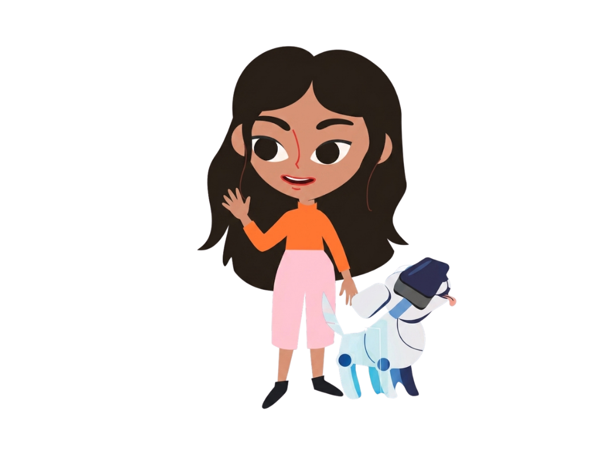

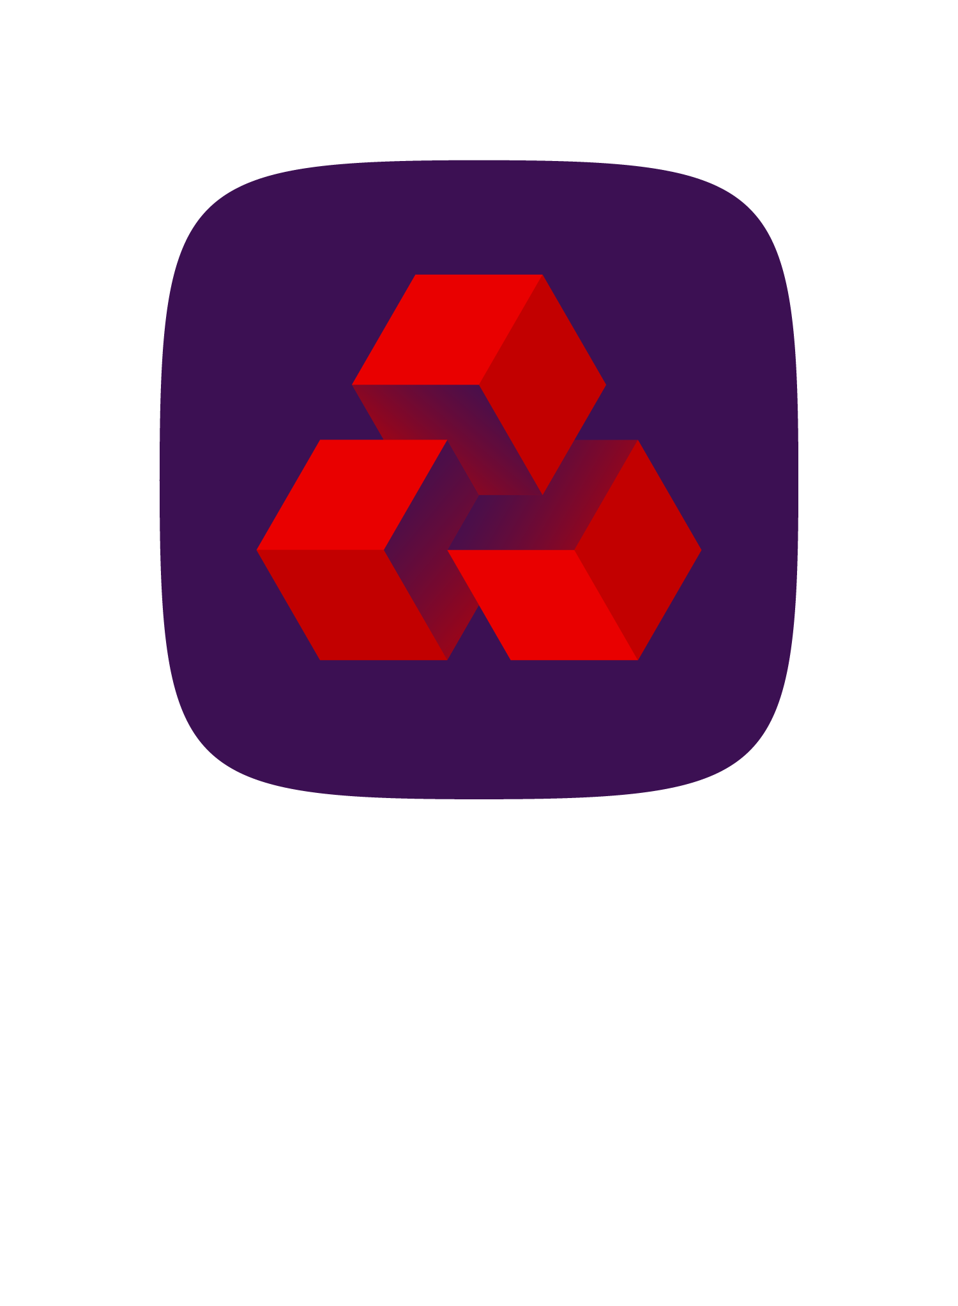
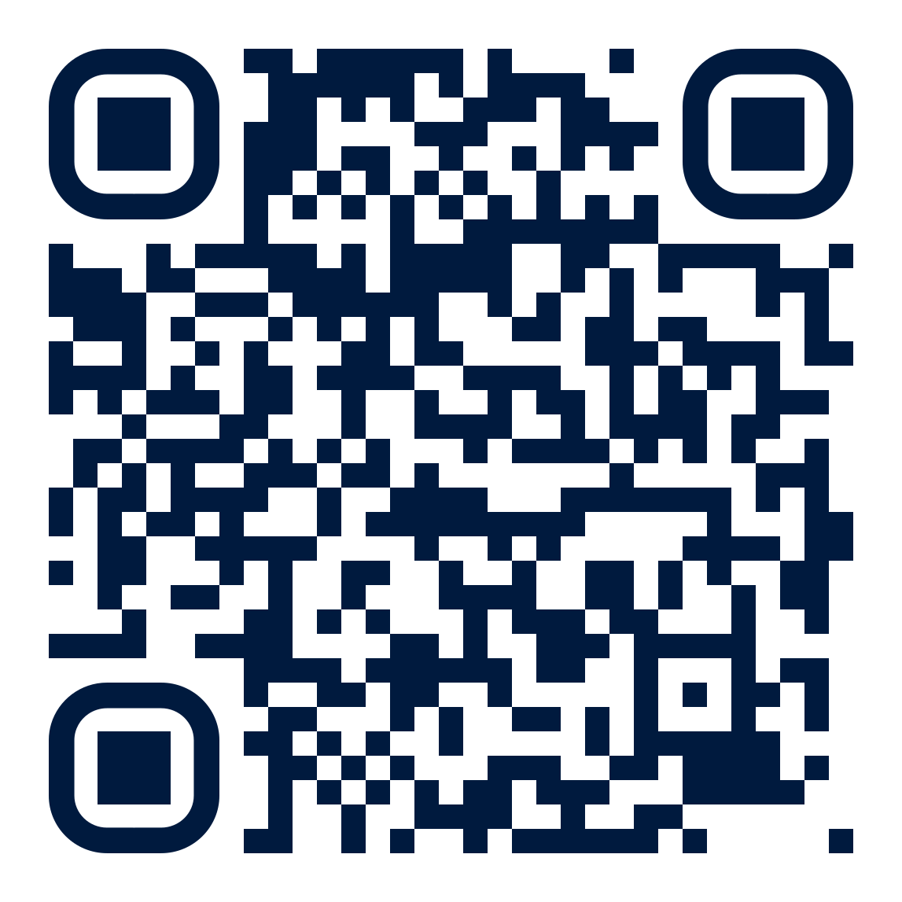
in partnership with:
Find out more about upcoming live lessons by signing up for our newsletter: ​
​
techshecan.org
@Tech_She_Can
TechSheCan
© Tech She Can 2026
Notes:
That brings us to the end of today's lesson.
Thank you so much everyone for how well you listened. Thank you all for joining us today and we will hopefully see you all soon for another Tech We Can session.
Bye everyone! And Bye from Katie and Tex!

